Slide 2
SERMON TITLE
The Altar Call
In Churches

Slide 3
Genesis 26:25 And he builded an altar there, and called upon the name of the LORD, and pitched his tent there: and there Isaac's servants digged a well.
True Words Christian Church

Slide 4
Genesis 33:20 And he erected there an altar, and called it El-elohe-Israel.
True Words Christian Church

Slide 5
Genesis 35:6-7 So Jacob came to Luz, which is in the land of Canaan, that is, Beth-el, he and all the people that were with him. 7 And he built there an altar, and called the place El-beth-el: because there God appeared unto him, when he fled from the face of his brother.
True Words Christian Church

Slide 6
Exodus 17:15 And Moses built an altar, and called the name of it Jehovah-nissi:
True Words Christian Church

Slide 7
True Words Christian Church

Slide 8
True Words Christian Church

Slide 9
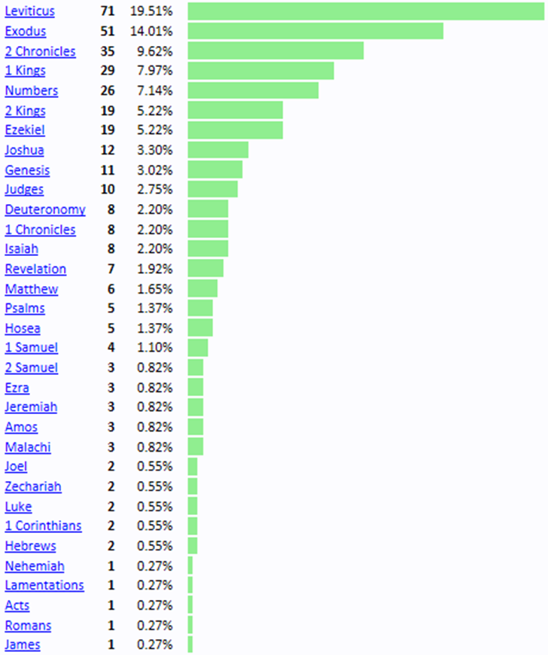
True Words Christian Church

Slide 10
Genesis 8:20-21 And Noah builded an altar unto the LORD; and took of every clean beast, and of every clean fowl, and offered burnt offerings on the altar. 21 And the LORD smelled a sweet savour; and the LORD said in his heart, I will not again curse the ground any more for man's sake; for the imagination of man's heart is evil from his youth; neither will I again smite any more every thing living, as I have done.
True Words Christian Church

Slide 11
2 Kings 17:31 And the Avites made Nibhaz and Tartak, and the Sepharvites burnt their children in fire to Adrammelech and Anammelech, the gods of Sepharvaim.
True Words Christian Church

Slide 12
Exodus 20:24 An altar of earth thou shalt make unto me, and shalt sacrifice thereon thy burnt offerings, and thy peace offerings, thy sheep, and thine oxen: in all places where I record my name I will come unto thee, and I will bless thee.
True Words Christian Church

Slide 13
Exodus 20:25 And if thou wilt make me an altar of stone, thou shalt not build it of hewn stone: for if thou lift up thy tool upon it, thou hast polluted it.
True Words Christian Church

Slide 14
Exodus 20:26 Neither shalt thou go up by steps unto mine altar, that thy nakedness be not discovered thereon.
True Words Christian Church

Slide 15
Romans 12:17 Recompense to no man evil for evil. Provide things honest in the sight of all men.
True Words Christian Church

Slide 16
Joshua 5:14 And he said, Nay; but as captain of the host of the LORD am I now come. And Joshua fell on his face to the earth, and did worship, and said unto him, What saith my lord unto his servant?
True Words Christian Church

Slide 17
1 Kings 12:30 And this thing became a sin: for the people went to worship before the one, even unto Dan.
True Words Christian Church

Slide 18
Jeremiah 2:8 The priests said not, Where is the LORD? and they that handle the law knew me not: the pastors also transgressed against me, and the prophets prophesied by Baal, and walked after things that do not profit.
True Words Christian Church

Slide 19
Jeremiah 23:1-2 Woe be unto the pastors that destroy and scatter the sheep of my pasture! saith the LORD. 2 Therefore thus saith the LORD God of Israel against the pastors that feed my people; Ye have scattered my flock, and driven them away, and have not visited them: behold, I will visit upon you the evil of your doings, saith the LORD.
True Words Christian Church

Slide 20
Exodus 20:4-6 Thou shalt not make unto thee any graven image, or any likeness of any thing that is in heaven above, or that is in the earth beneath, or that is in the water under the earth: 5 Thou shalt not bow down thyself to them, nor serve them: for I the LORD thy God am a jealous God, visiting the iniquity of the fathers upon the children unto the third and fourth generation of them that hate me; 6 And shewing mercy unto thousands of them that love me, and keep my commandments.
True Words Christian Church

Slide 21
Leviticus 26:1 Ye shall make you no idols nor graven image, neither rear you up a standing image, neither shall ye set up any image of stone in your land, to bow down unto it: for I am the LORD your God.
True Words Christian Church

Slide 22
Leviticus 9:24 And there came a fire out from before the LORD, and consumed upon the altar the burnt offering and the fat: which when all the people saw, they shouted, and fell on their faces.
True Words Christian Church

Slide 23
Leviticus 10:1-2 And Nadab and Abihu, the sons of Aaron, took either of them his censer, and put fire therein, and put incense thereon, and offered strange fire before the LORD, which he commanded them not. 2 And there went out fire from the LORD, and devoured them, and they died before the LORD.
True Words Christian Church

Slide 24
1 Thessalonians 5:21-22 Prove all things; hold fast that which is good. 22 Abstain from all appearance of evil.
True Words Christian Church

Slide 25
Exodus 28:42-43 And thou shalt make them linen breeches to cover their nakedness; from the loins even unto the thighs they shall reach: 43 And they shall be upon Aaron, and upon his sons, when they come in unto the tabernacle of the congregation, or when they come near unto the altar to minister in the holy place; that they bear not iniquity, and die: it shall be a statute for ever unto him and his seed after him.
True Words Christian Church

Slide 26
1 Samuel 15:22-23 And Samuel said, Hath the LORD as great delight in burnt offerings and sacrifices, as in obeying the voice of the LORD? Behold, to obey is better than sacrifice, and to hearken than the fat of rams. 23 For rebellion is as the sin of witchcraft, and stubbornness is as iniquity and idolatry. Because thou hast rejected the word of the LORD, he hath also rejected thee from being king.
True Words Christian Church

Slide 27
1 Chronicles 10:13-14 So Saul died for his transgression which he committed against the LORD, even against the word of the LORD, which he kept not, and also for asking counsel of one that had a familiar spirit, to inquire of it; 14 And inquired not of the LORD: therefore he slew him, and turned the kingdom unto David the son of Jesse.
True Words Christian Church

Slide 28
Exodus 29:37 Seven days thou shalt make an atonement for the altar, and sanctify it; and it shall be an altar most holy: whatsoever toucheth the altar shall be holy.
True Words Christian Church

Slide 29
Exodus 34:12-14 Take heed to thyself, lest thou make a covenant with the inhabitants of the land whither thou goest, lest it be for a snare in the midst of thee: 13 But ye shall destroy their altars, break their images, and cut down their groves: 14 For thou shalt worship no other god: for the LORD, whose name is Jealous, is a jealous God:
True Words Christian Church

Slide 30
Exodus 34:15-16 Lest thou make a covenant with the inhabitants of the land, and they go a whoring after their gods, and do sacrifice unto their gods, and one call thee, and thou eat of his sacrifice; 16 And thou take of their daughters unto thy sons, and their daughters go a whoring after their gods, and make thy sons go a whoring after their gods.
True Words Christian Church

Slide 31
Exodus 40:10 And thou shalt anoint the altar of the burnt offering, and all his vessels, and sanctify the altar: and it shall be an altar most holy.
True Words Christian Church

Slide 32
Matthew 6:1 Take heed that ye do not your alms before men, to be seen of them: otherwise ye have no reward of your Father which is in heaven.
True Words Christian Church

Slide 33
Matthew 6:5-6 And when thou prayest, thou shalt not be as the hypocrites are: for they love to pray standing in the synagogues and in the corners of the streets, that they may be seen of men. Verily I say unto you, They have their reward. 6 But thou, when thou prayest, enter into thy closet, and when thou hast shut thy door, pray to thy Father which is in secret; and thy Father which seeth in secret shall reward thee openly.
True Words Christian Church

Slide 34
Exodus 40:29-30 And he put the altar of burnt offering by the door of the tabernacle of the tent of the congregation, and offered upon it the burnt offering and the meat offering; as the LORD commanded Moses. 30 And he set the laver between the tent of the congregation and the altar, and put water there, to wash withal.
True Words Christian Church

Slide 35
Exodus 40:31-32 And Moses and Aaron and his sons washed their hands and their feet thereat: 32 When they went into the tent of the congregation, and when they came near unto the altar, they washed; as the LORD commanded Moses.
True Words Christian Church

Slide 36
Leviticus 6:9 Command Aaron and his sons, saying, This is the law of the burnt offering: It is the burnt offering, because of the burning upon the altar all night unto the morning, and the fire of the altar shall be burning in it.
True Words Christian Church

Slide 37
Leviticus 6:10-11 And the priest shall put on his linen garment, and his linen breeches shall he put upon his flesh, and take up the ashes which the fire hath consumed with the burnt offering on the altar, and he shall put them beside the altar. 11 And he shall put off his garments, and put on other garments, and carry forth the ashes without the camp unto a clean place.
True Words Christian Church

Slide 38
Leviticus 6:12-13 And the fire upon the altar shall be burning in it; it shall not be put out: and the priest shall burn wood on it every morning, and lay the burnt offering in order upon it; and he shall burn thereon the fat of the peace offerings. 13 The fire shall ever be burning upon the altar; it shall never go out.
True Words Christian Church

Slide 39
Leviticus 8:10-11 And Moses took the anointing oil, and anointed the tabernacle and all that was therein, and sanctified them. 11 And he sprinkled thereof upon the altar seven times, and anointed the altar and all his vessels, both the laver and his foot, to sanctify them.
True Words Christian Church

Slide 40
Numbers 16:35 And there came out a fire from the LORD, and consumed the two hundred and fifty men that offered incense.
True Words Christian Church

Slide 41
Numbers 16:38 The censers of these sinners against their own souls, let them make them broad plates for a covering of the altar: for they offered them before the LORD, therefore they are hallowed: and they shall be a sign unto the children of Israel.
True Words Christian Church

Slide 42
Numbers 16:40 To be a memorial unto the children of Israel, that no stranger, which is not of the seed of Aaron, come near to offer incense before the LORD; that he be not as Korah, and as his company: as the LORD said to him by the hand of Moses.
True Words Christian Church

Slide 43
Deuteronomy 16:21 Thou shalt not plant thee a grove of any trees near unto the altar of the LORD thy God, which thou shalt make thee.
True Words Christian Church

Slide 44
1 Kings 8:54 And it was so, that when Solomon had made an end of praying all this prayer and supplication unto the LORD, he arose from before the altar of the LORD, from kneeling on his knees with his hands spread up to heaven.
True Words Christian Church

Slide 45
Isaiah 65:2-3 I have spread out my hands all the day unto a rebellious people, which walketh in a way that was not good, after their own thoughts; 3 A people that provoketh me to anger continually to my face; that sacrificeth in gardens, and burneth incense upon altars of brick;
True Words Christian Church

Slide 46
Isaiah 65:4-5 Which remain among the graves, and lodge in the monuments, which eat swine's flesh, and broth of abominable things is in their vessels; 5 Which say, Stand by thyself, come not near to me; for I am holier than thou. These are a smoke in my nose, a fire that burneth all the day.
True Words Christian Church

Slide 47
Jeremiah 17:2 Whilst their children remember their altars and their groves by the green trees upon the high hills.
True Words Christian Church

Slide 48
Colossians 2:8 Beware lest any man spoil you through philosophy and vain deceit, after the tradition of men, after the rudiments of the world, and not after Christ.
True Words Christian Church

Slide 49
Ezekiel 6:4-5 And your altars shall be desolate, and your images shall be broken: and I will cast down your slain men before your idols. 5 And I will lay the dead carcases of the children of Israel before their idols; and I will scatter your bones round about your altars.
True Words Christian Church

Slide 50
Ezekiel 43:18-19 And he said unto me, Son of man, thus saith the Lord GOD; These are the ordinances of the altar in the day when they shall make it, to offer burnt offerings thereon, and to sprinkle blood thereon. 19 And thou shalt give to the priests the Levites that be of the seed of Zadok, which approach unto me, to minister unto me, saith the Lord GOD, a young bullock for a sin offering.
True Words Christian Church

Slide 51
Ezekiel 43:26-27 Seven days shall they purge the altar and purify it; and they shall consecrate themselves. 27 And when these days are expired, it shall be, that upon the eighth day, and so forward, the priests shall make your burnt offerings upon the altar, and your peace offerings; and I will accept you, saith the Lord GOD.
True Words Christian Church

Slide 52
Hosea 8:11-13 Because Ephraim hath made many altars to sin, altars shall be unto him to sin. 12 I have written to him the great things of my law, but they were counted as a strange thing. 13 They sacrifice flesh for the sacrifices of mine offerings, and eat it; but the LORD accepteth them not; now will he remember their iniquity, and visit their sins: they shall return to Egypt.
True Words Christian Church

Slide 53
Hebrews 9:8-9 The Holy Ghost this signifying, that the way into the holiest of all was not yet made manifest, while as the first tabernacle was yet standing: 9 Which was a figure for the time then present, in which were offered both gifts and sacrifices, that could not make him that did the service perfect, as pertaining to the conscience;
True Words Christian Church

Slide 54
Hebrews 9:10-11 Which stood only in meats and drinks, and divers washings, and carnal ordinances, imposed on them until the time of reformation. 11 But Christ being come an high priest of good things to come, by a greater and more perfect tabernacle, not made with hands, that is to say, not of this building;
True Words Christian Church

Slide 55
Hebrews 9:12-13 Neither by the blood of goats and calves, but by his own blood he entered in once into the holy place, having obtained eternal redemption for us. 13 For if the blood of bulls and of goats, and the ashes of an heifer sprinkling the unclean, sanctifieth to the purifying of the flesh:
True Words Christian Church

Slide 56
Hebrews 9:14 How much more shall the blood of Christ, who through the eternal Spirit offered himself without spot to God, purge your conscience from dead works to serve the living God?
True Words Christian Church

Slide 57
Malachi 1:6-7 A son honoureth his father, and a servant his master: if then I be a father, where is mine honour? and if I be a master, where is my fear? saith the LORD of hosts unto you, O priests, that despise my name. And ye say, Wherein have we despised thy name? 7 Ye offer polluted bread upon mine altar; and ye say, Wherein have we polluted thee? In that ye say, The table of the LORD is contemptible.
True Words Christian Church

Slide 58
Malachi 1:10 Who is there even among you that would shut the doors for nought? neither do ye kindle fire on mine altar for nought. I have no pleasure in you, saith the LORD of hosts, neither will I accept an offering at your hand.
True Words Christian Church

Slide 59
Malachi 2:13 And this have ye done again, covering the altar of the LORD with tears, with weeping, and with crying out, insomuch that he regardeth not the offering any more, or receiveth it with good will at your hand.
True Words Christian Church

