Slide 2
SERMON TITLE
Daniel Chapter 8

Slide 3
Daniel 7:8 I considered the horns, and, behold, there came up among them another little horn, before whom there were three of the first horns plucked up by the roots: and, behold, in this horn were eyes like the eyes of man, and a mouth speaking great things.
True Words Christian Church

Slide 4
Daniel 7:13-14 I saw in the night visions, and, behold, one like the Son of man came with the clouds of heaven, and came to the Ancient of days, and they brought him near before him. 14 And there was given him dominion, and glory, and a kingdom, that all people, nations, and languages, should serve him: his dominion is an everlasting dominion, which shall not pass away, and his kingdom that which shall not be destroyed.
True Words Christian Church

Slide 5
Daniel 7:17-18 These great beasts, which are four, are four kings, which shall arise out of the earth. 18 But the saints of the most High shall take the kingdom, and possess the kingdom for ever, even for ever and ever.
True Words Christian Church

Slide 6
Daniel 7:21-22 I beheld, and the same horn made war with the saints, and prevailed against them; 22 Until the Ancient of days came, and judgment was given to the saints of the most High; and the time came that the saints possessed the kingdom.
True Words Christian Church

Slide 7
Daniel 7:25 And he shall speak great words against the most High, and shall wear out the saints of the most High, and think to change times and laws: and they shall be given into his hand until a time and times and the dividing of time.
True Words Christian Church

Slide 8
Daniel 8:1 In the third year of the reign of king Belshazzar a vision appeared unto me, even unto me Daniel, after that which appeared unto me at the first.
True Words Christian Church

Slide 9
Daniel 8:2 And I saw in a vision; and it came to pass, when I saw, that I was at Shushan in the palace, which is in the province of Elam; and I saw in a vision, and I was by the river of Ulai.
True Words Christian Church

Slide 10
True Words Christian Church

Slide 11
Nehemiah 1:1-2 The words of Nehemiah the son of Hachaliah. And it came to pass in the month Chisleu, in the twentieth year, as I was in Shushan the palace, 2 That Hanani, one of my brethren, came, he and certain men of Judah; and I asked them concerning the Jews that had escaped, which were left of the captivity, and concerning Jerusalem.
True Words Christian Church

Slide 12
Daniel 8:3 Then I lifted up mine eyes, and saw, and, behold, there stood before the river a ram which had two horns: and the two horns were high; but one was higher than the other, and the higher came up last.
True Words Christian Church

Slide 13
Daniel 8:20 The ram which thou sawest having two horns are the kings of Media and Persia.
True Words Christian Church

Slide 14
Daniel 5:30-31 In that night was Belshazzar the king of the Chaldeans slain. 31 And Darius the Median took the kingdom, being about threescore and two years old.
True Words Christian Church

Slide 15
Daniel 6:28 So this Daniel prospered in the reign of Darius, and in the reign of Cyrus the Persian.
True Words Christian Church

Slide 16
Daniel 8:4 I saw the ram pushing westward, and northward, and southward; so that no beasts might stand before him, neither was there any that could deliver out of his hand; but he did according to his will, and became great.
True Words Christian Church

Slide 17
Daniel 8:5 And as I was considering, behold, an he goat came from the west on the face of the whole earth, and touched not the ground: and the goat had a notable horn between his eyes.
True Words Christian Church

Slide 18
Daniel 8:21 And the rough goat is the king of Grecia: and the great horn that is between his eyes is the first king.
True Words Christian Church

Slide 19
Daniel 7:6 After this I beheld, and lo another, like a leopard, which had upon the back of it four wings of a fowl; the beast had also four heads; and dominion was given to it.
True Words Christian Church

Slide 20
Daniel 8:6 And he came to the ram that had two horns, which I had seen standing before the river, and ran unto him in the fury of his power.
True Words Christian Church

Slide 21
Daniel 8:7 And I saw him come close unto the ram, and he was moved with choler against him, and smote the ram, and brake his two horns: and there was no power in the ram to stand before him, but he cast him down to the ground, and stamped upon him: and there was none that could deliver the ram out of his hand.
True Words Christian Church

Slide 22
Daniel 8:8 Therefore the he goat waxed very great: and when he was strong, the great horn was broken; and for it came up four notable ones toward the four winds of heaven.
True Words Christian Church

Slide 23
Psalm 55:23 But thou, O God, shalt bring them down into the pit of destruction: bloody and deceitful men shall not live out half their days; but I will trust in thee.
True Words Christian Church

Slide 24
Daniel 8:9 And out of one of them came forth a little horn, which waxed exceeding great, toward the south, and toward the east, and toward the pleasant land.
True Words Christian Church

Slide 25
Daniel 8:10 And it waxed great, even to the host of heaven; and it cast down some of the host and of the stars to the ground, and stamped upon them.
True Words Christian Church

Slide 26
Revelation 12:4 And his tail drew the third part of the stars of heaven, and did cast them to the earth: and the dragon stood before the woman which was ready to be delivered, for to devour her child as soon as it was born.
True Words Christian Church

Slide 27
Isaiah 14:12-14 How art thou fallen from heaven, O Lucifer, son of the morning! how art thou cut down to the ground, which didst weaken the nations! 13 For thou hast said in thine heart, I will ascend into heaven, I will exalt my throne above the stars of God: I will sit also upon the mount of the congregation, in the sides of the north: 14 I will ascend above the heights of the clouds; I will be like the most High.
True Words Christian Church

Slide 28
Daniel 8:11 Yea, he magnified himself even to the prince of the host, and by him the daily sacrifice was taken away, and the place of his sanctuary was cast down.
True Words Christian Church

Slide 29
Daniel 8:12 And an host was given him against the daily sacrifice by reason of transgression, and it cast down the truth to the ground; and it practised, and prospered.
True Words Christian Church

Slide 30
Daniel 8:13 Then I heard one saint speaking, and another saint said unto that certain saint which spake, How long shall be the vision concerning the daily sacrifice, and the transgression of desolation, to give both the sanctuary and the host to be trodden under foot?
True Words Christian Church

Slide 31
Daniel 8:14 And he said unto me, Unto two thousand and three hundred days; then shall the sanctuary be cleansed.
True Words Christian Church

Slide 32
Daniel 8:22 Now that being broken, whereas four stood up for it, four kingdoms shall stand up out of the nation, but not in his power.
True Words Christian Church

Slide 33
Daniel 8:23 And in the latter time of their kingdom, when the transgressors are come to the full, a king of fierce countenance, and understanding dark sentences, shall stand up.
True Words Christian Church

Slide 34
Daniel 8:24 And his power shall be mighty, but not by his own power: and he shall destroy wonderfully, and shall prosper, and practise, and shall destroy the mighty and the holy people.
True Words Christian Church

Slide 35
Daniel 8:25 And through his policy also he shall cause craft to prosper in his hand; and he shall magnify himself in his heart, and by peace shall destroy many: he shall also stand up against the Prince of princes; but he shall be broken without hand.
True Words Christian Church

Slide 36
Acts 8:9-10 But there was a certain man, called Simon, which beforetime in the same city used sorcery, and bewitched the people of Samaria, giving out that himself was some great one: 10 To whom they all gave heed, from the least to the greatest, saying, This man is the great power of God.
True Words Christian Church

Slide 37
Daniel 8:9 And out of one of them came forth a little horn, which waxed exceeding great, toward the south, and toward the east, and toward the pleasant land.
True Words Christian Church

Slide 38
True Words Christian Church

Slide 39
True Words Christian Church

Slide 40
1 Timothy 3:16 And without controversy great is the mystery of godliness: God was manifest in the flesh, justified in the Spirit, seen of angels, preached unto the Gentiles, believed on in the world, received up into glory.
True Words Christian Church

Slide 41
Matthew 24:4-5 And Jesus answered and said unto them, Take heed that no man deceive you. 5 For many shall come in my name, saying, I am Christ; and shall deceive many.
True Words Christian Church

Slide 42
Mark 13:5-6 And Jesus answering them began to say, Take heed lest any man deceive you: 6 For many shall come in my name, saying, I am Christ; and shall deceive many.
True Words Christian Church

Slide 43
Luke 21:8 And he said, Take heed that ye be not deceived: for many shall come in my name, saying, I am Christ; and the time draweth near: go ye not therefore after them.
True Words Christian Church

Slide 44
Daniel 8:14 And he said unto me, Unto two thousand and three hundred days; then shall the sanctuary be cleansed.
True Words Christian Church

Slide 45
True Words Christian Church

Slide 46
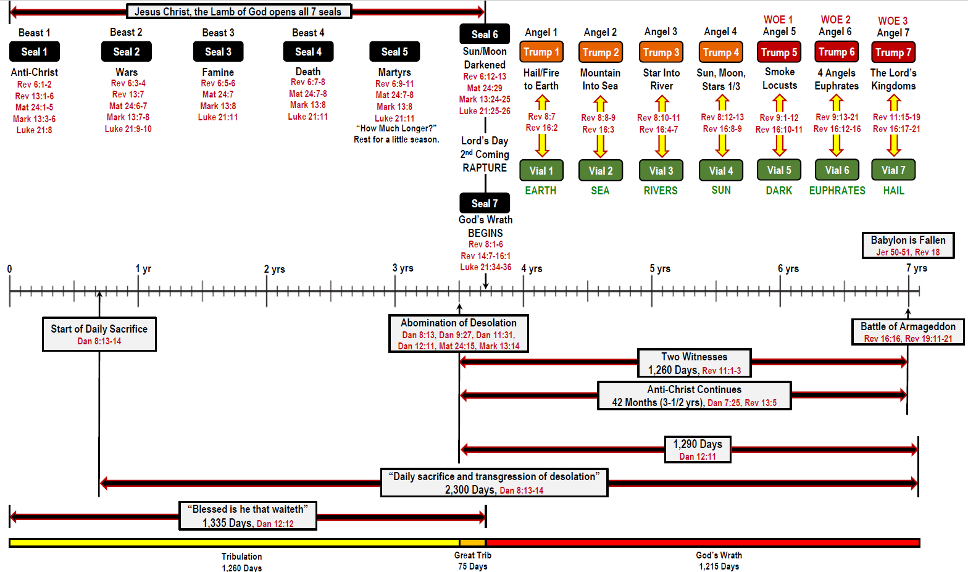
True Words Christian Church

Slide 47
Matthew 24:15-17 When ye therefore shall see the abomination of desolation, spoken of by Daniel the prophet, stand in the holy place, (whoso readeth, let him understand:) 16 Then let them which be in Judaea flee into the mountains: 17 Let him which is on the housetop not come down to take any thing out of his house:
True Words Christian Church

Slide 48
Matthew 24:18-20 Neither let him which is in the field return back to take his clothes. 19 And woe unto them that are with child, and to them that give suck in those days! 20 But pray ye that your flight be not in the winter, neither on the sabbath day:
True Words Christian Church

Slide 49
Matthew 24:21-22 For then shall be great tribulation, such as was not since the beginning of the world to this time, no, nor ever shall be. 22 And except those days should be shortened, there should no flesh be saved: but for the elect's sake those days shall be shortened.
True Words Christian Church

Slide 50
1 Thessalonians 4:17 Then we which are alive and remain shall be caught up together with them in the clouds, to meet the Lord in the air: and so shall we ever be with the Lord.
True Words Christian Church

Slide 51
Daniel 8:15-16 And it came to pass, when I, even I Daniel, had seen the vision, and sought for the meaning, then, behold, there stood before me as the appearance of a man. 16 And I heard a man's voice between the banks of Ulai, which called, and said, Gabriel, make this man to understand the vision.
True Words Christian Church

Slide 52
Luke 1:31-33 And, behold, thou shalt conceive in thy womb, and bring forth a son, and shalt call his name JESUS. 32 He shall be great, and shall be called the Son of the Highest: and the Lord God shall give unto him the throne of his father David: 33 And he shall reign over the house of Jacob for ever; and of his kingdom there shall be no end.
True Words Christian Church

Slide 53
Daniel 8:17 So he came near where I stood: and when he came, I was afraid, and fell upon my face: but he said unto me, Understand, O son of man: for at the time of the end shall be the vision.
True Words Christian Church

Slide 54
Daniel 8:18-19 Now as he was speaking with me, I was in a deep sleep on my face toward the ground: but he touched me, and set me upright. 19 And he said, Behold, I will make thee know what shall be in the last end of the indignation: for at the time appointed the end shall be.
True Words Christian Church

Slide 55
Daniel 8:20-21 The ram which thou sawest having two horns are the kings of Media and Persia. 21 And the rough goat is the king of Grecia: and the great horn that is between his eyes is the first king.
True Words Christian Church

Slide 56
Daniel 8:22-23 Now that being broken, whereas four stood up for it, four kingdoms shall stand up out of the nation, but not in his power. 23 And in the latter time of their kingdom, when the transgressors are come to the full, a king of fierce countenance, and understanding dark sentences, shall stand up.
True Words Christian Church

Slide 57
Daniel 8:24-25 And his power shall be mighty, but not by his own power: and he shall destroy wonderfully, and shall prosper, and practise, and shall destroy the mighty and the holy people. 25 And through his policy also he shall cause craft to prosper in his hand; and he shall magnify himself in his heart, and by peace shall destroy many: he shall also stand up against the Prince of princes; but he shall be broken without hand.
True Words Christian Church

Slide 58
Daniel 8:26 And the vision of the evening and the morning which was told is true: wherefore shut thou up the vision; for it shall be for many days.
True Words Christian Church

Slide 59
Daniel 8:27 And I Daniel fainted, and was sick certain days; afterward I rose up, and did the king's business; and I was astonished at the vision, but none understood it.
True Words Christian Church

