Slide 2
SERMON TITLE
Daniel Chapter 12

Slide 3
Daniel 11:45 And he shall plant the tabernacles of his palace between the seas in the glorious holy mountain; yet he shall come to his end, and none shall help him.
True Words Christian Church

Slide 4
Daniel 12:1 And at that time shall Michael stand up, the great prince which standeth for the children of thy people: and there shall be a time of trouble, such as never was since there was a nation even to that same time: and at that time thy people shall be delivered, every one that shall be found written in the book.
True Words Christian Church

Slide 5
Matthew 24:21-22 For then shall be great tribulation, such as was not since the beginning of the world to this time, no, nor ever shall be. 22 And except those days should be shortened, there should no flesh be saved: but for the elect's sake those days shall be shortened.
True Words Christian Church

Slide 6
Matthew 24:29-30 Immediately after the tribulation of those days shall the sun be darkened, and the moon shall not give her light, and the stars shall fall from heaven, and the powers of the heavens shall be shaken: 30 And then shall appear the sign of the Son of man in heaven: and then shall all the tribes of the earth mourn, and they shall see the Son of man coming in the clouds of heaven with power and great glory.
True Words Christian Church

Slide 7
Matthew 24:31 And he shall send his angels with a great sound of a trumpet, and they shall gather together his elect from the four winds, from one end of heaven to the other.
True Words Christian Church

Slide 8
Daniel 12:2 And many of them that sleep in the dust of the earth shall awake, some to everlasting life, and some to shame and everlasting contempt.
True Words Christian Church

Slide 9
#1 | #2 | #3
The Firstfruits | The First Resurrection | The Second Resurrection
Who? Jesus Christ | Who? All Saved Prior to Rapture | Who? All Saved After the Rapture
When? His Resurrection | When? At the Rapture | When? After the Thousand Years
True Words Christian Church

Slide 10
Daniel 12:2 And many of them that sleep in the dust of the earth shall awake, some to everlasting life, and some to shame and everlasting contempt.
True Words Christian Church

Slide 11
John 5:28-29 Marvel not at this: for the hour is coming, in the which all that are in the graves shall hear his voice, 29 And shall come forth; they that have done good, unto the resurrection of life; and they that have done evil, unto the resurrection of damnation.
True Words Christian Church

Slide 12
Revelation 1:17-18 And when I saw him, I fell at his feet as dead. And he laid his right hand upon me, saying unto me, Fear not; I am the first and the last: 18 I am he that liveth, and was dead; and, behold, I am alive for evermore, Amen; and have the keys of hell and of death.
True Words Christian Church

Slide 13
Acts 2:31 He seeing this before spake of the resurrection of Christ, that his soul was not left in hell, neither his flesh did see corruption.
True Words Christian Church

Slide 14
Acts 23:8 For the Sadducees say that there is no resurrection, neither angel, nor spirit: but the Pharisees confess both.
True Words Christian Church

Slide 15
2 Timothy 2:17-18 And their word will eat as doth a canker: of whom is Hymenaeus and Philetus; 18 Who concerning the truth have erred, saying that the resurrection is past already; and overthrow the faith of some.
True Words Christian Church

Slide 16
John 20:27-28 Then saith he to Thomas, Reach hither thy finger, and behold my hands; and reach hither thy hand, and thrust it into my side: and be not faithless, but believing. 28 And Thomas answered and said unto him, My Lord and my God.
True Words Christian Church

Slide 17
Daniel 12:3 And they that be wise shall shine as the brightness of the firmament; and they that turn many to righteousness as the stars for ever and ever.
True Words Christian Church

Slide 18
Genesis 15:6 And he believed in the LORD; and he counted it to him for righteousness.
True Words Christian Church

Slide 19
Proverbs 11:30 The fruit of the righteous is a tree of life; and he that winneth souls is wise.
True Words Christian Church

Slide 20
Revelation 22:12 And, behold, I come quickly; and my reward is with me, to give every man according as his work shall be.
True Words Christian Church

Slide 21
Daniel 12:4 But thou, O Daniel, shut up the words, and seal the book, even to the time of the end: many shall run to and fro, and knowledge shall be increased.
True Words Christian Church

Slide 22
Daniel 10:4-5 And in the four and twentieth day of the first month, as I was by the side of the great river, which is Hiddekel; 5 Then I lifted up mine eyes, and looked, and behold a certain man clothed in linen, whose loins were girded with fine gold of Uphaz:
True Words Christian Church

Slide 23
Daniel 10:6 His body also was like the beryl, and his face as the appearance of lightning, and his eyes as lamps of fire, and his arms and his feet like in colour to polished brass, and the voice of his words like the voice of a multitude.
True Words Christian Church

Slide 24
Daniel 12:5 Then I Daniel looked, and, behold, there stood other two, the one on this side of the bank of the river, and the other on that side of the bank of the river.
True Words Christian Church

Slide 25
Daniel 12:6 And one said to the man clothed in linen, which was upon the waters of the river, How long shall it be to the end of these wonders?
True Words Christian Church

Slide 26
Daniel 12:7 And I heard the man clothed in linen, which was upon the waters of the river, when he held up his right hand and his left hand unto heaven, and sware by him that liveth for ever that it shall be for a time, times, and an half; and when he shall have accomplished to scatter the power of the holy people, all these things shall be finished.
True Words Christian Church

Slide 27
Daniel 9:27 And he shall confirm the covenant with many for one week: and in the midst of the week he shall cause the sacrifice and the oblation to cease, and for the overspreading of abominations he shall make it desolate, even until the consummation, and that determined shall be poured upon the desolate.
True Words Christian Church

Slide 28
Daniel 12:8-9 And I heard, but I understood not: then said I, O my Lord, what shall be the end of these things? 9 And he said, Go thy way, Daniel: for the words are closed up and sealed till the time of the end.
True Words Christian Church

Slide 29
Daniel 12:10 Many shall be purified, and made white, and tried; but the wicked shall do wickedly: and none of the wicked shall understand; but the wise shall understand.
True Words Christian Church

Slide 30
Daniel 11:33-34 And they that understand among the people shall instruct many: yet they shall fall by the sword, and by flame, by captivity, and by spoil, many days. 34 Now when they shall fall, they shall be holpen with a little help: but many shall cleave to them with flatteries.
True Words Christian Church

Slide 31
Daniel 11:35 And some of them of understanding shall fall, to try them, and to purge, and to make them white, even to the time of the end: because it is yet for a time appointed.
True Words Christian Church

Slide 32
Daniel 12:10 Many shall be purified, and made white, and tried; but the wicked shall do wickedly: and none of the wicked shall understand; but the wise shall understand.
True Words Christian Church

Slide 33
John 6:47 Verily, verily, I say unto you, He that believeth on me hath everlasting life.
True Words Christian Church

Slide 34
Daniel 12:10 Many shall be purified, and made white, and tried; but the wicked shall do wickedly: and none of the wicked shall understand; but the wise shall understand.
True Words Christian Church

Slide 35
Proverbs 1:5-6 A wise man will hear, and will increase learning; and a man of understanding shall attain unto wise counsels: 6 To understand a proverb, and the interpretation; the words of the wise, and their dark sayings.
True Words Christian Church

Slide 36
Proverbs 2:1-3 My son, if thou wilt receive my words, and hide my commandments with thee; 2 So that thou incline thine ear unto wisdom, and apply thine heart to understanding; 3 Yea, if thou criest after knowledge, and liftest up thy voice for understanding;
True Words Christian Church

Slide 37
Proverbs 2:4-6 If thou seekest her as silver, and searchest for her as for hid treasures; 5 Then shalt thou understand the fear of the LORD, and find the knowledge of God. 6 For the LORD giveth wisdom: out of his mouth cometh knowledge and understanding.
True Words Christian Church

Slide 38
1 Corinthians 2:12-13 Now we have received, not the spirit of the world, but the spirit which is of God; that we might know the things that are freely given to us of God. 13 Which things also we speak, not in the words which man's wisdom teacheth, but which the Holy Ghost teacheth; comparing spiritual things with spiritual.
True Words Christian Church

Slide 39
1 Corinthians 2:14-15 But the natural man receiveth not the things of the Spirit of God: for they are foolishness unto him: neither can he know them, because they are spiritually discerned. 15 But he that is spiritual judgeth all things, yet he himself is judged of no man.
True Words Christian Church

Slide 40
Daniel 12:11 And from the time that the daily sacrifice shall be taken away, and the abomination that maketh desolate set up, there shall be a thousand two hundred and ninety days.
True Words Christian Church

Slide 41
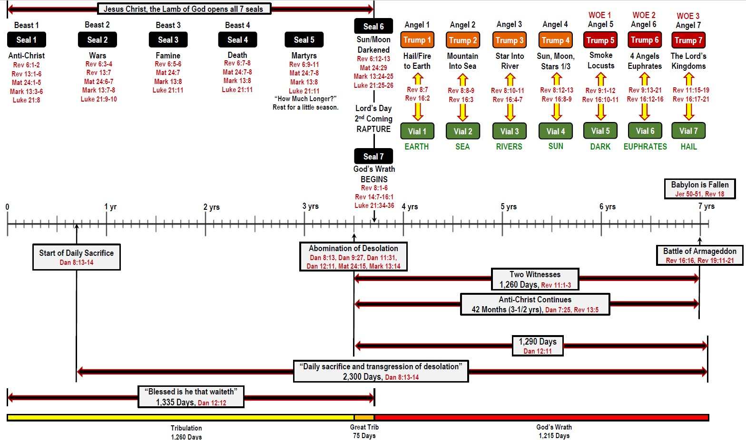
True Words Christian Church

Slide 42
Daniel 12:12 Blessed is he that waiteth, and cometh to the thousand three hundred and five and thirty days.
True Words Christian Church

Slide 43
Daniel 12:12 Blessed is he that waiteth, and cometh to the thousand three hundred and five and thirty days.
True Words Christian Church

Slide 44
Psalm 102:13 Thou shalt arise, and have mercy upon Zion: for the time to favour her, yea, the set time, is come.
True Words Christian Church

Slide 45
Romans 8:23 And not only they, but ourselves also, which have the firstfruits of the Spirit, even we ourselves groan within ourselves, waiting for the adoption, to wit, the redemption of our body.
True Words Christian Church

Slide 46
2 Thessalonians 3:5 And the Lord direct your hearts into the love of God, and into the patient waiting for Christ.
True Words Christian Church

Slide 47
1 Corinthians 1:6-8 Even as the testimony of Christ was confirmed in you: 7 So that ye come behind in no gift; waiting for the coming of our Lord Jesus Christ: 8 Who shall also confirm you unto the end, that ye may be blameless in the day of our Lord Jesus Christ.
True Words Christian Church

Slide 48
1 Thessalonians 1:10 And to wait for his Son from heaven, whom he raised from the dead, even Jesus, which delivered us from the wrath to come.
True Words Christian Church

Slide 49
Daniel 12:13 But go thou thy way till the end be: for thou shalt rest, and stand in thy lot at the end of the days.
True Words Christian Church

Slide 50
1 Thessalonians 4:16-17 For the Lord himself shall descend from heaven with a shout, with the voice of the archangel, and with the trump of God: and the dead in Christ shall rise first: 17 Then we which are alive and remain shall be caught up together with them in the clouds, to meet the Lord in the air: and so shall we ever be with the Lord.
True Words Christian Church

Slide 51
Hebrews 10:25 Not forsaking the assembling of ourselves together, as the manner of some is; but exhorting one another: and so much the more, as ye see the day approaching.
True Words Christian Church

Slide 52
1 Thessalonians 5:4-5 But ye, brethren, are not in darkness, that that day should overtake you as a thief. 5 Ye are all the children of light, and the children of the day: we are not of the night, nor of darkness.
True Words Christian Church

Slide 53
Matthew 25:13 Watch therefore, for ye know neither the day nor the hour wherein the Son of man cometh.
True Words Christian Church

Slide 54
Luke 21:28 And when these things begin to come to pass, then look up, and lift up your heads; for your redemption draweth nigh.
True Words Christian Church

