Slide 2
SERMON TITLE
Sheol, Gehenna, Hades, Or Hell?

Slide 3
Ezra 4:8 – 6:18
Ezra 7:12 – 7:26
Daniel 2:4 – 7:28
Jeremiah 10:11
True Words Christian Church

Slide 4
Matthew 27:46 And about the ninth hour Jesus cried with a loud voice, saying, Eli, Eli, lama sabachthani? that is to say, My God, my God, why hast thou forsaken me?
True Words Christian Church

Slide 5
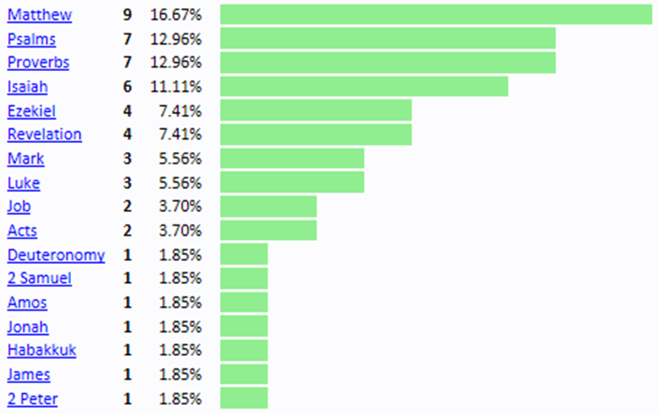
True Words Christian Church

Slide 6
Sheol = Hebrew, Hell = English
Gehenna = Greek, Hell = English
Hades = Greek, Hell = English
Tartaros = Greek, Hell = English
True Words Christian Church

Slide 7
Bible Version | Hell | Doctrine | Saints | Fornication | Damned | Human
KJB | 53 | 56 | 98 | 44 | 9 | 0
NKJV | 32 | 42 | 98 | 21 | 0 | 15
NASB | 13 | 14 | 68 | 8 | 0 | 39
ESV | 14 | 13 | 82 | 0 | 0 | 65
NIV | 13 | 7 | 0 | 0 | 0 | 214
True Words Christian Church

Slide 8
Genesis 1:27 So God created man in his own image, in the image of God created he him; male and female created he them.
True Words Christian Church

Slide 9
Genesis 1:27 (False NLT) So God created human beings in his own image. In the image of God he created them; male and female he created them.
True Words Christian Church

Slide 10
Malachi 3:5-6 And I will come near to you to judgment; and I will be a swift witness against the sorcerers, and against the adulterers, and against false swearers, and against those that oppress the hireling in his wages, the widow, and the fatherless, and that turn aside the stranger from his right, and fear not me, saith the LORD of hosts. 6 For I am the LORD, I change not; therefore ye sons of Jacob are not consumed.
True Words Christian Church

Slide 11
Numbers 23:19 God is not a man, that he should lie; neither the son of man, that he should repent: hath he said, and shall he not do it? or hath he spoken, and shall he not make it good?
True Words Christian Church

Slide 12
James 1:17 Every good gift and every perfect gift is from above, and cometh down from the Father of lights, with whom is no variableness, neither shadow of turning.
True Words Christian Church

Slide 13
Hebrews 13:8 Jesus Christ the same yesterday, and to day, and for ever.
True Words Christian Church

Slide 14
Luke 16:23-24 And in hell he lift up his eyes, being in torments, and seeth Abraham afar off, and Lazarus in his bosom. 24 And he cried and said, Father Abraham, have mercy on me, and send Lazarus, that he may dip the tip of his finger in water, and cool my tongue; for I am tormented in this flame.
True Words Christian Church

Slide 15
Romans 3:4 God forbid: yea, let God be true, but every man a liar; as it is written, That thou mightest be justified in thy sayings, and mightest overcome when thou art judged.
True Words Christian Church

Slide 16
Sheol | Gehenna | Hades | Tartaros | Total
31 Times | 12 Times | 10 Times | 1 Time | 54 Times
True Words Christian Church

Slide 17
Deuteronomy 32:22 (False NASB) For a fire is kindled in My anger, And burns to the lowest part of Sheol, And consumes the earth with its yield, And sets on fire the foundations of the mountains.
True Words Christian Church

Slide 18
King James Bible | NIV 1984
Psalm 9:17 The wicked shall be turned into hell, and all the nations that forget God. | Psalm 9:17 The wicked return to the grave, all the nations that forget God.
True Words Christian Church

Slide 19
Revelation 20:13 And the sea gave up the dead which were in it; and death and hell delivered up the dead which were in them: and they were judged every man according to their works.
True Words Christian Church

Slide 20
King James Bible | NIV 1984
Psalm 9:17 The wicked shall be turned into hell, and all the nations that forget God. | Psalm 9:17 The wicked return to the grave, all the nations that forget God.
True Words Christian Church

Slide 21
Matthew 5:29-30 And if thy right eye offend thee, pluck it out, and cast it from thee: for it is profitable for thee that one of thy members should perish, and not that thy whole body should be cast into hell. 30 And if thy right hand offend thee, cut it off, and cast it from thee: for it is profitable for thee that one of thy members should perish, and not that thy whole body should be cast into hell.
True Words Christian Church

Slide 22
Matthew 10:28 And fear not them which kill the body, but are not able to kill the soul: but rather fear him which is able to destroy both soul and body in hell.
True Words Christian Church

Slide 23
James 3:6 And the tongue is a fire, a world of iniquity: so is the tongue among our members, that it defileth the whole body, and setteth on fire the course of nature; and it is set on fire of hell.
True Words Christian Church

Slide 24
Revelation 20:15 And whosoever was not found written in the book of life was cast into the lake of fire.
True Words Christian Church

Slide 25
Revelation 20:15 And [kaí] whosoever [eí tis] was [heurískō] not [ou] found [heurískō] written [gráphō] in [en] the book [bíblos] of life [zōḗ] was cast [bállō] into [eis] the lake [límnē] of fire [pŷr].
True Words Christian Church

Slide 26
γέεννα géenna, gheh'-en-nah
of Hebrew origin (H1516 and H2011); valley of (the son of) Hinnom; ge-henna (or Ge-Hinnom), a valley of Jerusalem, used (figuratively) as a name for the place (or state) of everlasting punishment:—hell.
True Words Christian Church

Slide 27
True Words Christian Church

Slide 28
True Words Christian Church

Slide 29
Matthew 5:22 But I say unto you, That whosoever is angry with his brother without a cause shall be in danger of the judgment: and whosoever shall say to his brother, Raca, shall be in danger of the council: but whosoever shall say, Thou fool, shall be in danger of hell fire.
True Words Christian Church

Slide 30
Matthew 10:28 And fear not them which kill the body, but are not able to kill the soul: but rather fear him which is able to destroy both soul and body in hell.
True Words Christian Church

Slide 31
Matthew 18:9 And if thine eye offend thee, pluck it out, and cast it from thee: it is better for thee to enter into life with one eye, rather than having two eyes to be cast into hell fire.
True Words Christian Church

Slide 32
Matthew 23:15 Woe unto you, scribes and Pharisees, hypocrites! for ye compass sea and land to make one proselyte, and when he is made, ye make him twofold more the child of hell than yourselves.
True Words Christian Church

Slide 33
Matthew 23:33 Ye serpents, ye generation of vipers, how can ye escape the damnation of hell?
True Words Christian Church

Slide 34
Mark 9:43-44 And if thy hand offend thee, cut it off: it is better for thee to enter into life maimed, than having two hands to go into hell, into the fire that never shall be quenched: 44 Where their worm dieth not, and the fire is not quenched.
True Words Christian Church

Slide 35
James 1:1 James, a servant of God and of the Lord Jesus Christ, to the twelve tribes which are scattered abroad, greeting.
True Words Christian Church

Slide 36
Acts 2:27 Because thou wilt not leave my soul in hell, neither wilt thou suffer thine Holy One to see corruption.
True Words Christian Church

Slide 37
Acts 2:31 He seeing this before spake of the resurrection of Christ, that his soul was not left in hell, neither his flesh did see corruption.
True Words Christian Church

Slide 38
Luke 16:23-24 And in hell he lift up his eyes, being in torments, and seeth Abraham afar off, and Lazarus in his bosom. 24 And he cried and said, Father Abraham, have mercy on me, and send Lazarus, that he may dip the tip of his finger in water, and cool my tongue; for I am tormented in this flame.
True Words Christian Church

Slide 39
Matthew 12:40 For as Jonas was three days and three nights in the whale's belly; so shall the Son of man be three days and three nights in the heart of the earth.
True Words Christian Church

Slide 40
Deuteronomy 32:22 For a fire is kindled in mine anger, and shall burn unto the lowest hell, and shall consume the earth with her increase, and set on fire the foundations of the mountains.
True Words Christian Church

Slide 41
Psalm 9:17 The wicked shall be turned into hell, and all the nations that forget God.
True Words Christian Church

Slide 42
Proverbs 15:11 Hell and destruction are before the LORD: how much more then the hearts of the children of men?
True Words Christian Church

Slide 43
Psalm 139:7-8 Whither shall I go from thy spirit? or whither shall I flee from thy presence? 8 If I ascend up into heaven, thou art there: if I make my bed in hell, behold, thou art there.
True Words Christian Church

Slide 44
Matthew 8:29 And, behold, they cried out, saying, What have we to do with thee, Jesus, thou Son of God? art thou come hither to torment us before the time?
True Words Christian Church

Slide 45
Mark 5:5-7 And always, night and day, he was in the mountains, and in the tombs, crying, and cutting himself with stones. 6 But when he saw Jesus afar off, he ran and worshipped him, 7 And cried with a loud voice, and said, What have I to do with thee, Jesus, thou Son of the most high God? I adjure thee by God, that thou torment me not.
True Words Christian Church

Slide 46
Matthew 13:49-51 So shall it be at the end of the world: the angels shall come forth, and sever the wicked from among the just, 50 And shall cast them into the furnace of fire: there shall be wailing and gnashing of teeth. 51 Jesus saith unto them, Have ye understood all these things? They say unto him, Yea, Lord.
True Words Christian Church

Slide 47
Revelation 1:18 I am he that liveth, and was dead; and, behold, I am alive for evermore, Amen; and have the keys of hell and of death.
True Words Christian Church

Slide 48
Revelation 14:10-11 The same shall drink of the wine of the wrath of God, which is poured out without mixture into the cup of his indignation; and he shall be tormented with fire and brimstone in the presence of the holy angels, and in the presence of the Lamb: 11 And the smoke of their torment ascendeth up for ever and ever: and they have no rest day nor night, who worship the beast and his image, and whosoever receiveth the mark of his name.
True Words Christian Church

Slide 49
2 Peter 2:4 For if God spared not the angels that sinned, but cast them down to hell, and delivered them into chains of darkness, to be reserved unto judgment;
True Words Christian Church

