Slide 2
SERMON TITLE
Leaders of Israel
And Judah

Slide 3
Genesis 17:5 Neither shall thy name any more be called Abram, but thy name shall be Abraham; for a father of many nations have I made thee.
True Words Christian Church

Slide 4
Genesis 32:27-28 And he said unto him, What is thy name? And he said, Jacob. 28 And he said, Thy name shall be called no more Jacob, but Israel: for as a prince hast thou power with God and with men, and hast prevailed.
True Words Christian Church

Slide 5
Genesis 49:28 All these are the twelve tribes of Israel: and this is it that their father spake unto them, and blessed them; every one according to his blessing he blessed them.
True Words Christian Church

Slide 6
Genesis 35:16-18 And they journeyed from Beth-el; and there was but a little way to come to Ephrath: and Rachel travailed, and she had hard labour. 17 And it came to pass, when she was in hard labour, that the midwife said unto her, Fear not; thou shalt have this son also. 18 And it came to pass, as her soul was in departing, (for she died) that she called his name Ben-oni: but his father called him Benjamin.
True Words Christian Church

Slide 7
Genesis 41:45 And Pharaoh called Joseph's name Zaphnath-paaneah; and he gave him to wife Asenath the daughter of Poti-pherah priest of On. And Joseph went out over all the land of Egypt.
True Words Christian Church

Slide 8
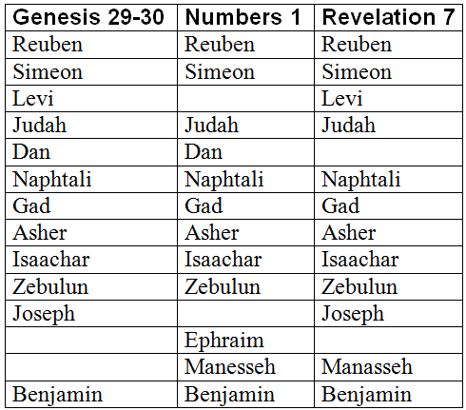
True Words Christian Church

Slide 9
Exodus 2:21-22 And Moses was content to dwell with the man: and he gave Moses Zipporah his daughter. 22 And she bare him a son, and he called his name Gershom: for he said, I have been a stranger in a strange land.
True Words Christian Church

Slide 10
Exodus 4:14 And the anger of the LORD was kindled against Moses, and he said, Is not Aaron the Levite thy brother? I know that he can speak well. And also, behold, he cometh forth to meet thee: and when he seeth thee, he will be glad in his heart.
True Words Christian Church

Slide 11
Exodus 6:13 And the LORD spake unto Moses and unto Aaron, and gave them a charge unto the children of Israel, and unto Pharaoh king of Egypt, to bring the children of Israel out of the land of Egypt.
True Words Christian Church

Slide 12
Numbers 27:18-19 And the LORD said unto Moses, Take thee Joshua the son of Nun, a man in whom is the spirit, and lay thine hand upon him; 19 And set him before Eleazar the priest, and before all the congregation; and give him a charge in their sight.
True Words Christian Church

Slide 13
Deuteronomy 32:44 And Moses came and spake all the words of this song in the ears of the people, he, and Hoshea the son of Nun.
True Words Christian Church

Slide 14
Exodus 33:11 And the LORD spake unto Moses face to face, as a man speaketh unto his friend. And he turned again into the camp: but his servant Joshua, the son of Nun, a young man, departed not out of the tabernacle.
True Words Christian Church

Slide 15
Numbers 13:8 Of the tribe of Ephraim, Oshea the son of Nun.
True Words Christian Church

Slide 16
Numbers 13:16 These are the names of the men which Moses sent to spy out the land. And Moses called Oshea the son of Nun Jehoshua.
True Words Christian Church

Slide 17
Acts 7:45 Which also our fathers that came after brought in with Jesus into the possession of the Gentiles, whom God drave out before the face of our fathers, unto the days of David;
True Words Christian Church

Slide 18
Hebrews 4:8 For if Jesus had given them rest, then would he not afterward have spoken of another day.
True Words Christian Church

Slide 19
Joshua 24:15 And if it seem evil unto you to serve the LORD, choose you this day whom ye will serve; whether the gods which your fathers served that were on the other side of the flood, or the gods of the Amorites, in whose land ye dwell: but as for me and my house, we will serve the LORD.
True Words Christian Church

Slide 20
Judges 2:11-13 And the children of Israel did evil in the sight of the LORD, and served Baalim: 12 And they forsook the LORD God of their fathers, which brought them out of the land of Egypt, and followed other gods, of the gods of the people that were round about them, and bowed themselves unto them, and provoked the LORD to anger. 13 And they forsook the LORD, and served Baal and Ashtaroth.
True Words Christian Church

Slide 21
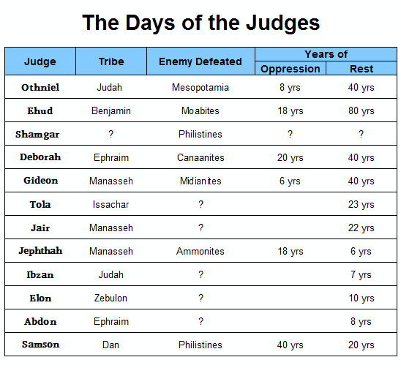
True Words Christian Church

Slide 22
Judges 3:16-17 But Ehud made him a dagger which had two edges, of a cubit length; and he did gird it under his raiment upon his right thigh. 17 And he brought the present unto Eglon king of Moab: and Eglon was a very fat man.
True Words Christian Church

Slide 23
True Words Christian Church

Slide 24
Judges 10:1 And after Abimelech there arose to defend Israel Tola the son of Puah, the son of Dodo, a man of Issachar; and he dwelt in Shamir in mount Ephraim.
True Words Christian Church

Slide 25
True Words Christian Church

Slide 26
Judges 11:1 Now Jephthah the Gileadite was a mighty man of valour, and he was the son of an harlot: and Gilead begat Jephthah.
True Words Christian Church

Slide 27
True Words Christian Church

Slide 28
1 Samuel 8:1 And it came to pass, when Samuel was old, that he made his sons judges over Israel.
True Words Christian Church

Slide 29
1 Samuel 8:3 And his sons walked not in his ways, but turned aside after lucre, and took bribes, and perverted judgment.
True Words Christian Church

Slide 30
1 Samuel 8:4-5 Then all the elders of Israel gathered themselves together, and came to Samuel unto Ramah, 5 And said unto him, Behold, thou art old, and thy sons walk not in thy ways: now make us a king to judge us like all the nations.
True Words Christian Church

Slide 31
Ruth 4:17 And the women her neighbours gave it a name, saying, There is a son born to Naomi; and they called his name Obed: he is the father of Jesse, the father of David.
True Words Christian Church

Slide 32
Revelation 5:5 And one of the elders saith unto me, Weep not: behold, the Lion of the tribe of Juda, the Root of David, hath prevailed to open the book, and to loose the seven seals thereof.
True Words Christian Church

Slide 33
1 Kings 11:43 And Solomon slept with his fathers, and was buried in the city of David his father: and Rehoboam his son reigned in his stead.
True Words Christian Church

Slide 34
1 Kings 15:5 Because David did that which was right in the eyes of the LORD, and turned not aside from any thing that he commanded him all the days of his life, save only in the matter of Uriah the Hittite.
True Words Christian Church

Slide 35
2 Chronicles 21:5-6 Jehoram was thirty and two years old when he began to reign, and he reigned eight years in Jerusalem. 6 And he walked in the way of the kings of Israel, like as did the house of Ahab: for he had the daughter of Ahab to wife: and he wrought that which was evil in the eyes of the LORD.
True Words Christian Church

Slide 36
1 Kings 14:22-23 And Judah did evil in the sight of the LORD, and they provoked him to jealousy with their sins which they had committed, above all that their fathers had done. 23 For they also built them high places, and images, and groves, on every high hill, and under every green tree.
True Words Christian Church

Slide 37
1 Kings 14:24 And there were also sodomites in the land: and they did according to all the abominations of the nations which the LORD cast out before the children of Israel.
True Words Christian Church

Slide 38
1 Kings 15:11-13 And Asa did that which was right in the eyes of the LORD, as did David his father. 12 And he took away the sodomites out of the land, and removed all the idols that his fathers had made. 13 And also Maachah his mother, even her he removed from being queen, because she had made an idol in a grove; and Asa destroyed her idol, and burnt it by the brook Kidron.
True Words Christian Church

Slide 39
2 Chronicles 19:1-2 And Jehoshaphat the king of Judah returned to his house in peace to Jerusalem. 2 And Jehu the son of Hanani the seer went out to meet him, and said to king Jehoshaphat, Shouldest thou help the ungodly, and love them that hate the LORD? therefore is wrath upon thee from before the LORD.
True Words Christian Church

Slide 40
2 Chronicles 20:35-37 And after this did Jehoshaphat king of Judah join himself with Ahaziah king of Israel, who did very wickedly: 36 And he joined himself with him to make ships to go to Tarshish: and they made the ships in Ezion-geber. 37 Then Eliezer the son of Dodavah of Mareshah prophesied against Jehoshaphat, saying, Because thou hast joined thyself with Ahaziah, the LORD hath broken thy works. And the ships were broken, that they were not able to go to Tarshish.
True Words Christian Church

Slide 41
2 Kings 8:26 Two and twenty years old was Ahaziah when he began to reign; and he reigned one year in Jerusalem. And his mother's name was Athaliah, the daughter of Omri king of Israel.
True Words Christian Church

Slide 42
2 Kings 9:27 But when Ahaziah the king of Judah saw this, he fled by the way of the garden house. And Jehu followed after him, and said, Smite him also in the chariot. And they did so at the going up to Gur, which is by Ibleam. And he fled to Megiddo, and died there.
True Words Christian Church

Slide 43
2 Kings 11:1 And when Athaliah the mother of Ahaziah saw that her son was dead, she arose and destroyed all the seed royal.
True Words Christian Church

Slide 44
2 Kings 11:2 But Jehosheba, the daughter of king Joram, sister of Ahaziah, took Joash the son of Ahaziah, and stole him from among the king's sons which were slain; and they hid him, even him and his nurse, in the bedchamber from Athaliah, so that he was not slain.
True Words Christian Church

Slide 45
2 Kings 11:3 And he was with her hid in the house of the LORD six years. And Athaliah did reign over the land.
True Words Christian Church

Slide 46
2 Kings 11:20-21 And all the people of the land rejoiced, and the city was in quiet: and they slew Athaliah with the sword beside the king's house. 21 Seven years old was Jehoash when he began to reign.
True Words Christian Church

Slide 47
Matthew 1:1 The book of the generation of Jesus Christ, the son of David, the son of Abraham.
True Words Christian Church

Slide 48
Matthew 1:6-7 And Jesse begat David the king; and David the king begat Solomon of her that had been the wife of Urias; 7 And Solomon begat Roboam; and Roboam begat Abia; and Abia begat Asa;
True Words Christian Church

Slide 49
Matthew 1:16 And Jacob begat Joseph the husband of Mary, of whom was born Jesus, who is called Christ.
True Words Christian Church

Slide 50
Luke 3:23 And Jesus himself began to be about thirty years of age, being (as was supposed) the son of Joseph, which was the son of Heli,
True Words Christian Church

Slide 51
Luke 3:31-32 Which was the son of Melea, which was the son of Menan, which was the son of Mattatha, which was the son of Nathan, which was the son of David, 32 Which was the son of Jesse, which was the son of Obed, which was the son of Booz, which was the son of Salmon, which was the son of Naasson,
True Words Christian Church

Slide 52
Luke 3:38 Which was the son of Enos, which was the son of Seth, which was the son of Adam, which was the son of God.
True Words Christian Church

Slide 53
1 Kings 16:18-19 And it came to pass, when Zimri saw that the city was taken, that he went into the palace of the king's house, and burnt the king's house over him with fire, and died, 19 For his sins which he sinned in doing evil in the sight of the LORD, in walking in the way of Jeroboam, and in his sin which he did, to make Israel to sin.
True Words Christian Church

