Slide 2
SERMON TITLE
Who Are
The Gentiles?

Slide 3
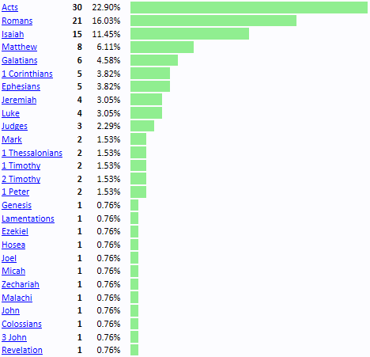
True Words Christian Church

Slide 4
Genesis 10:1 Now these are the generations of the sons of Noah, Shem, Ham, and Japheth: and unto them were sons born after the flood.
True Words Christian Church

Slide 5
Genesis 10:2-4 The sons of Japheth; Gomer, and Magog, and Madai, and Javan, and Tubal, and Meshech, and Tiras. 3 And the sons of Gomer; Ashkenaz, and Riphath, and Togarmah. 4 And the sons of Javan; Elishah, and Tarshish, Kittim, and Dodanim.
True Words Christian Church

Slide 6
Genesis 10:5 By these were the isles of the Gentiles divided in their lands; every one after his tongue, after their families, in their nations.
True Words Christian Church

Slide 7
Esther 10:1 And the king Ahasuerus laid a tribute upon the land, and upon the isles of the sea.
True Words Christian Church

Slide 8
Psalm 72:10 The kings of Tarshish and of the isles shall bring presents: the kings of Sheba and Seba shall offer gifts.
True Words Christian Church

Slide 9
Isaiah 23:1-2 The burden of Tyre. Howl, ye ships of Tarshish; for it is laid waste, so that there is no house, no entering in: from the land of Chittim it is revealed to them. 2 Be still, ye inhabitants of the isle; thou whom the merchants of Zidon, that pass over the sea, have replenished.
True Words Christian Church

Slide 10
True Words Christian Church

Slide 11
True Words Christian Church

Slide 12
Isaiah 23:6-8 Pass ye over to Tarshish; howl, ye inhabitants of the isle. 7 Is this your joyous city, whose antiquity is of ancient days? her own feet shall carry her afar off to sojourn. 8 Who hath taken this counsel against Tyre, the crowning city, whose merchants are princes, whose traffickers are the honourable of the earth?
True Words Christian Church

Slide 13
Isaiah 24:15 Wherefore glorify ye the LORD in the fires, even the name of the LORD God of Israel in the isles of the sea.
True Words Christian Church

Slide 14
Isaiah 42:10 Sing unto the LORD a new song, and his praise from the end of the earth, ye that go down to the sea, and all that is therein; the isles, and the inhabitants thereof.
True Words Christian Church

Slide 15
Isaiah 60:9 Surely the isles shall wait for me, and the ships of Tarshish first, to bring thy sons from far, their silver and their gold with them, unto the name of the LORD thy God, and to the Holy One of Israel, because he hath glorified thee.
True Words Christian Church

Slide 16
Isaiah 66:19 And I will set a sign among them, and I will send those that escape of them unto the nations, to Tarshish, Pul, and Lud, that draw the bow, to Tubal, and Javan, to the isles afar off, that have not heard my fame, neither have seen my glory; and they shall declare my glory among the Gentiles.
True Words Christian Church

Slide 17
Jeremiah 2:9-10 Wherefore I will yet plead with you, saith the LORD, and with your children's children will I plead. 10 For pass over the isles of Chittim, and see; and send unto Kedar, and consider diligently, and see if there be such a thing.
True Words Christian Church

Slide 18
Jeremiah 25:22-23 And all the kings of Tyrus, and all the kings of Zidon, and the kings of the isles which are beyond the sea, 23 Dedan, and Tema, and Buz, and all that are in the utmost corners,
True Words Christian Church

Slide 19
Jeremiah 31:10 Hear the word of the LORD, O ye nations, and declare it in the isles afar off, and say, He that scattered Israel will gather him, and keep him, as a shepherd doth his flock.
True Words Christian Church

Slide 20
Ezekiel 27:3-4 And say unto Tyrus, O thou that art situate at the entry of the sea, which art a merchant of the people for many isles, Thus saith the Lord GOD; O Tyrus, thou hast said, I am of perfect beauty. 4 Thy borders are in the midst of the seas, thy builders have perfected thy beauty.
True Words Christian Church

Slide 21
Ezekiel 27:5-6 They have made all thy ship boards of fir trees of Senir: they have taken cedars from Lebanon to make masts for thee. 6 Of the oaks of Bashan have they made thine oars; the company of the Ashurites have made thy benches of ivory, brought out of the isles of Chittim.
True Words Christian Church

Slide 22
Revelation 1:9 I John, who also am your brother, and companion in tribulation, and in the kingdom and patience of Jesus Christ, was in the isle that is called Patmos, for the word of God, and for the testimony of Jesus Christ.
True Words Christian Church

Slide 23
Judges 4:2 And the LORD sold them into the hand of Jabin king of Canaan, that reigned in Hazor; the captain of whose host was Sisera, which dwelt in Harosheth of the Gentiles.
True Words Christian Church

Slide 24
Judges 4:13 And Sisera gathered together all his chariots, even nine hundred chariots of iron, and all the people that were with him, from Harosheth of the Gentiles unto the river of Kishon.
True Words Christian Church

Slide 25
Judges 4:16 But Barak pursued after the chariots, and after the host, unto Harosheth of the Gentiles: and all the host of Sisera fell upon the edge of the sword; and there was not a man left.
True Words Christian Church

Slide 26
True Words Christian Church

Slide 27
Isaiah 11:10 And in that day there shall be a root of Jesse, which shall stand for an ensign of the people; to it shall the Gentiles seek: and his rest shall be glorious.
True Words Christian Church

Slide 28
Isaiah 42:1-3 Behold my servant, whom I uphold; mine elect, in whom my soul delighteth; I have put my spirit upon him: he shall bring forth judgment to the Gentiles. 2 He shall not cry, nor lift up, nor cause his voice to be heard in the street. 3 A bruised reed shall he not break, and the smoking flax shall he not quench: he shall bring forth judgment unto truth.
True Words Christian Church

Slide 29
Isaiah 42:4-5 He shall not fail nor be discouraged, till he have set judgment in the earth: and the isles shall wait for his law. 5 Thus saith God the LORD, he that created the heavens, and stretched them out; he that spread forth the earth, and that which cometh out of it; he that giveth breath unto the people upon it, and spirit to them that walk therein:
True Words Christian Church

Slide 30
Isaiah 42:6-7 I the LORD have called thee in righteousness, and will hold thine hand, and will keep thee, and give thee for a covenant of the people, for a light of the Gentiles; 7 To open the blind eyes, to bring out the prisoners from the prison, and them that sit in darkness out of the prison house.
True Words Christian Church

Slide 31
Isaiah 49:6 And he said, It is a light thing that thou shouldest be my servant to raise up the tribes of Jacob, and to restore the preserved of Israel: I will also give thee for a light to the Gentiles, that thou mayest be my salvation unto the end of the earth.
True Words Christian Church

Slide 32
Isaiah 45:22 Look unto me, and be ye saved, all the ends of the earth: for I am God, and there is none else.
True Words Christian Church

Slide 33
Psalm 98:3 He hath remembered his mercy and his truth toward the house of Israel: all the ends of the earth have seen the salvation of our God.
True Words Christian Church

Slide 34
Psalm 67:2 That thy way may be known upon earth, thy saving health among all nations.
True Words Christian Church

Slide 35
Zechariah 8:7-8 Thus saith the LORD of hosts; Behold, I will save my people from the east country, and from the west country; 8 And I will bring them, and they shall dwell in the midst of Jerusalem: and they shall be my people, and I will be their God, in truth and in righteousness.
True Words Christian Church

Slide 36
1 Timothy 2:3-6 For this is good and acceptable in the sight of God our Saviour; 4 Who will have all men to be saved, and to come unto the knowledge of the truth. 5 For there is one God, and one mediator between God and men, the man Christ Jesus; 6 Who gave himself a ransom for all, to be testified in due time.
True Words Christian Church

Slide 37
Isaiah 49:22 Thus saith the Lord GOD, Behold, I will lift up mine hand to the Gentiles, and set up my standard to the people: and they shall bring thy sons in their arms, and thy daughters shall be carried upon their shoulders.
True Words Christian Church

Slide 38
Isaiah 54:3 For thou shalt break forth on the right hand and on the left; and thy seed shall inherit the Gentiles, and make the desolate cities to be inhabited.
True Words Christian Church

Slide 39
1 John 2:22 Who is a liar but he that denieth that Jesus is the Christ? He is antichrist, that denieth the Father and the Son.
True Words Christian Church

Slide 40
1 John 4:3 And every spirit that confesseth not that Jesus Christ is come in the flesh is not of God: and this is that spirit of antichrist, whereof ye have heard that it should come; and even now already is it in the world.
True Words Christian Church

Slide 41
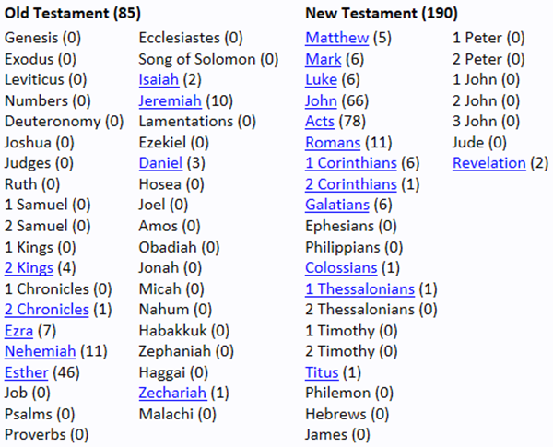
True Words Christian Church

Slide 42
2 Kings 16:5-6 Then Rezin king of Syria and Pekah son of Remaliah king of Israel came up to Jerusalem to war: and they besieged Ahaz, but could not overcome him. 6 At that time Rezin king of Syria recovered Elath to Syria, and drave the Jews from Elath: and the Syrians came to Elath, and dwelt there unto this day.
True Words Christian Church

Slide 43
Isaiah 60:1-3 Arise, shine; for thy light is come, and the glory of the LORD is risen upon thee. 2 For, behold, the darkness shall cover the earth, and gross darkness the people: but the LORD shall arise upon thee, and his glory shall be seen upon thee. 3 And the Gentiles shall come to thy light, and kings to the brightness of thy rising.
True Words Christian Church

Slide 44
Isaiah 60:4-5 Lift up thine eyes round about, and see: all they gather themselves together, they come to thee: thy sons shall come from far, and thy daughters shall be nursed at thy side. 5 Then thou shalt see, and flow together, and thine heart shall fear, and be enlarged; because the abundance of the sea shall be converted unto thee, the forces of the Gentiles shall come unto thee.
True Words Christian Church

Slide 45
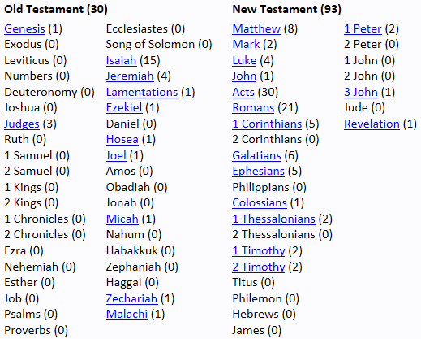
True Words Christian Church

Slide 46
Isaiah 60:16 Thou shalt also suck the milk of the Gentiles, and shalt suck the breast of kings: and thou shalt know that I the LORD am thy Saviour and thy Redeemer, the mighty One of Jacob.
True Words Christian Church

Slide 47
Isaiah 62:2 And the Gentiles shall see thy righteousness, and all kings thy glory: and thou shalt be called by a new name, which the mouth of the LORD shall name.
True Words Christian Church

Slide 48
Jeremiah 16:19 O LORD, my strength, and my fortress, and my refuge in the day of affliction, the Gentiles shall come unto thee from the ends of the earth, and shall say, Surely our fathers have inherited lies, vanity, and things wherein there is no profit.
True Words Christian Church

Slide 49
Jeremiah 16:20-21 Shall a man make gods unto himself, and they are no gods? 21 Therefore, behold, I will this once cause them to know, I will cause them to know mine hand and my might; and they shall know that my name is The LORD.
True Words Christian Church

Slide 50
Ezekiel 4:13 And the LORD said, Even thus shall the children of Israel eat their defiled bread among the Gentiles, whither I will drive them.
True Words Christian Church

Slide 51
Matthew 4:13-15 And leaving Nazareth, he came and dwelt in Capernaum, which is upon the sea coast, in the borders of Zabulon and Nephthalim: 14 That it might be fulfilled which was spoken by Esaias the prophet, saying, 15 The land of Zabulon, and the land of Nephthalim, by the way of the sea, beyond Jordan, Galilee of the Gentiles;
True Words Christian Church

Slide 52
Matthew 4:16-17 The people which sat in darkness saw great light; and to them which sat in the region and shadow of death light is sprung up. 17 From that time Jesus began to preach, and to say, Repent: for the kingdom of heaven is at hand.
True Words Christian Church

Slide 53
Isaiah 9:1-2 Nevertheless the dimness shall not be such as was in her vexation, when at the first he lightly afflicted the land of Zebulun and the land of Naphtali, and afterward did more grievously afflict her by the way of the sea, beyond Jordan, in Galilee of the nations. 2 The people that walked in darkness have seen a great light: they that dwell in the land of the shadow of death, upon them hath the light shined.
True Words Christian Church

Slide 54
Matthew 6:32-33 (For after all these things do the Gentiles seek:) for your heavenly Father knoweth that ye have need of all these things. 33 But seek ye first the kingdom of God, and his righteousness; and all these things shall be added unto you.
True Words Christian Church

Slide 55
Luke 12:30-31 For all these things do the nations of the world seek after: and your Father knoweth that ye have need of these things. 31 But rather seek ye the kingdom of God; and all these things shall be added unto you.
True Words Christian Church

Slide 56
Matthew 12:17-18 That it might be fulfilled which was spoken by Esaias the prophet, saying, 18 Behold my servant, whom I have chosen; my beloved, in whom my soul is well pleased: I will put my spirit upon him, and he shall shew judgment to the Gentiles.
True Words Christian Church

Slide 57
Matthew 12:19-21 He shall not strive, nor cry; neither shall any man hear his voice in the streets. 20 A bruised reed shall he not break, and smoking flax shall he not quench, till he send forth judgment unto victory. 21 And in his name shall the Gentiles trust.
True Words Christian Church

Slide 58
Matthew 28:16-18 Then the eleven disciples went away into Galilee, into a mountain where Jesus had appointed them. 17 And when they saw him, they worshipped him: but some doubted. 18 And Jesus came and spake unto them, saying, All power is given unto me in heaven and in earth.
True Words Christian Church

Slide 59
Matthew 28:19-20 Go ye therefore, and teach all nations, baptizing them in the name of the Father, and of the Son, and of the Holy Ghost: 20 Teaching them to observe all things whatsoever I have commanded you: and, lo, I am with you alway, even unto the end of the world. Amen.
True Words Christian Church

Slide 60
Acts 10:44-45 While Peter yet spake these words, the Holy Ghost fell on all them which heard the word. 45 And they of the circumcision which believed were astonished, as many as came with Peter, because that on the Gentiles also was poured out the gift of the Holy Ghost.
True Words Christian Church

Slide 61
Acts 11:1 And the apostles and brethren that were in Judaea heard that the Gentiles had also received the word of God.
True Words Christian Church

Slide 62
Acts 13:45 But when the Jews saw the multitudes, they were filled with envy, and spake against those things which were spoken by Paul, contradicting and blaspheming.
True Words Christian Church

Slide 63
Acts 13:46 Then Paul and Barnabas waxed bold, and said, It was necessary that the word of God should first have been spoken to you: but seeing ye put it from you, and judge yourselves unworthy of everlasting life, lo, we turn to the Gentiles.
True Words Christian Church

Slide 64
Acts 13:47-48 For so hath the Lord commanded us, saying, I have set thee to be a light of the Gentiles, that thou shouldest be for salvation unto the ends of the earth. 48 And when the Gentiles heard this, they were glad, and glorified the word of the Lord: and as many as were ordained to eternal life believed.
True Words Christian Church

Slide 65
Romans 1:13 Now I would not have you ignorant, brethren, that oftentimes I purposed to come unto you, (but was let hitherto,) that I might have some fruit among you also, even as among other Gentiles.
True Words Christian Church

Slide 66
Romans 2:8-9 But unto them that are contentious, and do not obey the truth, but obey unrighteousness, indignation and wrath, 9 Tribulation and anguish, upon every soul of man that doeth evil, of the Jew first, and also of the Gentile;
True Words Christian Church

Slide 67
Romans 2:10-11 But glory, honour, and peace, to every man that worketh good, to the Jew first, and also to the Gentile: 11 For there is no respect of persons with God.
True Words Christian Church

Slide 68
Romans 3:29-30 Is he the God of the Jews only? is he not also of the Gentiles? Yes, of the Gentiles also: 30 Seeing it is one God, which shall justify the circumcision by faith, and uncircumcision through faith.
True Words Christian Church

