Slide 2
SERMON TITLE
Does Baptism
Save You?

Slide 3
John 3:5 Jesus answered, Verily, verily, I say unto thee, Except a man be born of water and of the Spirit, he cannot enter into the kingdom of God.
True Words Christian Church

Slide 4
John 3:1-2 There was a man of the Pharisees, named Nicodemus, a ruler of the Jews: 2 The same came to Jesus by night, and said unto him, Rabbi, we know that thou art a teacher come from God: for no man can do these miracles that thou doest, except God be with him.
True Words Christian Church

Slide 5
John 3:3-4 Jesus answered and said unto him, Verily, verily, I say unto thee, Except a man be born again, he cannot see the kingdom of God. 4 Nicodemus saith unto him, How can a man be born when he is old? can he enter the second time into his mother's womb, and be born?
True Words Christian Church

Slide 6
John 3:5 Jesus answered, Verily, verily, I say unto thee, Except a man be born of water and of the Spirit, he cannot enter into the kingdom of God.
True Words Christian Church

Slide 7
John 3:6 That which is born of the flesh is flesh; and that which is born of the Spirit is spirit.
True Words Christian Church

Slide 8
John 3:15-16 That whosoever believeth in him should not perish, but have eternal life. 16 For God so loved the world, that he gave his only begotten Son, that whosoever believeth in him should not perish, but have everlasting life.
True Words Christian Church

Slide 9
John 3:17-18 For God sent not his Son into the world to condemn the world; but that the world through him might be saved. 18 He that believeth on him is not condemned: but he that believeth not is condemned already, because he hath not believed in the name of the only begotten Son of God.
True Words Christian Church

Slide 10
John 11:26 And whosoever liveth and believeth in me shall never die. Believest thou this?
True Words Christian Church

Slide 11
John 6:47 Verily, verily, I say unto you, He that believeth on me hath everlasting life.
True Words Christian Church

Slide 12
Mark 16:16 He that believeth and is baptized shall be saved; but he that believeth not shall be damned.
True Words Christian Church

Slide 13
Ephesians 4:13-14 Till we all come in the unity of the faith, and of the knowledge of the Son of God, unto a perfect man, unto the measure of the stature of the fulness of Christ: 14 That we henceforth be no more children, tossed to and fro, and carried about with every wind of doctrine, by the sleight of men, and cunning craftiness, whereby they lie in wait to deceive;
True Words Christian Church

Slide 14
Ephesians 4:15-16 But speaking the truth in love, may grow up into him in all things, which is the head, even Christ: 16 From whom the whole body fitly joined together and compacted by that which every joint supplieth, according to the effectual working in the measure of every part, maketh increase of the body unto the edifying of itself in love.
True Words Christian Church

Slide 15
Baptism
Baptisms
Baptist
Baptist’s
Baptize
Baptized
Baptizes
Baptizeth
Baptizing
True Words Christian Church

Slide 16
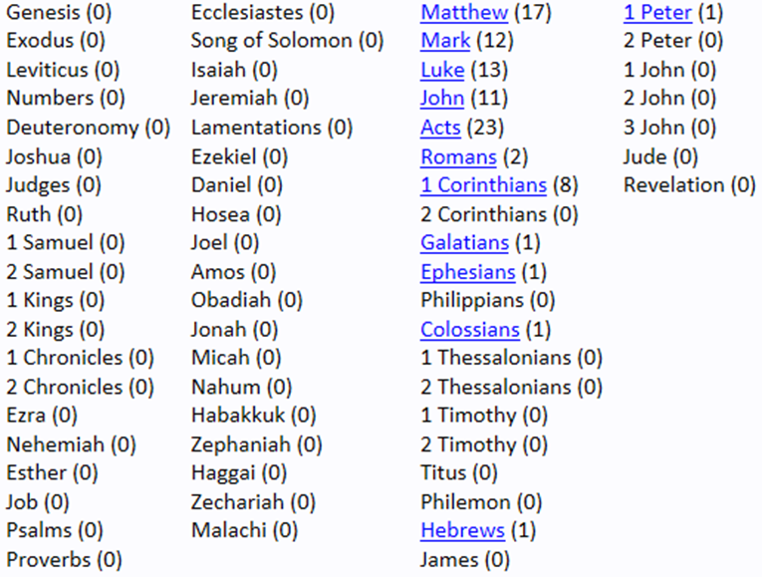
True Words Christian Church

Slide 17
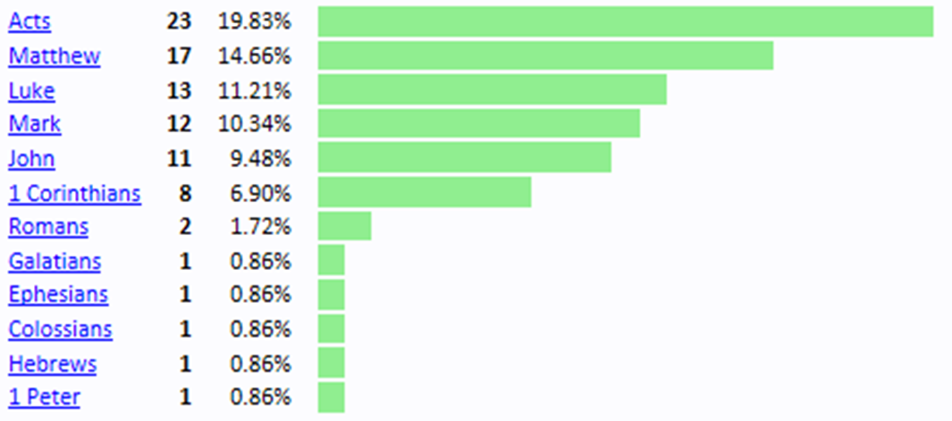
True Words Christian Church

Slide 18
Matthew 3:1-2 In those days came John the Baptist, preaching in the wilderness of Judaea, 2 And saying, Repent ye: for the kingdom of heaven is at hand.
True Words Christian Church

Slide 19
Acts 19:3-5 And he said unto them, Unto what then were ye baptized? And they said, Unto John's baptism. 4 Then said Paul, John verily baptized with the baptism of repentance, saying unto the people, that they should believe on him which should come after him, that is, on Christ Jesus. 5 When they heard this, they were baptized in the name of the Lord Jesus.
True Words Christian Church

Slide 20
Matthew 3:5-6 Then went out to him Jerusalem, and all Judaea, and all the region round about Jordan, 6 And were baptized of him in Jordan, confessing their sins.
True Words Christian Church

Slide 21
Matthew 3:7 But when he saw many of the Pharisees and Sadducees come to his baptism, he said unto them, O generation of vipers, who hath warned you to flee from the wrath to come?
True Words Christian Church

Slide 22
Matthew 3:8 Bring forth therefore fruits meet for repentance:
True Words Christian Church

Slide 23
Matthew 3:9 And think not to say within yourselves, We have Abraham to our father: for I say unto you, that God is able of these stones to raise up children unto Abraham.
True Words Christian Church

Slide 24
Matthew 3:10 And now also the axe is laid unto the root of the trees: therefore every tree which bringeth not forth good fruit is hewn down, and cast into the fire.
True Words Christian Church

Slide 25
Matthew 3:11-12 I indeed baptize you with water unto repentance: but he that cometh after me is mightier than I, whose shoes I am not worthy to bear: he shall baptize you with the Holy Ghost, and with fire: 12 Whose fan is in his hand, and he will throughly purge his floor, and gather his wheat into the garner; but he will burn up the chaff with unquenchable fire.
True Words Christian Church

Slide 26
True Words Christian Church

Slide 27
John 3:23 And John also was baptizing in AEnon near to Salim, because there was much water there: and they came, and were baptized.
True Words Christian Church

Slide 28
Ephesians 1:13-14 In whom ye also trusted, after that ye heard the word of truth, the gospel of your salvation: in whom also after that ye believed, ye were sealed with that holy Spirit of promise, 14 Which is the earnest of our inheritance until the redemption of the purchased possession, unto the praise of his glory.
True Words Christian Church

Slide 29
2 Thessalonians 1:7-9 And to you who are troubled rest with us, when the Lord Jesus shall be revealed from heaven with his mighty angels, 8 In flaming fire taking vengeance on them that know not God, and that obey not the gospel of our Lord Jesus Christ: 9 Who shall be punished with everlasting destruction from the presence of the Lord, and from the glory of his power;
True Words Christian Church

Slide 30
Matthew 3:13 Then cometh Jesus from Galilee to Jordan unto John, to be baptized of him.
True Words Christian Church

Slide 31
1 Timothy 1:15 This is a faithful saying, and worthy of all acceptation, that Christ Jesus came into the world to save sinners; of whom I am chief.
True Words Christian Church

Slide 32
John 4:1-2 When therefore the Lord knew how the Pharisees had heard that Jesus made and baptized more disciples than John, 2 (Though Jesus himself baptized not, but his disciples,)
True Words Christian Church

Slide 33
Matthew 3:14-15 But John forbad him, saying, I have need to be baptized of thee, and comest thou to me? 15 And Jesus answering said unto him, Suffer it to be so now: for thus it becometh us to fulfil all righteousness. Then he suffered him.
True Words Christian Church

Slide 34
Matthew 3:16-17 And Jesus, when he was baptized, went up straightway out of the water: and, lo, the heavens were opened unto him, and he saw the Spirit of God descending like a dove, and lighting upon him: 17 And lo a voice from heaven, saying, This is my beloved Son, in whom I am well pleased.
True Words Christian Church

Slide 35
1 Peter 3:18-19 For Christ also hath once suffered for sins, the just for the unjust, that he might bring us to God, being put to death in the flesh, but quickened by the Spirit: 19 By which also he went and preached unto the spirits in prison;
True Words Christian Church

Slide 36
1 Peter 3:20 Which sometime were disobedient, when once the longsuffering of God waited in the days of Noah, while the ark was a preparing, wherein few, that is, eight souls were saved by water.
True Words Christian Church

Slide 37
1 Peter 3:21-22 The like figure whereunto even baptism doth also now save us (not the putting away of the filth of the flesh, but the answer of a good conscience toward God,) by the resurrection of Jesus Christ: 22 Who is gone into heaven, and is on the right hand of God; angels and authorities and powers being made subject unto him.
True Words Christian Church

Slide 38
1 Corinthians 10:1-3 Moreover, brethren, I would not that ye should be ignorant, how that all our fathers were under the cloud, and all passed through the sea; 2 And were all baptized unto Moses in the cloud and in the sea; 3 And did all eat the same spiritual meat;
True Words Christian Church

Slide 39
1 Corinthians 10:4-5 And did all drink the same spiritual drink: for they drank of that spiritual Rock that followed them: and that Rock was Christ. 5 But with many of them God was not well pleased: for they were overthrown in the wilderness.
True Words Christian Church

Slide 40
Hebrews 8:6-7 But now hath he obtained a more excellent ministry, by how much also he is the mediator of a better covenant, which was established upon better promises. 7 For if that first covenant had been faultless, then should no place have been sought for the second.
True Words Christian Church

Slide 41
Hebrews 8:8 For finding fault with them, he saith, Behold, the days come, saith the Lord, when I will make a new covenant with the house of Israel and with the house of Judah:
True Words Christian Church

Slide 42
Hebrews 8:9 Not according to the covenant that I made with their fathers in the day when I took them by the hand to lead them out of the land of Egypt; because they continued not in my covenant, and I regarded them not, saith the Lord.
True Words Christian Church

Slide 43
Hebrews 8:10-11 For this is the covenant that I will make with the house of Israel after those days, saith the Lord; I will put my laws into their mind, and write them in their hearts: and I will be to them a God, and they shall be to me a people: 11 And they shall not teach every man his neighbour, and every man his brother, saying, Know the Lord: for all shall know me, from the least to the greatest.
True Words Christian Church

Slide 44
Hebrews 8:12-13 For I will be merciful to their unrighteousness, and their sins and their iniquities will I remember no more. 13 In that he saith, A new covenant, he hath made the first old. Now that which decayeth and waxeth old is ready to vanish away.
True Words Christian Church

Slide 45
Matthew 12:39-40 But he answered and said unto them, An evil and adulterous generation seeketh after a sign; and there shall no sign be given to it, but the sign of the prophet Jonas: 40 For as Jonas was three days and three nights in the whale's belly; so shall the Son of man be three days and three nights in the heart of the earth.
True Words Christian Church

Slide 46
Revelation 1:18 I am he that liveth, and was dead; and, behold, I am alive for evermore, Amen; and have the keys of hell and of death.
True Words Christian Church

Slide 47
Matthew 12:41 The men of Nineveh shall rise in judgment with this generation, and shall condemn it: because they repented at the preaching of Jonas; and, behold, a greater than Jonas is here.
True Words Christian Church

Slide 48
Acts 10:43 To him give all the prophets witness, that through his name whosoever believeth in him shall receive remission of sins.
True Words Christian Church

Slide 49
Acts 2:38 Then Peter said unto them, Repent, and be baptized every one of you in the name of Jesus Christ for the remission of sins, and ye shall receive the gift of the Holy Ghost.
True Words Christian Church

Slide 50
Acts 2:41 Then they that gladly received his word were baptized: and the same day there were added unto them about three thousand souls.
True Words Christian Church

Slide 51
Acts 8:12 But when they believed Philip preaching the things concerning the kingdom of God, and the name of Jesus Christ, they were baptized, both men and women.
True Words Christian Church

Slide 52
1 Corinthians 1:17 For Christ sent me not to baptize, but to preach the gospel: not with wisdom of words, lest the cross of Christ should be made of none effect.
True Words Christian Church

Slide 53
Galatians 3:27 For as many of you as have been baptized into Christ have put on Christ.
True Words Christian Church

Slide 54
Galatians 3:22-24 But the scripture hath concluded all under sin, that the promise by faith of Jesus Christ might be given to them that believe. 23 But before faith came, we were kept under the law, shut up unto the faith which should afterwards be revealed. 24 Wherefore the law was our schoolmaster to bring us unto Christ, that we might be justified by faith.
True Words Christian Church

Slide 55
Galatians 3:25-28 But after that faith is come, we are no longer under a schoolmaster. 26 For ye are all the children of God by faith in Christ Jesus. 27 For as many of you as have been baptized into Christ have put on Christ. 28 There is neither Jew nor Greek, there is neither bond nor free, there is neither male nor female: for ye are all one in Christ Jesus.
True Words Christian Church

