Slide 2
SERMON TITLE
Are 501c3 Churches Evil?

Slide 3
“An organization may qualify for an exemption from federal income tax under section 501(c)(3) if it is organized and operated exclusively for one or more of the following purposes. Religious. Charitable. Scientific. Testing for public safety. Literary. Educational. The prevention of cruelty to children or animals.”
True Words Christian Church

Slide 4
“To qualify, the organization must be organized as a corporation (including a limited liability company), unincorporated association, or trust. Sole proprietorships, partnerships, individuals, or loosely associated groups of individuals won't qualify.”
True Words Christian Church

Slide 5
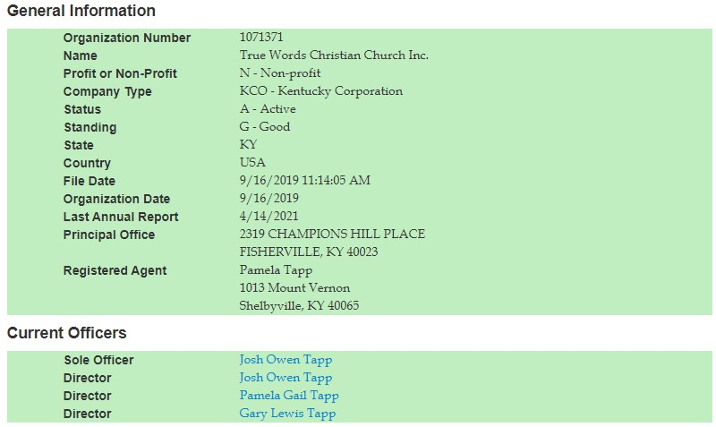
True Words Christian Church

Slide 6
1 Chronicles 26:29-30 Of the Izharites, Chenaniah and his sons were for the outward business over Israel, for officers and judges. 30 And of the Hebronites, Hashabiah and his brethren, men of valour, a thousand and seven hundred, were officers among them of Israel on this side Jordan westward in all the business of the LORD, and in the service of the king.
True Words Christian Church

Slide 7
2 Chronicles 13:10 But as for us, the LORD is our God, and we have not forsaken him; and the priests, which minister unto the LORD, are the sons of Aaron, and the Levites wait upon their business:
True Words Christian Church

Slide 8
2 Chronicles 13:11 And they burn unto the LORD every morning and every evening burnt sacrifices and sweet incense: the shewbread also set they in order upon the pure table; and the candlestick of gold with the lamps thereof, to burn every evening: for we keep the charge of the LORD our God; but ye have forsaken him.
True Words Christian Church

Slide 9
Nehemiah 11:16 And Shabbethai and Jozabad, of the chief of the Levites, had the oversight of the outward business of the house of God.
True Words Christian Church

Slide 10
Nehemiah 11:22 The overseer also of the Levites at Jerusalem was Uzzi the son of Bani, the son of Hashabiah, the son of Mattaniah, the son of Micha. Of the sons of Asaph, the singers were over the business of the house of God.
True Words Christian Church

Slide 11
Luke 2:48-49 And when they saw him, they were amazed: and his mother said unto him, Son, why hast thou thus dealt with us? behold, thy father and I have sought thee sorrowing. 49 And he said unto them, How is it that ye sought me? wist ye not that I must be about my Father's business?
True Words Christian Church

Slide 12
Romans 12:11 Not slothful in business; fervent in spirit; serving the Lord;
True Words Christian Church

Slide 13
1 Thessalonians 4:11 And that ye study to be quiet, and to do your own business, and to work with your own hands, as we commanded you;
True Words Christian Church

Slide 14
Matthew 17:24-25 And when they were come to Capernaum, they that received tribute money came to Peter, and said, Doth not your master pay tribute? 25 He saith, Yes. And when he was come into the house, Jesus prevented him, saying, What thinkest thou, Simon? of whom do the kings of the earth take custom or tribute? of their own children, or of strangers?
True Words Christian Church

Slide 15
Matthew 17:26-27 Peter saith unto him, Of strangers. Jesus saith unto him, Then are the children free. 27 Notwithstanding, lest we should offend them, go thou to the sea, and cast an hook, and take up the fish that first cometh up; and when thou hast opened his mouth, thou shalt find a piece of money: that take, and give unto them for me and thee.
True Words Christian Church

Slide 16
Mark 12:17 And Jesus answering said unto them, Render to Caesar the things that are Caesar's, and to God the things that are God's. And they marvelled at him.
True Words Christian Church

Slide 17
“Contributions to domestic organizations described in this chapter, except organizations testing for public safety, are deductible as charitable contributions on the donor's federal income tax return.”
True Words Christian Church

Slide 18
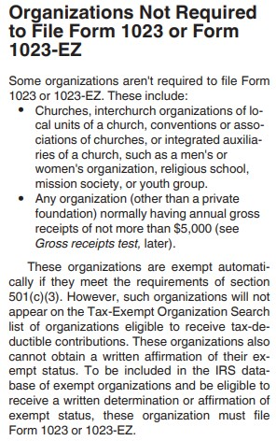
True Words Christian Church

Slide 19
Mark 8:36 For what shall it profit a man, if he shall gain the whole world, and lose his own soul?
True Words Christian Church

Slide 20
“In case you may not have understood this, it means your church has NO constitutional rights once you sign up for 501c3. You have no First Amendment freedom of speech or freedom of religion rights, and you have no Fifth Amendment rights, which means the state can hold you as a witness against yourself to sentence you for any crime they choose. (This is not to say our government will do that, but I'm pointing out that they have the legal power to do that under the 501c3 contract.)”
True Words Christian Church

Slide 21
“After the 501c3 contract is established, you are now a corporate soul, which means you only have privileges (not freedoms) that are granted by the judicial system according to the regulations of your contract. At that point, the IRS has full power to remove your privileges whenever they choose, and for any reason.”
True Words Christian Church

Slide 22
Acts 5:29 Then Peter and the other apostles answered and said, We ought to obey God rather than men.
True Words Christian Church

Slide 23
Hebrews 10:24-25 And let us consider one another to provoke unto love and to good works: 25 Not forsaking the assembling of ourselves together, as the manner of some is; but exhorting one another: and so much the more, as ye see the day approaching.
True Words Christian Church

Slide 24
1 Thessalonians 5:22 Abstain from all appearance of evil.
True Words Christian Church

