Slide 2
SERMON TITLE
A Bible Study
On Devils

Slide 3
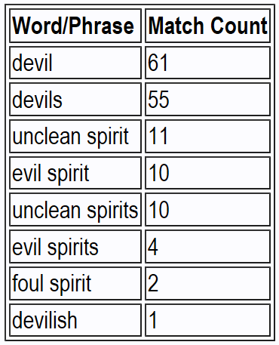
True Words Christian Church

Slide 4
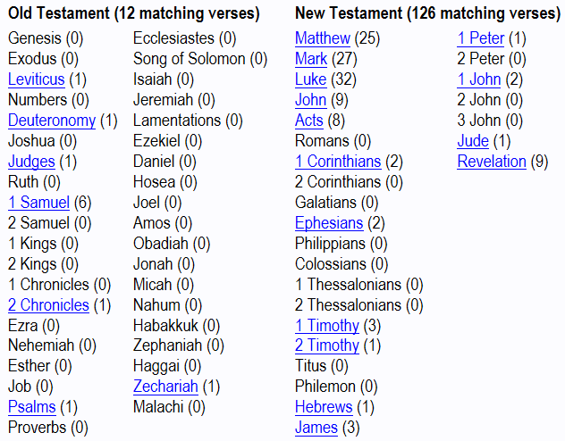
True Words Christian Church

Slide 5
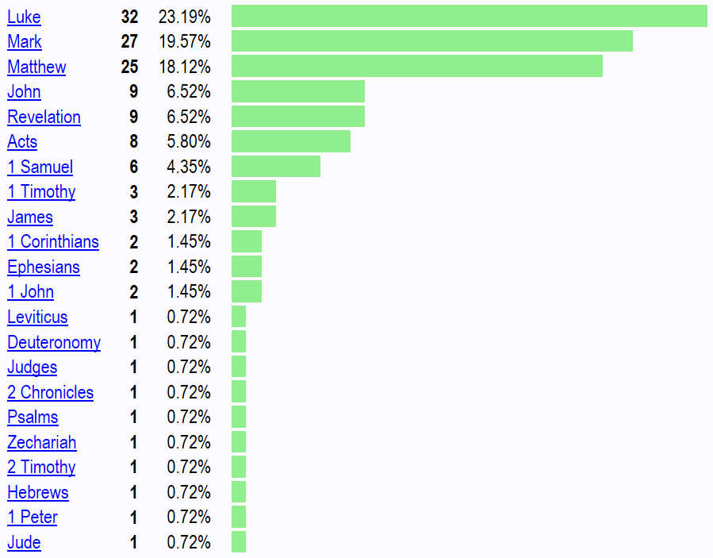
True Words Christian Church

Slide 6
Leviticus 17:6-7 And the priest shall sprinkle the blood upon the altar of the LORD at the door of the tabernacle of the congregation, and burn the fat for a sweet savour unto the LORD. 7 And they shall no more offer their sacrifices unto devils, after whom they have gone a whoring. This shall be a statute for ever unto them throughout their generations.
True Words Christian Church

Slide 7
Deuteronomy 32:16-19 They provoked him to jealousy with strange gods, with abominations provoked they him to anger. 17 They sacrificed unto devils, not to God; to gods whom they knew not, to new gods that came newly up, whom your fathers feared not. 18 Of the Rock that begat thee thou art unmindful, and hast forgotten God that formed thee. 19 And when the LORD saw it, he abhorred them, because of the provoking of his sons, and of his daughters.
True Words Christian Church

Slide 8
Deuteronomy 32:20-21 And he said, I will hide my face from them, I will see what their end shall be: for they are a very froward generation, children in whom is no faith. 21 They have moved me to jealousy with that which is not God; they have provoked me to anger with their vanities: and I will move them to jealousy with those which are not a people; I will provoke them to anger with a foolish nation.
True Words Christian Church

Slide 9
Judges 9:22-23 When Abimelech had reigned three years over Israel, 23 Then God sent an evil spirit between Abimelech and the men of Shechem; and the men of Shechem dealt treacherously with Abimelech:
True Words Christian Church

Slide 10
Judges 9:24 That the cruelty done to the threescore and ten sons of Jerubbaal might come, and their blood be laid upon Abimelech their brother, which slew them; and upon the men of Shechem, which aided him in the killing of his brethren.
True Words Christian Church

Slide 11
Judges 9:53-54 And a certain woman cast a piece of a millstone upon Abimelech's head, and all to brake his skull. 54 Then he called hastily unto the young man his armourbearer, and said unto him, Draw thy sword, and slay me, that men say not of me, A woman slew him. And his young man thrust him through, and he died.
True Words Christian Church

Slide 12
1 Samuel 16:14-15 But the Spirit of the LORD departed from Saul, and an evil spirit from the LORD troubled him. 15 And Saul's servants said unto him, Behold now, an evil spirit from God troubleth thee.
True Words Christian Church

Slide 13
Mark 3:22-23 And the scribes which came down from Jerusalem said, He hath Beelzebub, and by the prince of the devils casteth he out devils. 23 And he called them unto him, and said unto them in parables, How can Satan cast out Satan?
True Words Christian Church

Slide 14
Mark 3:24-25 And if a kingdom be divided against itself, that kingdom cannot stand. 25 And if a house be divided against itself, that house cannot stand.
True Words Christian Church

Slide 15
1 Corinthians 6:19-20 What? know ye not that your body is the temple of the Holy Ghost which is in you, which ye have of God, and ye are not your own? 20 For ye are bought with a price: therefore glorify God in your body, and in your spirit, which are God's.
True Words Christian Church

Slide 16
Mark 3:26-27 And if Satan rise up against himself, and be divided, he cannot stand, but hath an end. 27 No man can enter into a strong man's house, and spoil his goods, except he will first bind the strong man; and then he will spoil his house.
True Words Christian Church

Slide 17
Matthew 25:41 Then shall he say also unto them on the left hand, Depart from me, ye cursed, into everlasting fire, prepared for the devil and his angels:
True Words Christian Church

Slide 18
Mark 3:28-30 Verily I say unto you, All sins shall be forgiven unto the sons of men, and blasphemies wherewith soever they shall blaspheme: 29 But he that shall blaspheme against the Holy Ghost hath never forgiveness, but is in danger of eternal damnation: 30 Because they said, He hath an unclean spirit.
True Words Christian Church

Slide 19
Job 1:6-7 Now there was a day when the sons of God came to present themselves before the LORD, and Satan came also among them. 7 And the LORD said unto Satan, Whence comest thou? Then Satan answered the LORD, and said, From going to and fro in the earth, and from walking up and down in it.
True Words Christian Church

Slide 20
Job 1:10-12 Hast not thou made an hedge about him, and about his house, and about all that he hath on every side? thou hast blessed the work of his hands, and his substance is increased in the land. 11 But put forth thine hand now, and touch all that he hath, and he will curse thee to thy face. 12 And the LORD said unto Satan, Behold, all that he hath is in thy power; only upon himself put not forth thine hand. So Satan went forth from the presence of the LORD.
True Words Christian Church

Slide 21
Job 2:4-6 And Satan answered the LORD, and said, Skin for skin, yea, all that a man hath will he give for his life. 5 But put forth thine hand now, and touch his bone and his flesh, and he will curse thee to thy face. 6 And the LORD said unto Satan, Behold, he is in thine hand; but save his life.
True Words Christian Church

Slide 22
Job 2:7 So went Satan forth from the presence of the LORD, and smote Job with sore boils from the sole of his foot unto his crown.
True Words Christian Church

Slide 23
Matthew 4:1 Then was Jesus led up of the Spirit into the wilderness to be tempted of the devil.
True Words Christian Church

Slide 24
1 Samuel 16:23 And it came to pass, when the evil spirit from God was upon Saul, that David took an harp, and played with his hand: so Saul was refreshed, and was well, and the evil spirit departed from him.
True Words Christian Church

Slide 25
2 Chronicles 11:14-15 For the Levites left their suburbs and their possession, and came to Judah and Jerusalem: for Jeroboam and his sons had cast them off from executing the priest's office unto the LORD: 15 And he ordained him priests for the high places, and for the devils, and for the calves which he had made.
True Words Christian Church

Slide 26
Psalm 106:36-38 And they served their idols: which were a snare unto them. 37 Yea, they sacrificed their sons and their daughters unto devils, 38 And shed innocent blood, even the blood of their sons and of their daughters, whom they sacrificed unto the idols of Canaan: and the land was polluted with blood.
True Words Christian Church

Slide 27
Matthew 4:24 And his fame went throughout all Syria: and they brought unto him all sick people that were taken with divers diseases and torments, and those which were possessed with devils, and those which were lunatick, and those that had the palsy; and he healed them.
True Words Christian Church

Slide 28
Matthew 7:22-23 Many will say to me in that day, Lord, Lord, have we not prophesied in thy name? and in thy name have cast out devils? and in thy name done many wonderful works? 23 And then will I profess unto them, I never knew you: depart from me, ye that work iniquity.
True Words Christian Church

Slide 29
Matthew 8:28-29 And when he was come to the other side into the country of the Gergesenes, there met him two possessed with devils, coming out of the tombs, exceeding fierce, so that no man might pass by that way. 29 And, behold, they cried out, saying, What have we to do with thee, Jesus, thou Son of God? art thou come hither to torment us before the time?
True Words Christian Church

Slide 30
Matthew 8:30-32 And there was a good way off from them an herd of many swine feeding. 31 So the devils besought him, saying, If thou cast us out, suffer us to go away into the herd of swine. 32 And he said unto them, Go. And when they were come out, they went into the herd of swine: and, behold, the whole herd of swine ran violently down a steep place into the sea, and perished in the waters.
True Words Christian Church

Slide 31
Ecclesiastes 3:21 Who knoweth the spirit of man that goeth upward, and the spirit of the beast that goeth downward to the earth?
True Words Christian Church

Slide 32
Matthew 9:32-34 As they went out, behold, they brought to him a dumb man possessed with a devil. 33 And when the devil was cast out, the dumb spake: and the multitudes marvelled, saying, It was never so seen in Israel. 34 But the Pharisees said, He casteth out devils through the prince of the devils.
True Words Christian Church

Slide 33
John 9:1-3 And as Jesus passed by, he saw a man which was blind from his birth. 2 And his disciples asked him, saying, Master, who did sin, this man, or his parents, that he was born blind? 3 Jesus answered, Neither hath this man sinned, nor his parents: but that the works of God should be made manifest in him.
True Words Christian Church

Slide 34
Matthew 10:1 And when he had called unto him his twelve disciples, he gave them power against unclean spirits, to cast them out, and to heal all manner of sickness and all manner of disease.
True Words Christian Church

Slide 35
Matthew 10:2-4 Now the names of the twelve apostles are these; The first, Simon, who is called Peter, and Andrew his brother; James the son of Zebedee, and John his brother; 3 Philip, and Bartholomew; Thomas, and Matthew the publican; James the son of Alphaeus, and Lebbaeus, whose surname was Thaddaeus; 4 Simon the Canaanite, and Judas Iscariot, who also betrayed him.
True Words Christian Church

Slide 36
Matthew 10:8 Heal the sick, cleanse the lepers, raise the dead, cast out devils: freely ye have received, freely give.
True Words Christian Church

Slide 37
Matthew 11:18 For John came neither eating nor drinking, and they say, He hath a devil.
True Words Christian Church

Slide 38
Matthew 12:22 Then was brought unto him one possessed with a devil, blind, and dumb: and he healed him, insomuch that the blind and dumb both spake and saw.
True Words Christian Church

Slide 39
Matthew 12:43-44 When the unclean spirit is gone out of a man, he walketh through dry places, seeking rest, and findeth none. 44 Then he saith, I will return into my house from whence I came out; and when he is come, he findeth it empty, swept, and garnished.
True Words Christian Church

Slide 40
Matthew 12:45 Then goeth he, and taketh with himself seven other spirits more wicked than himself, and they enter in and dwell there: and the last state of that man is worse than the first. Even so shall it be also unto this wicked generation.
True Words Christian Church

Slide 41
Matthew 15:22 And, behold, a woman of Canaan came out of the same coasts, and cried unto him, saying, Have mercy on me, O Lord, thou Son of David; my daughter is grievously vexed with a devil.
True Words Christian Church

Slide 42
Matthew 17:14-16 And when they were come to the multitude, there came to him a certain man, kneeling down to him, and saying, 15 Lord, have mercy on my son: for he is lunatick, and sore vexed: for ofttimes he falleth into the fire, and oft into the water. 16 And I brought him to thy disciples, and they could not cure him.
True Words Christian Church

Slide 43
Matthew 17:17-18 Then Jesus answered and said, O faithless and perverse generation, how long shall I be with you? how long shall I suffer you? bring him hither to me. 18 And Jesus rebuked the devil; and he departed out of him: and the child was cured from that very hour.
True Words Christian Church

Slide 44
Matthew 17:19-21 Then came the disciples to Jesus apart, and said, Why could not we cast him out? 20 And Jesus said unto them, Because of your unbelief: for verily I say unto you, If ye have faith as a grain of mustard seed, ye shall say unto this mountain, Remove hence to yonder place; and it shall remove; and nothing shall be impossible unto you. 21 Howbeit this kind goeth not out but by prayer and fasting.
True Words Christian Church

Slide 45
Mark 1:23-26 And there was in their synagogue a man with an unclean spirit; and he cried out, 24 Saying, Let us alone; what have we to do with thee, thou Jesus of Nazareth? art thou come to destroy us? I know thee who thou art, the Holy One of God. 25 And Jesus rebuked him, saying, Hold thy peace, and come out of him. 26 And when the unclean spirit had torn him, and cried with a loud voice, he came out of him.
True Words Christian Church

Slide 46
Mark 1:27 And they were all amazed, insomuch that they questioned among themselves, saying, What thing is this? what new doctrine is this? for with authority commandeth he even the unclean spirits, and they do obey him.
True Words Christian Church

Slide 47
Mark 5:2-4 And when he was come out of the ship, immediately there met him out of the tombs a man with an unclean spirit, 3 Who had his dwelling among the tombs; and no man could bind him, no, not with chains: 4 Because that he had been often bound with fetters and chains, and the chains had been plucked asunder by him, and the fetters broken in pieces: neither could any man tame him.
True Words Christian Church

Slide 48
Mark 5:5-7 And always, night and day, he was in the mountains, and in the tombs, crying, and cutting himself with stones. 6 But when he saw Jesus afar off, he ran and worshipped him, 7 And cried with a loud voice, and said, What have I to do with thee, Jesus, thou Son of the most high God? I adjure thee by God, that thou torment me not.
True Words Christian Church

Slide 49
Mark 5:8-9 For he said unto him, Come out of the man, thou unclean spirit. 9 And he asked him, What is thy name? And he answered, saying, My name is Legion: for we are many.
True Words Christian Church

Slide 50
Mark 16:9 Now when Jesus was risen early the first day of the week, he appeared first to Mary Magdalene, out of whom he had cast seven devils.
True Words Christian Church

Slide 51
Luke 8:12 Those by the way side are they that hear; then cometh the devil, and taketh away the word out of their hearts, lest they should believe and be saved.
True Words Christian Church

Slide 52
Luke 8:27 And when he went forth to land, there met him out of the city a certain man, which had devils long time, and ware no clothes, neither abode in any house, but in the tombs.
True Words Christian Church

Slide 53
Luke 10:17-20 And the seventy returned again with joy, saying, Lord, even the devils are subject unto us through thy name. 18 And he said unto them, I beheld Satan as lightning fall from heaven. 19 Behold, I give unto you power to tread on serpents and scorpions, and over all the power of the enemy: and nothing shall by any means hurt you. 20 Notwithstanding in this rejoice not, that the spirits are subject unto you; but rather rejoice, because your names are written in heaven.
True Words Christian Church

Slide 54
John 6:70-71 Jesus answered them, Have not I chosen you twelve, and one of you is a devil? 71 He spake of Judas Iscariot the son of Simon: for he it was that should betray him, being one of the twelve.
True Words Christian Church

Slide 55
John 13:27 And after the sop Satan entered into him. Then said Jesus unto him, That thou doest, do quickly.
True Words Christian Church

Slide 56
Acts 10:38 How God anointed Jesus of Nazareth with the Holy Ghost and with power: who went about doing good, and healing all that were oppressed of the devil; for God was with him.
True Words Christian Church

Slide 57
Acts 13:8-10 But Elymas the sorcerer (for so is his name by interpretation) withstood them, seeking to turn away the deputy from the faith. 9 Then Saul, (who also is called Paul,) filled with the Holy Ghost, set his eyes on him, 10 And said, O full of all subtilty and all mischief, thou child of the devil, thou enemy of all righteousness, wilt thou not cease to pervert the right ways of the Lord?
True Words Christian Church

Slide 58
Acts 13:11-12 And now, behold, the hand of the Lord is upon thee, and thou shalt be blind, not seeing the sun for a season. And immediately there fell on him a mist and a darkness; and he went about seeking some to lead him by the hand. 12 Then the deputy, when he saw what was done, believed, being astonished at the doctrine of the Lord.
True Words Christian Church

Slide 59
Acts 19:11-12 And God wrought special miracles by the hands of Paul: 12 So that from his body were brought unto the sick handkerchiefs or aprons, and the diseases departed from them, and the evil spirits went out of them.
True Words Christian Church

Slide 60
Acts 19:13-14 Then certain of the vagabond Jews, exorcists, took upon them to call over them which had evil spirits the name of the Lord Jesus, saying, We adjure you by Jesus whom Paul preacheth. 14 And there were seven sons of one Sceva, a Jew, and chief of the priests, which did so.
True Words Christian Church

Slide 61
Acts 19:15-16 And the evil spirit answered and said, Jesus I know, and Paul I know; but who are ye? 16 And the man in whom the evil spirit was leaped on them, and overcame them, and prevailed against them, so that they fled out of that house naked and wounded.
True Words Christian Church

Slide 62
Ephesians 6:11 Put on the whole armour of God, that ye may be able to stand against the wiles of the devil.
True Words Christian Church

Slide 63
1 Timothy 3:6-7 Not a novice, lest being lifted up with pride he fall into the condemnation of the devil. 7 Moreover he must have a good report of them which are without; lest he fall into reproach and the snare of the devil.
True Words Christian Church

Slide 64
1 Timothy 4:1-3 Now the Spirit speaketh expressly, that in the latter times some shall depart from the faith, giving heed to seducing spirits, and doctrines of devils; 2 Speaking lies in hypocrisy; having their conscience seared with a hot iron; 3 Forbidding to marry, and commanding to abstain from meats, which God hath created to be received with thanksgiving of them which believe and know the truth.
True Words Christian Church

Slide 65
2 Timothy 2:24-26 And the servant of the Lord must not strive; but be gentle unto all men, apt to teach, patient, 25 In meekness instructing those that oppose themselves; if God peradventure will give them repentance to the acknowledging of the truth; 26 And that they may recover themselves out of the snare of the devil, who are taken captive by him at his will.
True Words Christian Church

Slide 66
1 Peter 5:8-9 Be sober, be vigilant; because your adversary the devil, as a roaring lion, walketh about, seeking whom he may devour: 9 Whom resist stedfast in the faith, knowing that the same afflictions are accomplished in your brethren that are in the world.
True Words Christian Church

Slide 67
Revelation 2:10 Fear none of those things which thou shalt suffer: behold, the devil shall cast some of you into prison, that ye may be tried; and ye shall have tribulation ten days: be thou faithful unto death, and I will give thee a crown of life.
True Words Christian Church

Slide 68
Revelation 12:9 And the great dragon was cast out, that old serpent, called the Devil, and Satan, which deceiveth the whole world: he was cast out into the earth, and his angels were cast out with him.
True Words Christian Church

Slide 69
Revelation 16:13-14 And I saw three unclean spirits like frogs come out of the mouth of the dragon, and out of the mouth of the beast, and out of the mouth of the false prophet. 14 For they are the spirits of devils, working miracles, which go forth unto the kings of the earth and of the whole world, to gather them to the battle of that great day of God Almighty.
True Words Christian Church

Slide 70
Revelation 18:2 And he cried mightily with a strong voice, saying, Babylon the great is fallen, is fallen, and is become the habitation of devils, and the hold of every foul spirit, and a cage of every unclean and hateful bird.
True Words Christian Church

Slide 71
Revelation 20:1-2 And I saw an angel come down from heaven, having the key of the bottomless pit and a great chain in his hand. 2 And he laid hold on the dragon, that old serpent, which is the Devil, and Satan, and bound him a thousand years,
True Words Christian Church

Slide 72
Revelation 20:10 And the devil that deceived them was cast into the lake of fire and brimstone, where the beast and the false prophet are, and shall be tormented day and night for ever and ever.
True Words Christian Church

