Slide 2
SERMON TITLE
The Process of Sanctification

Slide 3
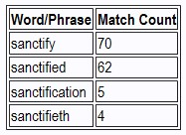
True Words Christian Church

Slide 4
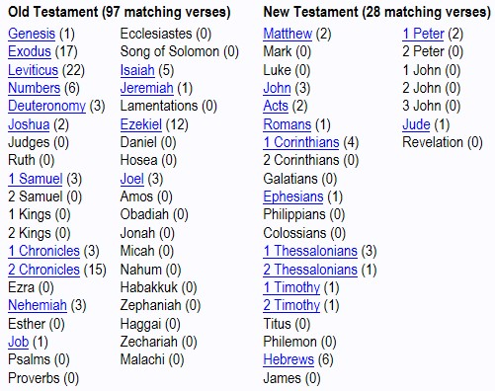
True Words Christian Church

Slide 5
1 Corinthians 1:30-31 But of him are ye in Christ Jesus, who of God is made unto us wisdom, and righteousness, and sanctification, and redemption: 31 That, according as it is written, He that glorieth, let him glory in the Lord.
True Words Christian Church

Slide 6
1 Corinthians 1:1-3 Paul, called to be an apostle of Jesus Christ through the will of God, and Sosthenes our brother, 2 Unto the church of God which is at Corinth, to them that are sanctified in Christ Jesus, called to be saints, with all that in every place call upon the name of Jesus Christ our Lord, both theirs and ours: 3 Grace be unto you, and peace, from God our Father, and from the Lord Jesus Christ.
True Words Christian Church

Slide 7
Ephesians 1:12-14 That we should be to the praise of his glory, who first trusted in Christ. 13 In whom ye also trusted, after that ye heard the word of truth, the gospel of your salvation: in whom also after that ye believed, ye were sealed with that holy Spirit of promise, 14 Which is the earnest of our inheritance until the redemption of the purchased possession, unto the praise of his glory.
True Words Christian Church

Slide 8
Ephesians 4:30 And grieve not the holy Spirit of God, whereby ye are sealed unto the day of redemption.
True Words Christian Church

Slide 9
2 Corinthians 1:21-22 Now he which stablisheth us with you in Christ, and hath anointed us, is God; 22 Who hath also sealed us, and given the earnest of the Spirit in our hearts.
True Words Christian Church

Slide 10
Galatians 3:1-4 O foolish Galatians, who hath bewitched you, that ye should not obey the truth, before whose eyes Jesus Christ hath been evidently set forth, crucified among you? 2 This only would I learn of you, Received ye the Spirit by the works of the law, or by the hearing of faith? 3 Are ye so foolish? having begun in the Spirit, are ye now made perfect by the flesh? 4 Have ye suffered so many things in vain? if it be yet in vain.
True Words Christian Church

Slide 11
Hebrews 10:12-14 But this man, after he had offered one sacrifice for sins for ever, sat down on the right hand of God; 13 From henceforth expecting till his enemies be made his footstool. 14 For by one offering he hath perfected for ever them that are sanctified.
True Words Christian Church

Slide 12
1 Corinthians 15:52 In a moment, in the twinkling of an eye, at the last trump: for the trumpet shall sound, and the dead shall be raised incorruptible, and we shall be changed.
True Words Christian Church

Slide 13
Romans 7:18-19 For I know that in me (that is, in my flesh,) dwelleth no good thing: for to will is present with me; but how to perform that which is good I find not. 19 For the good that I would I do not: but the evil which I would not, that I do.
True Words Christian Church

Slide 14
1 Thessalonians 4:3-4 For this is the will of God, even your sanctification, that ye should abstain from fornication: 4 That every one of you should know how to possess his vessel in sanctification and honour;
True Words Christian Church

Slide 15
2 Thessalonians 2:13-14 But we are bound to give thanks alway to God for you, brethren beloved of the Lord, because God hath from the beginning chosen you to salvation through sanctification of the Spirit and belief of the truth: 14 Whereunto he called you by our gospel, to the obtaining of the glory of our Lord Jesus Christ.
True Words Christian Church

Slide 16
1 Peter 1:2 Elect according to the foreknowledge of God the Father, through sanctification of the Spirit, unto obedience and sprinkling of the blood of Jesus Christ: Grace unto you, and peace, be multiplied.
True Words Christian Church

Slide 17
1 Peter 1:3-5 Blessed be the God and Father of our Lord Jesus Christ, which according to his abundant mercy hath begotten us again unto a lively hope by the resurrection of Jesus Christ from the dead, 4 To an inheritance incorruptible, and undefiled, and that fadeth not away, reserved in heaven for you, 5 Who are kept by the power of God through faith unto salvation ready to be revealed in the last time.
True Words Christian Church

Slide 18
Matthew 23:15-17 Woe unto you, scribes and Pharisees, hypocrites! for ye compass sea and land to make one proselyte, and when he is made, ye make him twofold more the child of hell than yourselves. 16 Woe unto you, ye blind guides, which say, Whosoever shall swear by the temple, it is nothing; but whosoever shall swear by the gold of the temple, he is a debtor! 17 Ye fools and blind: for whether is greater, the gold, or the temple that sanctifieth the gold?
True Words Christian Church

Slide 19
Matthew 23:19 Ye fools and blind: for whether is greater, the gift, or the altar that sanctifieth the gift?
True Words Christian Church

Slide 20
Hebrews 2:11-12 For both he that sanctifieth and they who are sanctified are all of one: for which cause he is not ashamed to call them brethren, 12 Saying, I will declare thy name unto my brethren, in the midst of the church will I sing praise unto thee.
True Words Christian Church

Slide 21
John 17:17-19 Sanctify them through thy truth: thy word is truth. 18 As thou hast sent me into the world, even so have I also sent them into the world. 19 And for their sakes I sanctify myself, that they also might be sanctified through the truth.
True Words Christian Church

Slide 22
Ephesians 5:26 That he might sanctify and cleanse it with the washing of water by the word,
True Words Christian Church

Slide 23
1 Thessalonians 5:23 And the very God of peace sanctify you wholly; and I pray God your whole spirit and soul and body be preserved blameless unto the coming of our Lord Jesus Christ.
True Words Christian Church

Slide 24
Hebrews 13:12 Wherefore Jesus also, that he might sanctify the people with his own blood, suffered without the gate.
True Words Christian Church

Slide 25
John 3:36 He that believeth on the Son hath everlasting life: and he that believeth not the Son shall not see life; but the wrath of God abideth on him.
True Words Christian Church

