Slide 2
SERMON TITLE
King Ahaziah 22 or 42 When He Began to Reign?

Slide 3
2 Kings 8:26 states that Ahaziah was 22 years old when he began his reign, and in 2 Chronicles 22:2 it states that he was 42 years old. Which one is it? I know there is a reconciling reason to his because I am a person who studies the KJV intently, but I just can’t find the bridge.
True Words Christian Church

Slide 4
True Words Christian Church

Slide 5
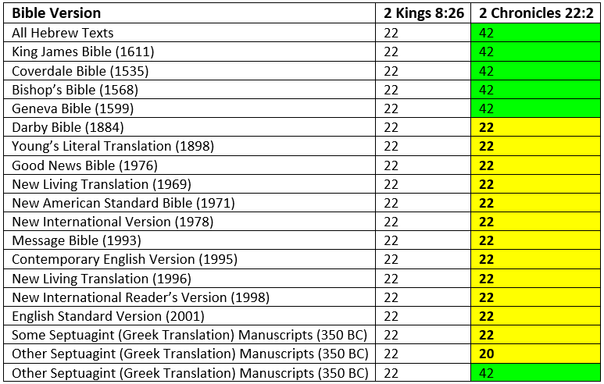
True Words Christian Church

Slide 6
2 Timothy 2:15 Study to shew thyself approved unto God, a workman that needeth not to be ashamed, rightly dividing the word of truth.
True Words Christian Church

Slide 7
2 Timothy 3:15 And that from a child thou hast known the holy scriptures, which are able to make thee wise unto salvation through faith which is in Christ Jesus.
True Words Christian Church

Slide 8
Genesis 3:1 Now the serpent was more subtil than any beast of the field which the LORD God had made. And he said unto the woman, Yea, hath God said, Ye shall not eat of every tree of the garden?
True Words Christian Church

Slide 9
1 Corinthians 1:19-20 For it is written, I will destroy the wisdom of the wise, and will bring to nothing the understanding of the prudent. 20 Where is the wise? where is the scribe? where is the disputer of this world? hath not God made foolish the wisdom of this world?
True Words Christian Church

Slide 10
1 Corinthians 3:19-20 For the wisdom of this world is foolishness with God. For it is written, He taketh the wise in their own craftiness. 20 And again, The Lord knoweth the thoughts of the wise, that they are vain.
True Words Christian Church

Slide 11
1 Kings 22:19-20 And he said, Hear thou therefore the word of the LORD: I saw the LORD sitting on his throne, and all the host of heaven standing by him on his right hand and on his left. 20 And the LORD said, Who shall persuade Ahab, that he may go up and fall at Ramoth-gilead? And one said on this manner, and another said on that manner.
True Words Christian Church

Slide 12
1 Kings 22:21-23 And there came forth a spirit, and stood before the LORD, and said, I will persuade him. 22 And the LORD said unto him, Wherewith? And he said, I will go forth, and I will be a lying spirit in the mouth of all his prophets. And he said, Thou shalt persuade him, and prevail also: go forth, and do so. 23 Now therefore, behold, the LORD hath put a lying spirit in the mouth of all these thy prophets, and the LORD hath spoken evil concerning thee.
True Words Christian Church

Slide 13
Proverbs 30:5-6 Every word of God is pure: he is a shield unto them that put their trust in him. 6 Add thou not unto his words, lest he reprove thee, and thou be found a liar.
True Words Christian Church

Slide 14
1 Timothy 6:20-21 O Timothy, keep that which is committed to thy trust, avoiding profane and vain babblings, and oppositions of science falsely so called: 21 Which some professing have erred concerning the faith. Grace be with thee. Amen.
True Words Christian Church

Slide 15
2 Kings 8:25-27 In the twelfth year of Joram the son of Ahab king of Israel did Ahaziah the son of Jehoram king of Judah begin to reign. 26 Two and twenty years old was Ahaziah when he began to reign; and he reigned one year in Jerusalem. And his mother's name was Athaliah, the daughter of Omri king of Israel. 27 And he walked in the way of the house of Ahab, and did evil in the sight of the LORD, as did the house of Ahab: for he was the son in law of the house of Ahab.
True Words Christian Church

Slide 16
1 Kings 14:7-8 Go, tell Jeroboam, Thus saith the LORD God of Israel, Forasmuch as I exalted thee from among the people, and made thee prince over my people Israel, 8 And rent the kingdom away from the house of David, and gave it thee: and yet thou hast not been as my servant David, who kept my commandments, and who followed me with all his heart, to do that only which was right in mine eyes;
True Words Christian Church

Slide 17
1 Kings 14:9-10 But hast done evil above all that were before thee: for thou hast gone and made thee other gods, and molten images, to provoke me to anger, and hast cast me behind thy back: 10 Therefore, behold, I will bring evil upon the house of Jeroboam, and will cut off from Jeroboam him that pisseth against the wall, and him that is shut up and left in Israel, and will take away the remnant of the house of Jeroboam, as a man taketh away dung, till it be all gone.
True Words Christian Church

Slide 18
1 Kings 14:11-13 Him that dieth of Jeroboam in the city shall the dogs eat; and him that dieth in the field shall the fowls of the air eat: for the LORD hath spoken it. 12 Arise thou therefore, get thee to thine own house: and when thy feet enter into the city, the child shall die. 13 And all Israel shall mourn for him, and bury him: for he only of Jeroboam shall come to the grave, because in him there is found some good thing toward the LORD God of Israel in the house of Jeroboam.
True Words Christian Church

Slide 19
2 Kings 9:7-10 And thou shalt smite the house of Ahab thy master, that I may avenge the blood of my servants the prophets, and the blood of all the servants of the LORD, at the hand of Jezebel. 8 For the whole house of Ahab shall perish: and I will cut off from Ahab him that pisseth against the wall, and him that is shut up and left in Israel: 9 And I will make the house of Ahab like the house of Jeroboam the son of Nebat, and like the house of Baasha the son of Ahijah: 10 And the dogs shall eat Jezebel in the portion of Jezreel, and there shall be none to bury her. And he opened the door, and fled.
True Words Christian Church

Slide 20
2 Kings 10:11 So Jehu slew all that remained of the house of Ahab in Jezreel, and all his great men, and his kinsfolks, and his priests, until he left him none remaining.
True Words Christian Church

Slide 21
2 Kings 11:1-2 And when Athaliah the mother of Ahaziah saw that her son was dead, she arose and destroyed all the seed royal. 2 But Jehosheba, the daughter of king Joram, sister of Ahaziah, took Joash the son of Ahaziah, and stole him from among the king's sons which were slain; and they hid him, even him and his nurse, in the bedchamber from Athaliah, so that he was not slain.
True Words Christian Church

Slide 22
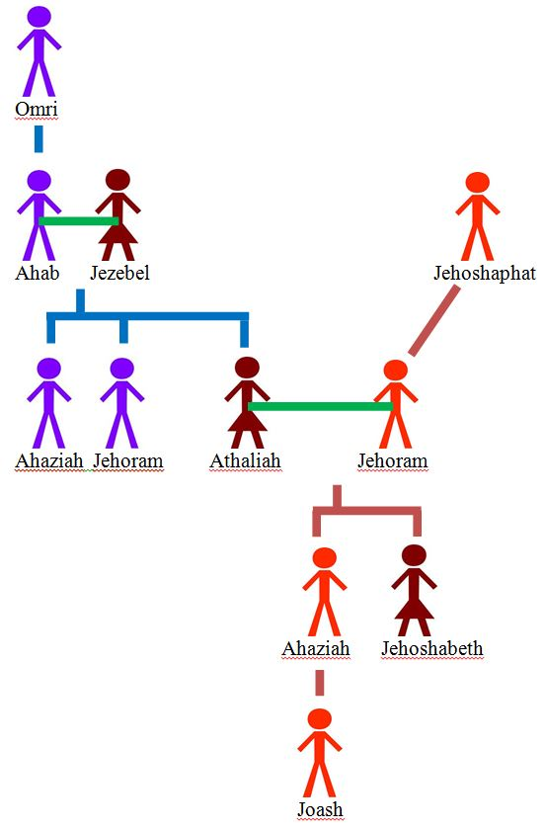
True Words Christian Church

Slide 23
2 Chronicles 21:19-20 And it came to pass, that in process of time, after the end of two years, his bowels fell out by reason of his sickness: so he died of sore diseases. And his people made no burning for him, like the burning of his fathers. 20 Thirty and two years old was he when he began to reign, and he reigned in Jerusalem eight years, and departed without being desired. Howbeit they buried him in the city of David, but not in the sepulchres of the kings.
True Words Christian Church

Slide 24
2 Chronicles 22:1-2 And the inhabitants of Jerusalem made Ahaziah his youngest son king in his stead: for the band of men that came with the Arabians to the camp had slain all the eldest. So Ahaziah the son of Jehoram king of Judah reigned. 2 Forty and two years old was Ahaziah when he began to reign, and he reigned one year in Jerusalem. His mother's name also was Athaliah the daughter of Omri.
True Words Christian Church

Slide 25
2 Chronicles 22:3-5 He also walked in the ways of the house of Ahab: for his mother was his counseller to do wickedly. 4 Wherefore he did evil in the sight of the LORD like the house of Ahab: for they were his counsellers after the death of his father to his destruction. 5 He walked also after their counsel, and went with Jehoram the son of Ahab king of Israel to war against Hazael king of Syria at Ramoth-gilead: and the Syrians smote Joram.
True Words Christian Church

Slide 26
2 Chronicles 22:7-8 And the destruction of Ahaziah was of God by coming to Joram: for when he was come, he went out with Jehoram against Jehu the son of Nimshi, whom the LORD had anointed to cut off the house of Ahab. 8 And it came to pass, that, when Jehu was executing judgment upon the house of Ahab, and found the princes of Judah, and the sons of the brethren of Ahaziah, that ministered to Ahaziah, he slew them.
True Words Christian Church

Slide 27
True Words Christian Church

Slide 28
2 Chronicles 18:1-2 Now Jehoshaphat had riches and honour in abundance, and joined affinity with Ahab. 2 And after certain years he went down to Ahab to Samaria. And Ahab killed sheep and oxen for him in abundance, and for the people that he had with him, and persuaded him to go up with him to Ramoth-gilead.
True Words Christian Church

Slide 29
2 Chronicles 19:1-2 And Jehoshaphat the king of Judah returned to his house in peace to Jerusalem. 2 And Jehu the son of Hanani the seer went out to meet him, and said to king Jehoshaphat, Shouldest thou help the ungodly, and love them that hate the LORD? therefore is wrath upon thee from before the LORD.
True Words Christian Church

Slide 30
Matthew 1:7-8 And Solomon begat Roboam; and Roboam begat Abia; and Abia begat Asa; 8 And Asa begat Josaphat; and Josaphat begat Joram; and Joram begat Ozias;
True Words Christian Church

Slide 31
2 Kings 15:12 This was the word of the LORD which he spake unto Jehu, saying, Thy sons shall sit on the throne of Israel unto the fourth generation. And so it came to pass.
True Words Christian Church

Slide 32
True Words Christian Church

Slide 33
True Words Christian Church

Slide 34
Matthew 1:11-12 And Josias begat Jechonias and his brethren, about the time they were carried away to Babylon: 12 And after they were brought to Babylon, Jechonias begat Salathiel; and Salathiel begat Zorobabel;
True Words Christian Church

Slide 35
2 Kings 24:8-9 Jehoiachin was eighteen years old when he began to reign, and he reigned in Jerusalem three months. And his mother's name was Nehushta, the daughter of Elnathan of Jerusalem. 9 And he did that which was evil in the sight of the LORD, according to all that his father had done.
True Words Christian Church

Slide 36
2 Chronicles 36:8-10 Now the rest of the acts of Jehoiakim, and his abominations which he did, and that which was found in him, behold, they are written in the book of the kings of Israel and Judah: and Jehoiachin his son reigned in his stead. 9 Jehoiachin was eight years old when he began to reign, and he reigned three months and ten days in Jerusalem: and he did that which was evil in the sight of the LORD. 10 And when the year was expired, king Nebuchadnezzar sent, and brought him to Babylon, with the goodly vessels of the house of the LORD, and made Zedekiah his brother king over Judah and Jerusalem.
True Words Christian Church

Slide 37
2 Kings 24:10-12 At that time the servants of Nebuchadnezzar king of Babylon came up against Jerusalem, and the city was besieged. 11 And Nebuchadnezzar king of Babylon came against the city, and his servants did besiege it. 12 And Jehoiachin the king of Judah went out to the king of Babylon, he, and his mother, and his servants, and his princes, and his officers: and the king of Babylon took him in the eighth year of his reign.
True Words Christian Church

Slide 38
Matthew 22:43-46 He saith unto them, How then doth David in spirit call him Lord, saying, 44 The LORD said unto my Lord, Sit thou on my right hand, till I make thine enemies thy footstool? 45 If David then call him Lord, how is he his son? 46 And no man was able to answer him a word, neither durst any man from that day forth ask him any more questions.
True Words Christian Church

