Slide 1
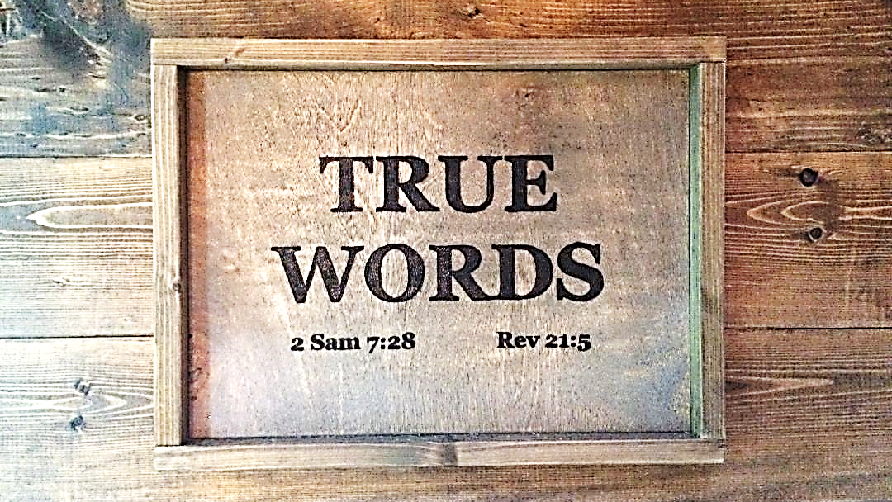

Slide 2
SERMON TITLE
Genesis Chapter 1

Slide 3
Genesis 1:1 In the beginning God created the heaven and the earth.
True Words Christian Church

Slide 4
Genesis 1:2-5 And the earth was without form, and void; and darkness was upon the face of the deep. And the Spirit of God moved upon the face of the waters. 3 And God said, Let there be light: and there was light. 4 And God saw the light, that it was good: and God divided the light from the darkness. 5 And God called the light Day, and the darkness he called Night. And the evening and the morning were the first day.
True Words Christian Church

Slide 5
Genesis 1:6-8 And God said, Let there be a firmament in the midst of the waters, and let it divide the waters from the waters. 7 And God made the firmament, and divided the waters which were under the firmament from the waters which were above the firmament: and it was so. 8 And God called the firmament Heaven. And the evening and the morning were the second day.
True Words Christian Church

Slide 6
Psalm 19:1 The heavens declare the glory of God; and the firmament sheweth his handywork.
True Words Christian Church

Slide 7
Psalm 148:4 Praise him, ye heavens of heavens, and ye waters that be above the heavens.
True Words Christian Church

Slide 8
Genesis 1:20 And God said, Let the waters bring forth abundantly the moving creature that hath life, and fowl that may fly above the earth in the open firmament of heaven.
True Words Christian Church

Slide 9
Genesis 1:14-15 And God said, Let there be lights in the firmament of the heaven to divide the day from the night; and let them be for signs, and for seasons, and for days, and years: 15 And let them be for lights in the firmament of the heaven to give light upon the earth: and it was so.
True Words Christian Church

Slide 10
2 Corinthians 12:1-4 It is not expedient for me doubtless to glory. I will come to visions and revelations of the Lord. 2 I knew a man in Christ above fourteen years ago, (whether in the body, I cannot tell; or whether out of the body, I cannot tell: God knoweth;) such an one caught up to the third heaven. 3 And I knew such a man, (whether in the body, or out of the body, I cannot tell: God knoweth;) 4 How that he was caught up into paradise, and heard unspeakable words, which it is not lawful for a man to utter.
True Words Christian Church

Slide 11
Revelation 2:7 He that hath an ear, let him hear what the Spirit saith unto the churches; To him that overcometh will I give to eat of the tree of life, which is in the midst of the paradise of God.
True Words Christian Church

Slide 12
Genesis 1:1 In the beginning God created the heaven and the earth.
True Words Christian Church

Slide 13
Genesis 1:6-7 And God said, Let there be a firmament in the midst of the waters, and let it divide the waters from the waters. 7 And God made the firmament, and divided the waters which were under the firmament from the waters which were above the firmament: and it was so.
True Words Christian Church

Slide 14
Genesis 1:2 And the earth was without form, and void; and darkness was upon the face of the deep. And the Spirit of God moved upon the face of the waters.
True Words Christian Church

Slide 15
Genesis 2:4 These are the generations of the heavens and of the earth when they were created, in the day that the LORD God made the earth and the heavens,
True Words Christian Church

Slide 16
Genesis 2:4-5 These are the generations of the heavens and of the earth when they were created, in the day that the LORD God made the earth and the heavens, 5 And every plant of the field before it was in the earth, and every herb of the field before it grew: for the LORD God had not caused it to rain upon the earth, and there was not a man to till the ground.
True Words Christian Church

Slide 17
Revelation 21:2 And I John saw the holy city, new Jerusalem, coming down from God out of heaven, prepared as a bride adorned for her husband.
True Words Christian Church

Slide 18
John 14:2 In my Father's house are many mansions: if it were not so, I would have told you. I go to prepare a place for you.
True Words Christian Church

Slide 19
Exodus 20:11 For in six days the LORD made heaven and earth, the sea, and all that in them is, and rested the seventh day: wherefore the LORD blessed the sabbath day, and hallowed it.
True Words Christian Church

Slide 20
Genesis 1:9-10 And God said, Let the waters under the heaven be gathered together unto one place, and let the dry land appear: and it was so. 10 And God called the dry land Earth; and the gathering together of the waters called he Seas: and God saw that it was good.
True Words Christian Church

Slide 21
Genesis 1:11-13 And God said, Let the earth bring forth grass, the herb yielding seed, and the fruit tree yielding fruit after his kind, whose seed is in itself, upon the earth: and it was so. 12 And the earth brought forth grass, and herb yielding seed after his kind, and the tree yielding fruit, whose seed was in itself, after his kind: and God saw that it was good. 13 And the evening and the morning were the third day.
True Words Christian Church

Slide 22
Genesis 1:14-15 And God said, Let there be lights in the firmament of the heaven to divide the day from the night; and let them be for signs, and for seasons, and for days, and years: 15 And let them be for lights in the firmament of the heaven to give light upon the earth: and it was so.
True Words Christian Church

Slide 23
Genesis 1:16-19 And God made two great lights; the greater light to rule the day, and the lesser light to rule the night: he made the stars also. 17 And God set them in the firmament of the heaven to give light upon the earth, 18 And to rule over the day and over the night, and to divide the light from the darkness: and God saw that it was good. 19 And the evening and the morning were the fourth day.
True Words Christian Church

Slide 24
Revelation 21:22-23 And I saw no temple therein: for the Lord God Almighty and the Lamb are the temple of it. 23 And the city had no need of the sun, neither of the moon, to shine in it: for the glory of God did lighten it, and the Lamb is the light thereof.
True Words Christian Church

Slide 25
1 John 1:5 This then is the message which we have heard of him, and declare unto you, that God is light, and in him is no darkness at all.
True Words Christian Church

Slide 26
Genesis 1:20-21 And God said, Let the waters bring forth abundantly the moving creature that hath life, and fowl that may fly above the earth in the open firmament of heaven. 21 And God created great whales, and every living creature that moveth, which the waters brought forth abundantly, after their kind, and every winged fowl after his kind: and God saw that it was good.
True Words Christian Church

Slide 27
Genesis 1:22-23 And God blessed them, saying, Be fruitful, and multiply, and fill the waters in the seas, and let fowl multiply in the earth. 23 And the evening and the morning were the fifth day.
True Words Christian Church

Slide 28
Genesis 1:24-25 And God said, Let the earth bring forth the living creature after his kind, cattle, and creeping thing, and beast of the earth after his kind: and it was so. 25 And God made the beast of the earth after his kind, and cattle after their kind, and every thing that creepeth upon the earth after his kind: and God saw that it was good.
True Words Christian Church

Slide 29
Genesis 1:26 And God said, Let us make man in our image, after our likeness: and let them have dominion over the fish of the sea, and over the fowl of the air, and over the cattle, and over all the earth, and over every creeping thing that creepeth upon the earth.
True Words Christian Church

Slide 30
1 John 5:7 For there are three that bear record in heaven, the Father, the Word, and the Holy Ghost: and these three are one.
True Words Christian Church

Slide 31
John 17:5 And now, O Father, glorify thou me with thine own self with the glory which I had with thee before the world was.
True Words Christian Church

Slide 32
John 5:31-32 If I bear witness of myself, my witness is not true. 32 There is another that beareth witness of me; and I know that the witness which he witnesseth of me is true.
True Words Christian Church

Slide 33
Matthew 26:39 And he went a little further, and fell on his face, and prayed, saying, O my Father, if it be possible, let this cup pass from me: nevertheless not as I will, but as thou wilt.
True Words Christian Church

Slide 34
John 1:1-3 In the beginning was the Word, and the Word was with God, and the Word was God. 2 The same was in the beginning with God. 3 All things were made by him; and without him was not any thing made that was made.
True Words Christian Church

Slide 35
John 6:46 Not that any man hath seen the Father, save he which is of God, he hath seen the Father.
True Words Christian Church

Slide 36
John 10:30 I and my Father are one.
True Words Christian Church

Slide 37
Genesis 1:26 And God said, Let us make man in our image, after our likeness: and let them have dominion over the fish of the sea, and over the fowl of the air, and over the cattle, and over all the earth, and over every creeping thing that creepeth upon the earth.
True Words Christian Church

Slide 38
Genesis 3:21 Unto Adam also and to his wife did the LORD God make coats of skins, and clothed them.
True Words Christian Church

Slide 39
True Words Christian Church

Slide 40
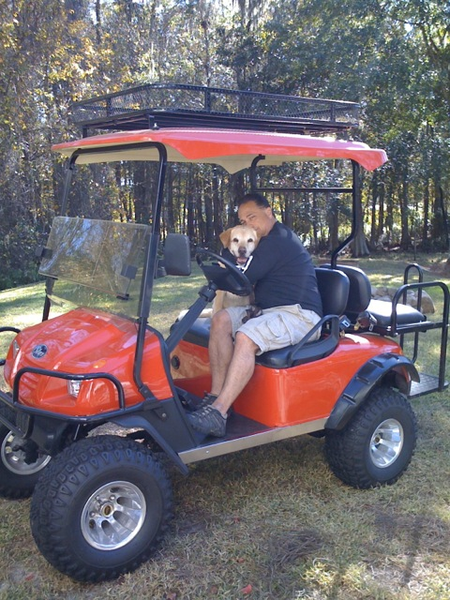
True Words Christian Church

Slide 41
Proverbs 30:30 A lion which is strongest among beasts, and turneth not away for any;
True Words Christian Church

Slide 42
1 Samuel 17:34-36 And David said unto Saul, Thy servant kept his father's sheep, and there came a lion, and a bear, and took a lamb out of the flock: 35 And I went out after him, and smote him, and delivered it out of his mouth: and when he arose against me, I caught him by his beard, and smote him, and slew him. 36 Thy servant slew both the lion and the bear: and this uncircumcised Philistine shall be as one of them, seeing he hath defied the armies of the living God.
True Words Christian Church

Slide 43
Genesis 1:27 So God created man in his own image, in the image of God created he him; male and female created he them.
True Words Christian Church

Slide 44
Genesis 1:28 And God blessed them, and God said unto them, Be fruitful, and multiply, and replenish the earth, and subdue it: and have dominion over the fish of the sea, and over the fowl of the air, and over every living thing that moveth upon the earth.
True Words Christian Church

Slide 45
Genesis 1:29 And God said, Behold, I have given you every herb bearing seed, which is upon the face of all the earth, and every tree, in the which is the fruit of a tree yielding seed; to you it shall be for meat.
True Words Christian Church

Slide 46
Genesis 1:30 And to every beast of the earth, and to every fowl of the air, and to every thing that creepeth upon the earth, wherein there is life, I have given every green herb for meat: and it was so.
True Words Christian Church

Slide 47
Genesis 1:31 And God saw every thing that he had made, and, behold, it was very good. And the evening and the morning were the sixth day.
True Words Christian Church

Slide 48
Psalm 19:1 The heavens declare the glory of God; and the firmament sheweth his handywork.
True Words Christian Church

Slide 49
Psalm 97:6 The heavens declare his righteousness, and all the people see his glory.
True Words Christian Church

