Slide 2
SERMON TITLE
Day of the Lord
vs.
Day of Christ

Slide 3
2 Thessalonians 2:1-2 Now we beseech you, brethren, by the coming of our Lord Jesus Christ, and by our gathering together unto him, 2 That ye be not soon shaken in mind, or be troubled, neither by spirit, nor by word, nor by letter as from us, as that the day of Christ is at hand.
True Words Christian Church

Slide 4
Acts 2:19-20 And I will shew wonders in heaven above, and signs in the earth beneath; blood, and fire, and vapour of smoke: 20 The sun shall be turned into darkness, and the moon into blood, before that great and notable day of the Lord come:
True Words Christian Church

Slide 5
Matthew 24:29-31 Immediately after the tribulation of those days shall the sun be darkened, and the moon shall not give her light, and the stars shall fall from heaven, and the powers of the heavens shall be shaken: 30 And then shall appear the sign of the Son of man in heaven: and then shall all the tribes of the earth mourn, and they shall see the Son of man coming in the clouds of heaven with power and great glory. 31 And he shall send his angels with a great sound of a trumpet, and they shall gather together his elect from the four winds, from one end of heaven to the other.
True Words Christian Church

Slide 6
Revelation 6:12-14 And I beheld when he had opened the sixth seal, and, lo, there was a great earthquake; and the sun became black as sackcloth of hair, and the moon became as blood; 13 And the stars of heaven fell unto the earth, even as a fig tree casteth her untimely figs, when she is shaken of a mighty wind. 14 And the heaven departed as a scroll when it is rolled together; and every mountain and island were moved out of their places.
True Words Christian Church

Slide 7
Revelation 6:15-17 And the kings of the earth, and the great men, and the rich men, and the chief captains, and the mighty men, and every bondman, and every free man, hid themselves in the dens and in the rocks of the mountains; 16 And said to the mountains and rocks, Fall on us, and hide us from the face of him that sitteth on the throne, and from the wrath of the Lamb: 17 For the great day of his wrath is come; and who shall be able to stand?
True Words Christian Church

Slide 8
Revelation 7:13-14 And one of the elders answered, saying unto me, What are these which are arrayed in white robes? and whence came they? 14 And I said unto him, Sir, thou knowest. And he said to me, These are they which came out of great tribulation, and have washed their robes, and made them white in the blood of the Lamb.
True Words Christian Church

Slide 9
Revelation 14:14-16 And I looked, and behold a white cloud, and upon the cloud one sat like unto the Son of man, having on his head a golden crown, and in his hand a sharp sickle. 15 And another angel came out of the temple, crying with a loud voice to him that sat on the cloud, Thrust in thy sickle, and reap: for the time is come for thee to reap; for the harvest of the earth is ripe. 16 And he that sat on the cloud thrust in his sickle on the earth; and the earth was reaped.
True Words Christian Church

Slide 10
Revelation 14:17-18 And another angel came out of the temple which is in heaven, he also having a sharp sickle. 18 And another angel came out from the altar, which had power over fire; and cried with a loud cry to him that had the sharp sickle, saying, Thrust in thy sharp sickle, and gather the clusters of the vine of the earth; for her grapes are fully ripe.
True Words Christian Church

Slide 11
Revelation 14:19-20 And the angel thrust in his sickle into the earth, and gathered the vine of the earth, and cast it into the great winepress of the wrath of God. 20 And the winepress was trodden without the city, and blood came out of the winepress, even unto the horse bridles, by the space of a thousand and six hundred furlongs.
True Words Christian Church

Slide 12
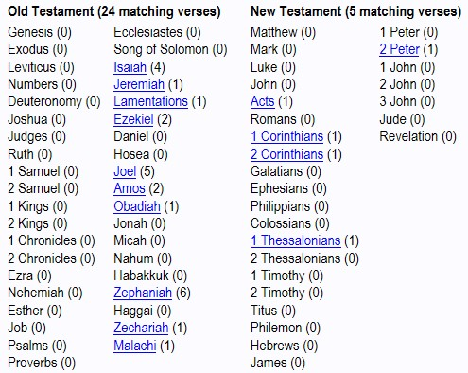
True Words Christian Church

Slide 13
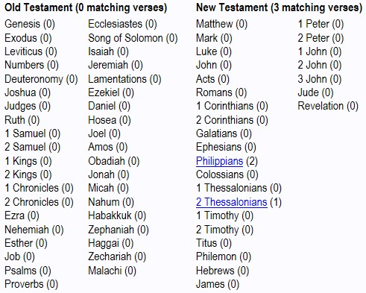
True Words Christian Church

Slide 14
Philippians 1:9-11 And this I pray, that your love may abound yet more and more in knowledge and in all judgment; 10 That ye may approve things that are excellent; that ye may be sincere and without offence till the day of Christ; 11 Being filled with the fruits of righteousness, which are by Jesus Christ, unto the glory and praise of God.
True Words Christian Church

Slide 15
Philippians 2:14-16 Do all things without murmurings and disputings: 15 That ye may be blameless and harmless, the sons of God, without rebuke, in the midst of a crooked and perverse nation, among whom ye shine as lights in the world; 16 Holding forth the word of life; that I may rejoice in the day of Christ, that I have not run in vain, neither laboured in vain.
True Words Christian Church

Slide 16
2 Thessalonians 2:1-2 Now we beseech you, brethren, by the coming of our Lord Jesus Christ, and by our gathering together unto him, 2 That ye be not soon shaken in mind, or be troubled, neither by spirit, nor by word, nor by letter as from us, as that the day of Christ is at hand.
True Words Christian Church

Slide 17
2 Thessalonians 2:3-4 Let no man deceive you by any means: for that day shall not come, except there come a falling away first, and that man of sin be revealed, the son of perdition; 4 Who opposeth and exalteth himself above all that is called God, or that is worshipped; so that he as God sitteth in the temple of God, shewing himself that he is God.
True Words Christian Church

Slide 18
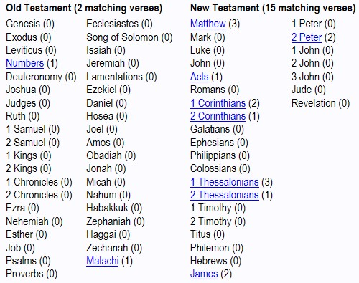
True Words Christian Church

Slide 19
Matthew 24:26-28 Wherefore if they shall say unto you, Behold, he is in the desert; go not forth: behold, he is in the secret chambers; believe it not. 27 For as the lightning cometh out of the east, and shineth even unto the west; so shall also the coming of the Son of man be. 28 For wheresoever the carcase is, there will the eagles be gathered together.
True Words Christian Church

Slide 20
Matthew 24:36-39 But of that day and hour knoweth no man, no, not the angels of heaven, but my Father only. 37 But as the days of Noe were, so shall also the coming of the Son of man be. 38 For as in the days that were before the flood they were eating and drinking, marrying and giving in marriage, until the day that Noe entered into the ark, 39 And knew not until the flood came, and took them all away; so shall also the coming of the Son of man be.
True Words Christian Church

Slide 21
1 Thessalonians 4:15-16 For this we say unto you by the word of the Lord, that we which are alive and remain unto the coming of the Lord shall not prevent them which are asleep. 16 For the Lord himself shall descend from heaven with a shout, with the voice of the archangel, and with the trump of God: and the dead in Christ shall rise first:
True Words Christian Church

Slide 22
1 Thessalonians 4:17-18 Then we which are alive and remain shall be caught up together with them in the clouds, to meet the Lord in the air: and so shall we ever be with the Lord. 18 Wherefore comfort one another with these words.
True Words Christian Church

Slide 23
1 Thessalonians 5:1-2 But of the times and the seasons, brethren, ye have no need that I write unto you. 2 For yourselves know perfectly that the day of the Lord so cometh as a thief in the night.
True Words Christian Church

Slide 24
1 Thessalonians 5:3-5 For when they shall say, Peace and safety; then sudden destruction cometh upon them, as travail upon a woman with child; and they shall not escape. 4 But ye, brethren, are not in darkness, that that day should overtake you as a thief. 5 Ye are all the children of light, and the children of the day: we are not of the night, nor of darkness.
True Words Christian Church

Slide 25
Acts 1:9-11 And when he had spoken these things, while they beheld, he was taken up; and a cloud received him out of their sight. 10 And while they looked stedfastly toward heaven as he went up, behold, two men stood by them in white apparel; 11 Which also said, Ye men of Galilee, why stand ye gazing up into heaven? this same Jesus, which is taken up from you into heaven, shall so come in like manner as ye have seen him go into heaven.
True Words Christian Church

Slide 26
Revelation 1:7 Behold, he cometh with clouds; and every eye shall see him, and they also which pierced him: and all kindreds of the earth shall wail because of him. Even so, Amen.
True Words Christian Church

Slide 27
1 Thessalonians 5:6-8 Therefore let us not sleep, as do others; but let us watch and be sober. 7 For they that sleep sleep in the night; and they that be drunken are drunken in the night. 8 But let us, who are of the day, be sober, putting on the breastplate of faith and love; and for an helmet, the hope of salvation.
True Words Christian Church

Slide 28
2 Peter 3:10-13 But the day of the Lord will come as a thief in the night; in the which the heavens shall pass away with a great noise, and the elements shall melt with fervent heat, the earth also and the works that are therein shall be burned up. 11 Seeing then that all these things shall be dissolved, what manner of persons ought ye to be in all holy conversation and godliness, 12 Looking for and hasting unto the coming of the day of God, wherein the heavens being on fire shall be dissolved, and the elements shall melt with fervent heat? 13 Nevertheless we, according to his promise, look for new heavens and a new earth, wherein dwelleth righteousness.
True Words Christian Church

Slide 29
Revelation 16:12-16 And the sixth angel poured out his vial upon the great river Euphrates; and the water thereof was dried up, that the way of the kings of the east might be prepared. 13 And I saw three unclean spirits like frogs come out of the mouth of the dragon, and out of the mouth of the beast, and out of the mouth of the false prophet. 14 For they are the spirits of devils, working miracles, which go forth unto the kings of the earth and of the whole world, to gather them to the battle of that great day of God Almighty. 15 Behold, I come as a thief. Blessed is he that watcheth, and keepeth his garments, lest he walk naked, and they see his shame. 16 And he gathered them together into a place called in the Hebrew tongue Armageddon.
True Words Christian Church

