Slide 2
SERMON TITLE
Lessons From
Absalom

Slide 3
2 Samuel 5:13 And David took him more concubines and wives out of Jerusalem, after he was come from Hebron: and there were yet sons and daughters born to David.
True Words Christian Church

Slide 4
2 Samuel 13:1 And it came to pass after this, that Absalom the son of David had a fair sister, whose name was Tamar; and Amnon the son of David loved her.
True Words Christian Church

Slide 5
2 Samuel 3:2 And unto David were sons born in Hebron: and his firstborn was Amnon, of Ahinoam the Jezreelitess;
True Words Christian Church

Slide 6
2 Samuel 13:2 And Amnon was so vexed, that he fell sick for his sister Tamar; for she was a virgin; and Amnon thought it hard for him to do any thing to her.
True Words Christian Church

Slide 7
2 Samuel 13:3-4 But Amnon had a friend, whose name was Jonadab, the son of Shimeah David's brother: and Jonadab was a very subtil man. 4 And he said unto him, Why art thou, being the king's son, lean from day to day? wilt thou not tell me? And Amnon said unto him, I love Tamar, my brother Absalom's sister.
True Words Christian Church

Slide 8
2 Samuel 13:11-12 And when she had brought them unto him to eat, he took hold of her, and said unto her, Come lie with me, my sister. 12 And she answered him, Nay, my brother, do not force me; for no such thing ought to be done in Israel: do not thou this folly.
True Words Christian Church

Slide 9
2 Samuel 13:15 Then Amnon hated her exceedingly; so that the hatred wherewith he hated her was greater than the love wherewith he had loved her. And Amnon said unto her, Arise, be gone.
True Words Christian Church

Slide 10
2 Samuel 13:21 But when king David heard of all these things, he was very wroth.
True Words Christian Church

Slide 11
2 Samuel 13:22 And Absalom spake unto his brother Amnon neither good nor bad: for Absalom hated Amnon, because he had forced his sister Tamar.
True Words Christian Church

Slide 12
Psalm 11:5 The LORD trieth the righteous: but the wicked and him that loveth violence his soul hateth.
True Words Christian Church

Slide 13
2 Samuel 13:23 And it came to pass after two full years, that Absalom had sheepshearers in Baal-hazor, which is beside Ephraim: and Absalom invited all the king's sons.
True Words Christian Church

Slide 14
Deuteronomy 22:25-27 But if a man find a betrothed damsel in the field, and the man force her, and lie with her: then the man only that lay with her shall die: 26 But unto the damsel thou shalt do nothing; there is in the damsel no sin worthy of death: for as when a man riseth against his neighbour, and slayeth him, even so is this matter: 27 For he found her in the field, and the betrothed damsel cried, and there was none to save her.
True Words Christian Church

Slide 15
2 Samuel 13:26-27 Then said Absalom, If not, I pray thee, let my brother Amnon go with us. And the king said unto him, Why should he go with thee? 27 But Absalom pressed him, that he let Amnon and all the king's sons go with him.
True Words Christian Church

Slide 16
2 Samuel 13:28-29 Now Absalom had commanded his servants, saying, Mark ye now when Amnon's heart is merry with wine, and when I say unto you, Smite Amnon; then kill him, fear not: have not I commanded you? be courageous, and be valiant. 29 And the servants of Absalom did unto Amnon as Absalom had commanded. Then all the king's sons arose, and every man gat him up upon his mule, and fled.
True Words Christian Church

Slide 17
2 Samuel 13:32 And Jonadab, the son of Shimeah David's brother, answered and said, Let not my lord suppose that they have slain all the young men the king's sons; for Amnon only is dead: for by the appointment of Absalom this hath been determined from the day that he forced his sister Tamar.
True Words Christian Church

Slide 18
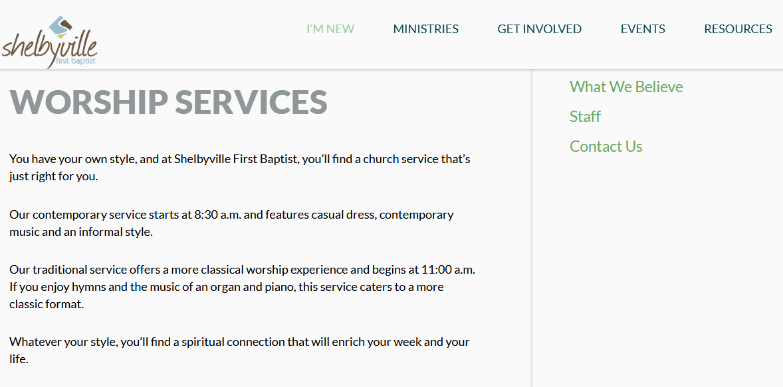
True Words Christian Church

Slide 19
2 Samuel 13:39 And the soul of king David longed to go forth unto Absalom: for he was comforted concerning Amnon, seeing he was dead.
True Words Christian Church

Slide 20
2 Samuel 14:21 And the king said unto Joab, Behold now, I have done this thing: go therefore, bring the young man Absalom again.
True Words Christian Church

Slide 21
2 Samuel 12:1-4 And the LORD sent Nathan unto David. And he came unto him, and said unto him, There were two men in one city; the one rich, and the other poor. 2 The rich man had exceeding many flocks and herds: 3 But the poor man had nothing, save one little ewe lamb, which he had bought and nourished up: and it grew up together with him, and with his children; it did eat of his own meat, and drank of his own cup, and lay in his bosom, and was unto him as a daughter. 4 And there came a traveller unto the rich man, and he spared to take of his own flock and of his own herd, to dress for the wayfaring man that was come unto him; but took the poor man's lamb, and dressed it for the man that was come to him.
True Words Christian Church

Slide 22
2 Samuel 12:5-6 And David's anger was greatly kindled against the man; and he said to Nathan, As the LORD liveth, the man that hath done this thing shall surely die: 6 And he shall restore the lamb fourfold, because he did this thing, and because he had no pity.
True Words Christian Church

Slide 23
2 Samuel 12:7 And Nathan said to David, Thou art the man. Thus saith the LORD God of Israel, I anointed thee king over Israel, and I delivered thee out of the hand of Saul;
True Words Christian Church

Slide 24
2 Samuel 12:11-12 Thus saith the LORD, Behold, I will raise up evil against thee out of thine own house, and I will take thy wives before thine eyes, and give them unto thy neighbour, and he shall lie with thy wives in the sight of this sun. 12 For thou didst it secretly: but I will do this thing before all Israel, and before the sun.
True Words Christian Church

Slide 25
2 Samuel 12:13 And David said unto Nathan, I have sinned against the LORD. And Nathan said unto David, The LORD also hath put away thy sin; thou shalt not die.
True Words Christian Church

Slide 26
2 Samuel 14:23-24 So Joab arose and went to Geshur, and brought Absalom to Jerusalem. 24 And the king said, Let him turn to his own house, and let him not see my face. So Absalom returned to his own house, and saw not the king's face.
True Words Christian Church

Slide 27
2 Samuel 14:25-26 But in all Israel there was none to be so much praised as Absalom for his beauty: from the sole of his foot even to the crown of his head there was no blemish in him. 26 And when he polled his head, (for it was at every year's end that he polled it: because the hair was heavy on him, therefore he polled it:) he weighed the hair of his head at two hundred shekels after the king's weight.
True Words Christian Church

Slide 28
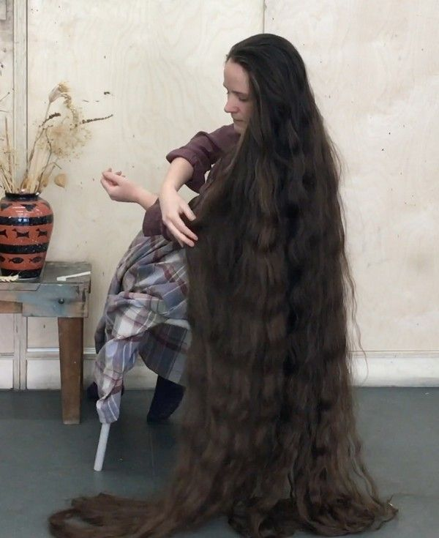
True Words Christian Church

Slide 29
2 Samuel 14:27 And unto Absalom there were born three sons, and one daughter, whose name was Tamar: she was a woman of a fair countenance.
True Words Christian Church

Slide 30
2 Samuel 14:28-29 So Absalom dwelt two full years in Jerusalem, and saw not the king's face. 29 Therefore Absalom sent for Joab, to have sent him to the king; but he would not come to him: and when he sent again the second time, he would not come.
True Words Christian Church

Slide 31
2 Samuel 14:30-31 Therefore he said unto his servants, See, Joab's field is near mine, and he hath barley there; go and set it on fire. And Absalom's servants set the field on fire. 31 Then Joab arose, and came to Absalom unto his house, and said unto him, Wherefore have thy servants set my field on fire?
True Words Christian Church

Slide 32
1 Corinthians 11:14 Doth not even nature itself teach you, that, if a man have long hair, it is a shame unto him?
True Words Christian Church

Slide 33
2 Samuel 14:33 So Joab came to the king, and told him: and when he had called for Absalom, he came to the king, and bowed himself on his face to the ground before the king: and the king kissed Absalom.
True Words Christian Church

Slide 34
2 Samuel 15:1 And it came to pass after this, that Absalom prepared him chariots and horses, and fifty men to run before him.
True Words Christian Church

Slide 35
2 Samuel 15:2 And Absalom rose up early, and stood beside the way of the gate: and it was so, that when any man that had a controversy came to the king for judgment, then Absalom called unto him, and said, Of what city art thou? And he said, Thy servant is of one of the tribes of Israel.
True Words Christian Church

Slide 36
2 Samuel 15:5-6 And it was so, that when any man came nigh to him to do him obeisance, he put forth his hand, and took him, and kissed him. 6 And on this manner did Absalom to all Israel that came to the king for judgment: so Absalom stole the hearts of the men of Israel.
True Words Christian Church

Slide 37
2 Samuel 15:7 And it came to pass after forty years, that Absalom said unto the king, I pray thee, let me go and pay my vow, which I have vowed unto the LORD, in Hebron.
True Words Christian Church

Slide 38
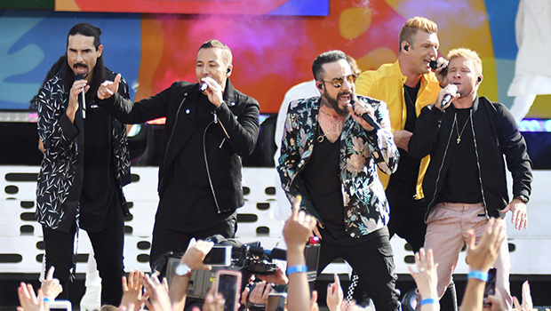
True Words Christian Church

Slide 39
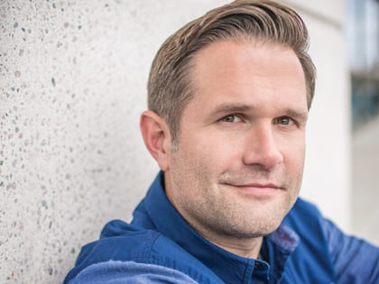
True Words Christian Church

Slide 40
2 Samuel 15:14 And David said unto all his servants that were with him at Jerusalem, Arise, and let us flee; for we shall not else escape from Absalom: make speed to depart, lest he overtake us suddenly, and bring evil upon us, and smite the city with the edge of the sword.
True Words Christian Church

Slide 41
2 Samuel 15:15-16 And the king's servants said unto the king, Behold, thy servants are ready to do whatsoever my lord the king shall appoint. 16 And the king went forth, and all his household after him. And the king left ten women, which were concubines, to keep the house.
True Words Christian Church

Slide 42
2 Samuel 16:21-22 And Ahithophel said unto Absalom, Go in unto thy father's concubines, which he hath left to keep the house; and all Israel shall hear that thou art abhorred of thy father: then shall the hands of all that are with thee be strong. 22 So they spread Absalom a tent upon the top of the house; and Absalom went in unto his father's concubines in the sight of all Israel.
True Words Christian Church

Slide 43
2 Samuel 18:5 And the king commanded Joab and Abishai and Ittai, saying, Deal gently for my sake with the young man, even with Absalom. And all the people heard when the king gave all the captains charge concerning Absalom.
True Words Christian Church

Slide 44
2 Samuel 18:6-7 So the people went out into the field against Israel: and the battle was in the wood of Ephraim; 7 Where the people of Israel were slain before the servants of David, and there was there a great slaughter that day of twenty thousand men.
True Words Christian Church

Slide 45
2 Samuel 18:8 For the battle was there scattered over the face of all the country: and the wood devoured more people that day than the sword devoured.
True Words Christian Church

Slide 46
2 Samuel 18:9 And Absalom met the servants of David. And Absalom rode upon a mule, and the mule went under the thick boughs of a great oak, and his head caught hold of the oak, and he was taken up between the heaven and the earth; and the mule that was under him went away.
True Words Christian Church

Slide 47
2 Samuel 18:10-11 And a certain man saw it, and told Joab, and said, Behold, I saw Absalom hanged in an oak. 11 And Joab said unto the man that told him, And, behold, thou sawest him, and why didst thou not smite him there to the ground? and I would have given thee ten shekels of silver, and a girdle.
True Words Christian Church

Slide 48
2 Samuel 18:12-13 And the man said unto Joab, Though I should receive a thousand shekels of silver in mine hand, yet would I not put forth mine hand against the king's son: for in our hearing the king charged thee and Abishai and Ittai, saying, Beware that none touch the young man Absalom. 13 Otherwise I should have wrought falsehood against mine own life: for there is no matter hid from the king, and thou thyself wouldest have set thyself against me.
True Words Christian Church

Slide 49
2 Samuel 18:14-17 Then said Joab, I may not tarry thus with thee. And he took three darts in his hand, and thrust them through the heart of Absalom, while he was yet alive in the midst of the oak. 15 And ten young men that bare Joab's armour compassed about and smote Absalom, and slew him. 16 And Joab blew the trumpet, and the people returned from pursuing after Israel: for Joab held back the people. 17 And they took Absalom, and cast him into a great pit in the wood, and laid a very great heap of stones upon him: and all Israel fled every one to his tent.
True Words Christian Church

Slide 50
2 Samuel 18:31-32 And, behold, Cushi came; and Cushi said, Tidings, my lord the king: for the LORD hath avenged thee this day of all them that rose up against thee. 32 And the king said unto Cushi, Is the young man Absalom safe? And Cushi answered, The enemies of my lord the king, and all that rise against thee to do thee hurt, be as that young man is.
True Words Christian Church

Slide 51
2 Samuel 18:33 And the king was much moved, and went up to the chamber over the gate, and wept: and as he went, thus he said, O my son Absalom, my son, my son Absalom! would God I had died for thee, O Absalom, my son, my son!
True Words Christian Church

Slide 52
Leviticus 20:13 If a man also lie with mankind, as he lieth with a woman, both of them have committed an abomination: they shall surely be put to death; their blood shall be upon them.
True Words Christian Church

Slide 53
Proverbs 23:13-14 Withhold not correction from the child: for if thou beatest him with the rod, he shall not die. 14 Thou shalt beat him with the rod, and shalt deliver his soul from hell.
True Words Christian Church

Slide 54
1 John 2:5 But whoso keepeth his word, in him verily is the love of God perfected: hereby know we that we are in him.
True Words Christian Church

Slide 55
1 John 3:16 Hereby perceive we the love of God, because he laid down his life for us: and we ought to lay down our lives for the brethren.
True Words Christian Church

