Slide 2
SERMON TITLE
Daniel Chapter 2

Slide 3
Daniel 2:4 Then spake the Chaldeans to the king in Syriack, O king, live for ever: tell thy servants the dream, and we will shew the interpretation.
True Words Christian Church

Slide 4
Daniel 7:28 Hitherto is the end of the matter. As for me Daniel, my cogitations much troubled me, and my countenance changed in me: but I kept the matter in my heart.
True Words Christian Church

Slide 5
Ezra 4:7 And in the days of Artaxerxes wrote Bishlam, Mithredath, Tabeel, and the rest of their companions, unto Artaxerxes king of Persia; and the writing of the letter was written in the Syrian tongue, and interpreted in the Syrian tongue.
True Words Christian Church

Slide 6
Daniel 2:1 And in the second year of the reign of Nebuchadnezzar Nebuchadnezzar dreamed dreams, wherewith his spirit was troubled, and his sleep brake from him.
True Words Christian Church

Slide 7
Daniel 2:2-3 Then the king commanded to call the magicians, and the astrologers, and the sorcerers, and the Chaldeans, for to shew the king his dreams. So they came and stood before the king. 3 And the king said unto them, I have dreamed a dream, and my spirit was troubled to know the dream.
True Words Christian Church

Slide 8
Daniel 2:4 Then spake the Chaldeans to the king in Syriack, O king, live for ever: tell thy servants the dream, and we will shew the interpretation.
True Words Christian Church

Slide 9
Daniel 2:5-6 The king answered and said to the Chaldeans, The thing is gone from me: if ye will not make known unto me the dream, with the interpretation thereof, ye shall be cut in pieces, and your houses shall be made a dunghill. 6 But if ye shew the dream, and the interpretation thereof, ye shall receive of me gifts and rewards and great honour: therefore shew me the dream, and the interpretation thereof.
True Words Christian Church

Slide 10
Daniel 2:7-8 They answered again and said, Let the king tell his servants the dream, and we will shew the interpretation of it. 8 The king answered and said, I know of certainty that ye would gain the time, because ye see the thing is gone from me.
True Words Christian Church

Slide 11
Daniel 2:9-11 But if ye will not make known unto me the dream, there is but one decree for you: for ye have prepared lying and corrupt words to speak before me, till the time be changed: therefore tell me the dream, and I shall know that ye can shew me the interpretation thereof. 10 The Chaldeans answered before the king, and said, There is not a man upon the earth that can shew the king's matter: therefore there is no king, lord, nor ruler, that asked such things at any magician, or astrologer, or Chaldean. 11 And it is a rare thing that the king requireth, and there is none other that can shew it before the king, except the gods, whose dwelling is not with flesh.
True Words Christian Church

Slide 12
Daniel 2:12-13 For this cause the king was angry and very furious, and commanded to destroy all the wise men of Babylon. 13 And the decree went forth that the wise men should be slain; and they sought Daniel and his fellows to be slain.
True Words Christian Church

Slide 13
Daniel 2:14-15 Then Daniel answered with counsel and wisdom to Arioch the captain of the king's guard, which was gone forth to slay the wise men of Babylon: 15 He answered and said to Arioch the king's captain, Why is the decree so hasty from the king? Then Arioch made the thing known to Daniel.
True Words Christian Church

Slide 14
Daniel 2:16 Then Daniel went in, and desired of the king that he would give him time, and that he would shew the king the interpretation.
True Words Christian Church

Slide 15
Daniel 2:17-18 Then Daniel went to his house, and made the thing known to Hananiah, Mishael, and Azariah, his companions: 18 That they would desire mercies of the God of heaven concerning this secret; that Daniel and his fellows should not perish with the rest of the wise men of Babylon.
True Words Christian Church

Slide 16
Daniel 2:19 Then was the secret revealed unto Daniel in a night vision. Then Daniel blessed the God of heaven.
True Words Christian Church

Slide 17
Daniel 2:20-23 Daniel answered and said, Blessed be the name of God for ever and ever: for wisdom and might are his: 21 And he changeth the times and the seasons: he removeth kings, and setteth up kings: he giveth wisdom unto the wise, and knowledge to them that know understanding: 22 He revealeth the deep and secret things: he knoweth what is in the darkness, and the light dwelleth with him. 23 I thank thee, and praise thee, O thou God of my fathers, who hast given me wisdom and might, and hast made known unto me now what we desired of thee: for thou hast now made known unto us the king's matter.
True Words Christian Church

Slide 18
Daniel 2:24 Therefore Daniel went in unto Arioch, whom the king had ordained to destroy the wise men of Babylon: he went and said thus unto him; Destroy not the wise men of Babylon: bring me in before the king, and I will shew unto the king the interpretation.
True Words Christian Church

Slide 19
Daniel 2:25 Then Arioch brought in Daniel before the king in haste, and said thus unto him, I have found a man of the captives of Judah, that will make known unto the king the interpretation.
True Words Christian Church

Slide 20
Daniel 2:26-27 The king answered and said to Daniel, whose name was Belteshazzar, Art thou able to make known unto me the dream which I have seen, and the interpretation thereof? 27 Daniel answered in the presence of the king, and said, The secret which the king hath demanded cannot the wise men, the astrologers, the magicians, the soothsayers, shew unto the king;
True Words Christian Church

Slide 21
Daniel 2:28 But there is a God in heaven that revealeth secrets, and maketh known to the king Nebuchadnezzar what shall be in the latter days. Thy dream, and the visions of thy head upon thy bed, are these;
True Words Christian Church

Slide 22
Daniel 2:29-30 As for thee, O king, thy thoughts came into thy mind upon thy bed, what should come to pass hereafter: and he that revealeth secrets maketh known to thee what shall come to pass. 30 But as for me, this secret is not revealed to me for any wisdom that I have more than any living, but for their sakes that shall make known the interpretation to the king, and that thou mightest know the thoughts of thy heart.
True Words Christian Church

Slide 23
Daniel 2:31 Thou, O king, sawest, and behold a great image. This great image, whose brightness was excellent, stood before thee; and the form thereof was terrible.
True Words Christian Church

Slide 24
Daniel 2:32-33 This image's head was of fine gold, his breast and his arms of silver, his belly and his thighs of brass, 33 His legs of iron, his feet part of iron and part of clay.
True Words Christian Church

Slide 25
Daniel 2:34-36 Thou sawest till that a stone was cut out without hands, which smote the image upon his feet that were of iron and clay, and brake them to pieces. 35 Then was the iron, the clay, the brass, the silver, and the gold, broken to pieces together, and became like the chaff of the summer threshingfloors; and the wind carried them away, that no place was found for them: and the stone that smote the image became a great mountain, and filled the whole earth. 36 This is the dream; and we will tell the interpretation thereof before the king.
True Words Christian Church

Slide 26
Daniel 2:37 Thou, O king, art a king of kings: for the God of heaven hath given thee a kingdom, power, and strength, and glory.
True Words Christian Church

Slide 27
Daniel 2:38-39 And wheresoever the children of men dwell, the beasts of the field and the fowls of the heaven hath he given into thine hand, and hath made thee ruler over them all. Thou art this head of gold. 39 And after thee shall arise another kingdom inferior to thee, and another third kingdom of brass, which shall bear rule over all the earth.
True Words Christian Church

Slide 28
Daniel 2:40 And the fourth kingdom shall be strong as iron: forasmuch as iron breaketh in pieces and subdueth all things: and as iron that breaketh all these, shall it break in pieces and bruise.
True Words Christian Church

Slide 29
Daniel 9:26 And after threescore and two weeks shall Messiah be cut off, but not for himself: and the people of the prince that shall come shall destroy the city and the sanctuary; and the end thereof shall be with a flood, and unto the end of the war desolations are determined.
True Words Christian Church

Slide 30
Matthew 24:1-2 And Jesus went out, and departed from the temple: and his disciples came to him for to shew him the buildings of the temple. 2 And Jesus said unto them, See ye not all these things? verily I say unto you, There shall not be left here one stone upon another, that shall not be thrown down.
True Words Christian Church

Slide 31
Daniel 2:40 And the fourth kingdom shall be strong as iron: forasmuch as iron breaketh in pieces and subdueth all things: and as iron that breaketh all these, shall it break in pieces and bruise.
True Words Christian Church

Slide 32
John 5:45-46 Do not think that I will accuse you to the Father: there is one that accuseth you, even Moses, in whom ye trust. 46 For had ye believed Moses, ye would have believed me: for he wrote of me.
True Words Christian Church

Slide 33
Exodus 20:4 Thou shalt not make unto thee any graven image, or any likeness of any thing that is in heaven above, or that is in the earth beneath, or that is in the water under the earth:
True Words Christian Church

Slide 34
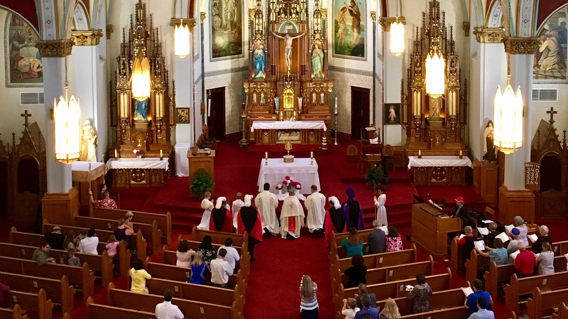
True Words Christian Church

Slide 35
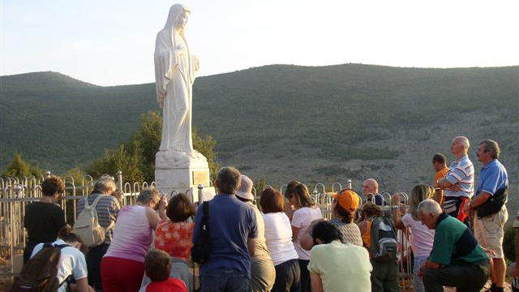
True Words Christian Church

Slide 36
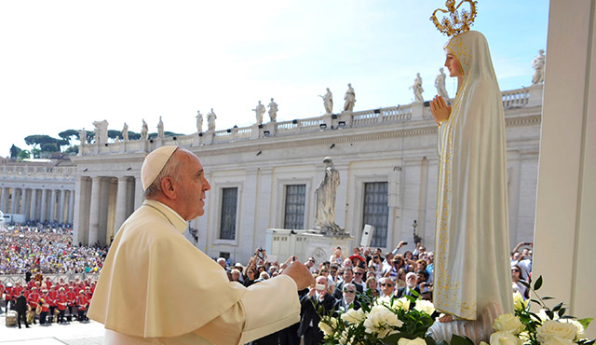
True Words Christian Church

Slide 37
Daniel 5:28 PERES; Thy kingdom is divided, and given to the Medes and Persians.
True Words Christian Church

Slide 38
Daniel 7:5 And behold another beast, a second, like to a bear, and it raised up itself on one side, and it had three ribs in the mouth of it between the teeth of it: and they said thus unto it, Arise, devour much flesh.
True Words Christian Church

Slide 39
Daniel 8:3 Then I lifted up mine eyes, and saw, and, behold, there stood before the river a ram which had two horns: and the two horns were high; but one was higher than the other, and the higher came up last.
True Words Christian Church

Slide 40
Genesis 22:8 And Abraham said, My son, God will provide himself a lamb for a burnt offering: so they went both of them together.
True Words Christian Church

Slide 41
Genesis 22:13 And Abraham lifted up his eyes, and looked, and behold behind him a ram caught in a thicket by his horns: and Abraham went and took the ram, and offered him up for a burnt offering in the stead of his son.
True Words Christian Church

Slide 42
John 1:29 The next day John seeth Jesus coming unto him, and saith, Behold the Lamb of God, which taketh away the sin of the world.
True Words Christian Church

Slide 43
Matthew 12:40 For as Jonas was three days and three nights in the whale's belly; so shall the Son of man be three days and three nights in the heart of the earth.
True Words Christian Church

Slide 44
Revelation 12:3 And there appeared another wonder in heaven; and behold a great red dragon, having seven heads and ten horns, and seven crowns upon his heads.
True Words Christian Church

Slide 45
Daniel 2:40-42 And the fourth kingdom shall be strong as iron: forasmuch as iron breaketh in pieces and subdueth all things: and as iron that breaketh all these, shall it break in pieces and bruise. 41 And whereas thou sawest the feet and toes, part of potters' clay, and part of iron, the kingdom shall be divided; but there shall be in it of the strength of the iron, forasmuch as thou sawest the iron mixed with miry clay. 42 And as the toes of the feet were part of iron, and part of clay, so the kingdom shall be partly strong, and partly broken.
True Words Christian Church

Slide 46
Daniel 2:43 And whereas thou sawest iron mixed with miry clay, they shall mingle themselves with the seed of men: but they shall not cleave one to another, even as iron is not mixed with clay.
True Words Christian Church

Slide 47
Daniel 2:44 And in the days of these kings shall the God of heaven set up a kingdom, which shall never be destroyed: and the kingdom shall not be left to other people, but it shall break in pieces and consume all these kingdoms, and it shall stand for ever.
True Words Christian Church

Slide 48
Daniel 2:45 Forasmuch as thou sawest that the stone was cut out of the mountain without hands, and that it brake in pieces the iron, the brass, the clay, the silver, and the gold; the great God hath made known to the king what shall come to pass hereafter: and the dream is certain, and the interpretation thereof sure.
True Words Christian Church

Slide 49
Daniel 7:13-14 I saw in the night visions, and, behold, one like the Son of man came with the clouds of heaven, and came to the Ancient of days, and they brought him near before him. 14 And there was given him dominion, and glory, and a kingdom, that all people, nations, and languages, should serve him: his dominion is an everlasting dominion, which shall not pass away, and his kingdom that which shall not be destroyed.
True Words Christian Church

Slide 50
Revelation 19:15 And out of his mouth goeth a sharp sword, that with it he should smite the nations: and he shall rule them with a rod of iron: and he treadeth the winepress of the fierceness and wrath of Almighty God.
True Words Christian Church

Slide 51
Daniel 2:46 Then the king Nebuchadnezzar fell upon his face, and worshipped Daniel, and commanded that they should offer an oblation and sweet odours unto him.
True Words Christian Church

Slide 52
Daniel 2:47 The king answered unto Daniel, and said, Of a truth it is, that your God is a God of gods, and a Lord of kings, and a revealer of secrets, seeing thou couldest reveal this secret.
True Words Christian Church

Slide 53
Daniel 2:48 Then the king made Daniel a great man, and gave him many great gifts, and made him ruler over the whole province of Babylon, and chief of the governors over all the wise men of Babylon.
True Words Christian Church

Slide 54
Daniel 2:49 Then Daniel requested of the king, and he set Shadrach, Meshach, and Abed-nego, over the affairs of the province of Babylon: but Daniel sat in the gate of the king.
True Words Christian Church

