Slide 2
SERMON TITLE
AN OVERVIEW
OF THE BIBLE

Slide 3
2 Peter 3:15-18 And account that the longsuffering of our Lord is salvation; even as our beloved brother Paul also according to the wisdom given unto him hath written unto you; 16 As also in all his epistles, speaking in them of these things; in which are some things hard to be understood, which they that are unlearned and unstable wrest, as they do also the other scriptures, unto their own destruction. 17 Ye therefore, beloved, seeing ye know these things before, beware lest ye also, being led away with the error of the wicked, fall from your own stedfastness. 18 But grow in grace, and in the knowledge of our Lord and Saviour Jesus Christ. To him be glory both now and for ever. Amen.
True Words Christian Church

Slide 4
Psalm 1:1-3 Blessed is the man that walketh not in the counsel of the ungodly, nor standeth in the way of sinners, nor sitteth in the seat of the scornful. 2 But his delight is in the law of the LORD; and in his law doth he meditate day and night. 3 And he shall be like a tree planted by the rivers of water, that bringeth forth his fruit in his season; his leaf also shall not wither; and whatsoever he doeth shall prosper.
True Words Christian Church

Slide 5
Exodus 31:17 It is a sign between me and the children of Israel for ever: for in six days the LORD made heaven and earth, and on the seventh day he rested, and was refreshed.
True Words Christian Church

Slide 6
Genesis 6:11 The earth also was corrupt before God, and the earth was filled with violence.
True Words Christian Church

Slide 7
Genesis 12:1-3 Now the LORD had said unto Abram, Get thee out of thy country, and from thy kindred, and from thy father's house, unto a land that I will shew thee: 2 And I will make of thee a great nation, and I will bless thee, and make thy name great; and thou shalt be a blessing: 3 And I will bless them that bless thee, and curse him that curseth thee: and in thee shall all families of the earth be blessed.
True Words Christian Church

Slide 8
Galatians 3:8 And the scripture, foreseeing that God would justify the heathen through faith, preached before the gospel unto Abraham, saying, In thee shall all nations be blessed.
True Words Christian Church

Slide 9
Numbers 32:11-12 Surely none of the men that came up out of Egypt, from twenty years old and upward, shall see the land which I sware unto Abraham, unto Isaac, and unto Jacob; because they have not wholly followed me: 12 Save Caleb the son of Jephunneh the Kenezite, and Joshua the son of Nun: for they have wholly followed the LORD.
True Words Christian Church

Slide 10
1 Samuel 8:7 And the LORD said unto Samuel, Hearken unto the voice of the people in all that they say unto thee: for they have not rejected thee, but they have rejected me, that I should not reign over them.
True Words Christian Church

Slide 11
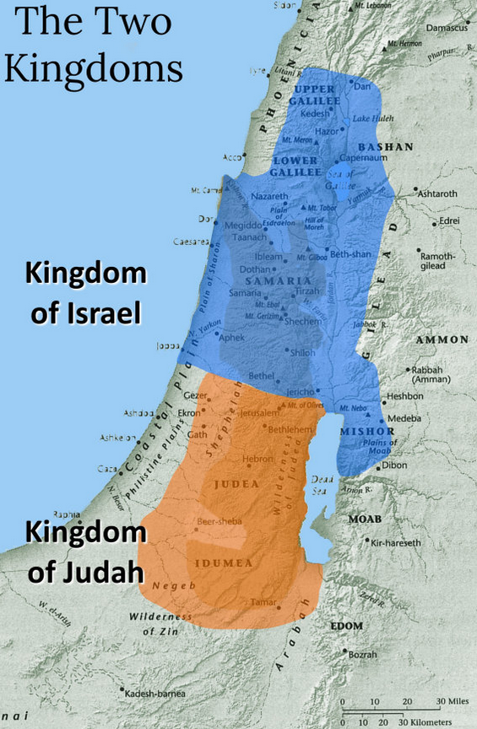
True Words Christian Church

Slide 12
1 Kings 16:30 And Ahab the son of Omri did evil in the sight of the LORD above all that were before him.
True Words Christian Church

Slide 13
2 Chronicles 14:2 And Asa did that which was good and right in the eyes of the LORD his God:
True Words Christian Church

Slide 14
True Words Christian Church

Slide 15
1 Kings 16:24 And he bought the hill Samaria of Shemer for two talents of silver, and built on the hill, and called the name of the city which he built, after the name of Shemer, owner of the hill, Samaria.
True Words Christian Church

Slide 16
2 Kings 16:5-7 Then Rezin king of Syria and Pekah son of Remaliah king of Israel came up to Jerusalem to war: and they besieged Ahaz, but could not overcome him. 6 At that time Rezin king of Syria recovered Elath to Syria, and drave the Jews from Elath: and the Syrians came to Elath, and dwelt there unto this day. 7 So Ahaz sent messengers to Tiglath-pileser king of Assyria, saying, I am thy servant and thy son: come up, and save me out of the hand of the king of Syria, and out of the hand of the king of Israel, which rise up against me.
True Words Christian Church

Slide 17
John 4:9-12 Then saith the woman of Samaria unto him, How is it that thou, being a Jew, askest drink of me, which am a woman of Samaria? for the Jews have no dealings with the Samaritans. 10 Jesus answered and said unto her, If thou knewest the gift of God, and who it is that saith to thee, Give me to drink; thou wouldest have asked of him, and he would have given thee living water. 11 The woman saith unto him, Sir, thou hast nothing to draw with, and the well is deep: from whence then hast thou that living water? 12 Art thou greater than our father Jacob, which gave us the well, and drank thereof himself, and his children, and his cattle?
True Words Christian Church

Slide 18
John 2:20 Then said the Jews, Forty and six years was this temple in building, and wilt thou rear it up in three days?
True Words Christian Church

Slide 19
True Words Christian Church

Slide 20
Isaiah 1:1 The vision of Isaiah the son of Amoz, which he saw concerning Judah and Jerusalem in the days of Uzziah, Jotham, Ahaz, and Hezekiah, kings of Judah.
True Words Christian Church

Slide 21
Jeremiah 1:1-2 The words of Jeremiah the son of Hilkiah, of the priests that were in Anathoth in the land of Benjamin: 2 To whom the word of the LORD came in the days of Josiah the son of Amon king of Judah, in the thirteenth year of his reign.
True Words Christian Church

Slide 22
Ezekiel 1:1-3 Now it came to pass in the thirtieth year, in the fourth month, in the fifth day of the month, as I was among the captives by the river of Chebar, that the heavens were opened, and I saw visions of God. 2 In the fifth day of the month, which was the fifth year of king Jehoiachin's captivity, 3 The word of the LORD came expressly unto Ezekiel the priest, the son of Buzi, in the land of the Chaldeans by the river Chebar; and the hand of the LORD was there upon him.
True Words Christian Church

Slide 23
Hosea 1:1 The word of the LORD that came unto Hosea, the son of Beeri, in the days of Uzziah, Jotham, Ahaz, and Hezekiah, kings of Judah, and in the days of Jeroboam the son of Joash, king of Israel.
True Words Christian Church

Slide 24
Zephaniah 1:1 The word of the LORD which came unto Zephaniah the son of Cushi, the son of Gedaliah, the son of Amariah, the son of Hizkiah, in the days of Josiah the son of Amon, king of Judah.
True Words Christian Church

Slide 25
Haggai 1:1 In the second year of Darius the king, in the sixth month, in the first day of the month, came the word of the LORD by Haggai the prophet unto Zerubbabel the son of Shealtiel, governor of Judah, and to Joshua the son of Josedech, the high priest, saying,
True Words Christian Church

Slide 26
Jeremiah 29:10 For thus saith the LORD, That after seventy years be accomplished at Babylon I will visit you, and perform my good word toward you, in causing you to return to this place.
True Words Christian Church

Slide 27
Malachi 4:4 Remember ye the law of Moses my servant, which I commanded unto him in Horeb for all Israel, with the statutes and judgments.
True Words Christian Church

Slide 28
Malachi 4:5-6 Behold, I will send you Elijah the prophet before the coming of the great and dreadful day of the LORD: 6 And he shall turn the heart of the fathers to the children, and the heart of the children to their fathers, lest I come and smite the earth with a curse.
True Words Christian Church

Slide 29
Matthew 17:10 And his disciples asked him, saying, Why then say the scribes that Elias must first come?
True Words Christian Church

Slide 30
Matthew 17:11-13 And Jesus answered and said unto them, Elias truly shall first come, and restore all things. 12 But I say unto you, That Elias is come already, and they knew him not, but have done unto him whatsoever they listed. Likewise shall also the Son of man suffer of them. 13 Then the disciples understood that he spake unto them of John the Baptist.
True Words Christian Church

Slide 31
2 John 1 The elder unto the elect lady and her children, whom I love in the truth; and not I only, but also all they that have known the truth;
True Words Christian Church

Slide 32
3 John 1 The elder unto the wellbeloved Gaius, whom I love in the truth.
True Words Christian Church

Slide 33
John 1:11-12 He came unto his own, and his own received him not. 12 But as many as received him, to them gave he power to become the sons of God, even to them that believe on his name:
True Words Christian Church

