Slide 2
SERMON TITLE
Genesis Chapter 6

Slide 3
Genesis 6:1-2 And it came to pass, when men began to multiply on the face of the earth, and daughters were born unto them, 2 That the sons of God saw the daughters of men that they were fair; and they took them wives of all which they chose.
True Words Christian Church

Slide 4
Genesis 6:3 And the LORD said, My spirit shall not always strive with man, for that he also is flesh: yet his days shall be an hundred and twenty years.
True Words Christian Church

Slide 5
Genesis 6:4 There were giants in the earth in those days; and also after that, when the sons of God came in unto the daughters of men, and they bare children to them, the same became mighty men which were of old, men of renown.
True Words Christian Church

Slide 6
True Words Christian Church

Slide 7
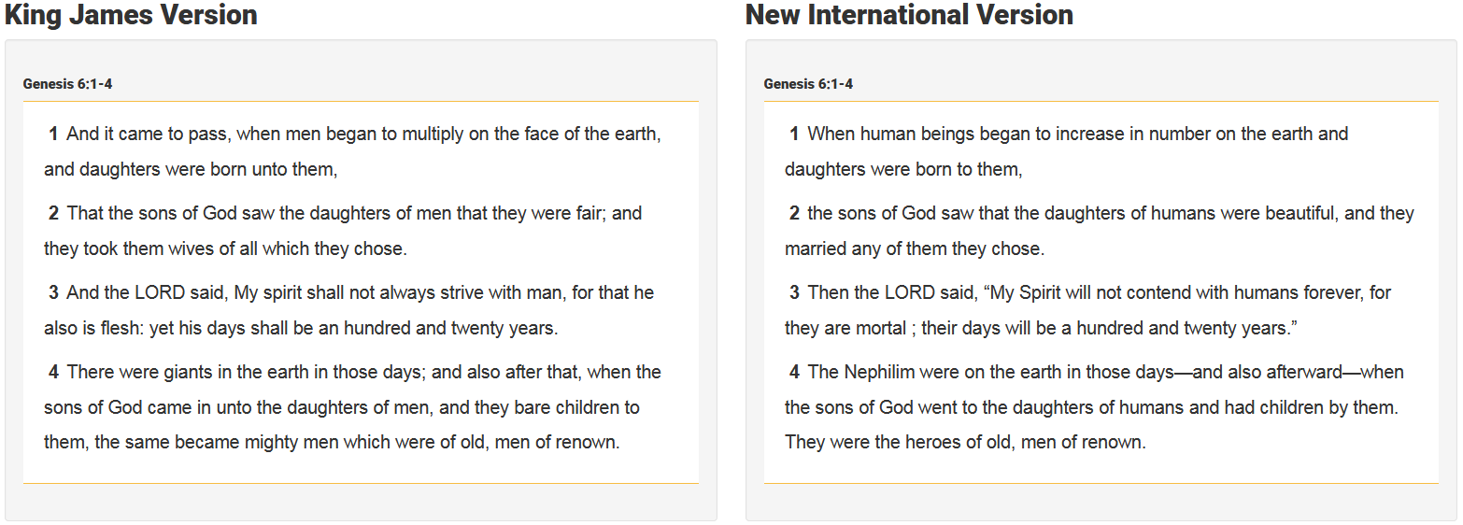
True Words Christian Church

Slide 8
Numbers 13:30-33 And Caleb stilled the people before Moses, and said, Let us go up at once, and possess it; for we are well able to overcome it. 31 But the men that went up with him said, We be not able to go up against the people; for they are stronger than we. 32 And they brought up an evil report of the land which they had searched unto the children of Israel, saying, The land, through which we have gone to search it, is a land that eateth up the inhabitants thereof; and all the people that we saw in it are men of a great stature. 33 And there we saw the giants, the sons of Anak, which come of the giants: and we were in our own sight as grasshoppers, and so we were in their sight.
True Words Christian Church

Slide 9
Job 1:6 Now there was a day when the sons of God came to present themselves before the LORD, and Satan came also among them.
True Words Christian Church

Slide 10
True Words Christian Church

Slide 11
John 1:12 But as many as received him, to them gave he power to become the sons of God, even to them that believe on his name:
True Words Christian Church

Slide 12
1 John 3:2 Beloved, now are we the sons of God, and it doth not yet appear what we shall be: but we know that, when he shall appear, we shall be like him; for we shall see him as he is.
True Words Christian Church

Slide 13
Hebrews 1:5 For unto which of the angels said he at any time, Thou art my Son, this day have I begotten thee? And again, I will be to him a Father, and he shall be to me a Son?
True Words Christian Church

Slide 14
Hebrews 1:13-14 But to which of the angels said he at any time, Sit on my right hand, until I make thine enemies thy footstool? 14 Are they not all ministering spirits, sent forth to minister for them who shall be heirs of salvation?
True Words Christian Church

Slide 15
1 Corinthians 4:15 For though ye have ten thousand instructors in Christ, yet have ye not many fathers: for in Christ Jesus I have begotten you through the gospel.
True Words Christian Church

Slide 16
Genesis 6:2 That the sons of God saw the daughters of men that they were fair; and they took them wives of all which they chose.
True Words Christian Church

Slide 17
Matthew 22:29-30 Jesus answered and said unto them, Ye do err, not knowing the scriptures, nor the power of God. 30 For in the resurrection they neither marry, nor are given in marriage, but are as the angels of God in heaven.
True Words Christian Church

Slide 18
John 3:6 That which is born of the flesh is flesh; and that which is born of the Spirit is spirit.
True Words Christian Church

Slide 19
Genesis 6:4 There were giants in the earth in those days; and also after that, when the sons of God came in unto the daughters of men, and they bare children to them, the same became mighty men which were of old, men of renown.
True Words Christian Church

Slide 20
Genesis 6:5 And GOD saw that the wickedness of man was great in the earth, and that every imagination of the thoughts of his heart was only evil continually.
True Words Christian Church

Slide 21
Genesis 6:6 And it repented the LORD that he had made man on the earth, and it grieved him at his heart.
True Words Christian Church

Slide 22
Malachi 3:6 For I am the LORD, I change not; therefore ye sons of Jacob are not consumed.
True Words Christian Church

Slide 23
Hebrews 13:8 Jesus Christ the same yesterday, and to day, and for ever.
True Words Christian Church

Slide 24
Numbers 23:19 God is not a man, that he should lie; neither the son of man, that he should repent: hath he said, and shall he not do it? or hath he spoken, and shall he not make it good?
True Words Christian Church

Slide 25
Exodus 32:14 And the LORD repented of the evil which he thought to do unto his people.
True Words Christian Church

Slide 26
1 Samuel 15:35 And Samuel came no more to see Saul until the day of his death: nevertheless Samuel mourned for Saul: and the LORD repented that he had made Saul king over Israel.
True Words Christian Church

Slide 27
Psalm 106:45 And he remembered for them his covenant, and repented according to the multitude of his mercies.
True Words Christian Church

Slide 28
Jonah 3:10 And God saw their works, that they turned from their evil way; and God repented of the evil, that he had said that he would do unto them; and he did it not.
True Words Christian Church

Slide 29
True Words Christian Church

Slide 30
1 Corinthians 14:33 For God is not the author of confusion, but of peace, as in all churches of the saints.
True Words Christian Church

Slide 31
Hebrews 8:6-7 But now hath he obtained a more excellent ministry, by how much also he is the mediator of a better covenant, which was established upon better promises. 7 For if that first covenant had been faultless, then should no place have been sought for the second.
True Words Christian Church

Slide 32
Hebrews 8:8-9 For finding fault with them, he saith, Behold, the days come, saith the Lord, when I will make a new covenant with the house of Israel and with the house of Judah: 9 Not according to the covenant that I made with their fathers in the day when I took them by the hand to lead them out of the land of Egypt; because they continued not in my covenant, and I regarded them not, saith the Lord.
True Words Christian Church

Slide 33
Psalm 89:34 My covenant will I not break, nor alter the thing that is gone out of my lips.
True Words Christian Church

Slide 34
Genesis 6:7 And the LORD said, I will destroy man whom I have created from the face of the earth; both man, and beast, and the creeping thing, and the fowls of the air; for it repenteth me that I have made them.
True Words Christian Church

Slide 35
Genesis 6:8-9 But Noah found grace in the eyes of the LORD. 9 These are the generations of Noah: Noah was a just man and perfect in his generations, and Noah walked with God.
True Words Christian Church

Slide 36
James 1:4 But let patience have her perfect work, that ye may be perfect and entire, wanting nothing.
True Words Christian Church

Slide 37
Hebrews 11:7 By faith Noah, being warned of God of things not seen as yet, moved with fear, prepared an ark to the saving of his house; by the which he condemned the world, and became heir of the righteousness which is by faith.
True Words Christian Church

Slide 38
Genesis 6:10 And Noah begat three sons, Shem, Ham, and Japheth.
True Words Christian Church

Slide 39
Genesis 6:11-12 The earth also was corrupt before God, and the earth was filled with violence. 12 And God looked upon the earth, and, behold, it was corrupt; for all flesh had corrupted his way upon the earth.
True Words Christian Church

Slide 40
Genesis 6:13 And God said unto Noah, The end of all flesh is come before me; for the earth is filled with violence through them; and, behold, I will destroy them with the earth.
True Words Christian Church

Slide 41
Psalm 11:5 The LORD trieth the righteous: but the wicked and him that loveth violence his soul hateth.
True Words Christian Church

Slide 42
Genesis 6:14-16 Make thee an ark of gopher wood; rooms shalt thou make in the ark, and shalt pitch it within and without with pitch. 15 And this is the fashion which thou shalt make it of: The length of the ark shall be three hundred cubits, the breadth of it fifty cubits, and the height of it thirty cubits. 16 A window shalt thou make to the ark, and in a cubit shalt thou finish it above; and the door of the ark shalt thou set in the side thereof; with lower, second, and third stories shalt thou make it.
True Words Christian Church

Slide 43
John 10:9 I am the door: by me if any man enter in, he shall be saved, and shall go in and out, and find pasture.
True Words Christian Church

Slide 44
Ephesians 4:30 And grieve not the holy Spirit of God, whereby ye are sealed unto the day of redemption.
True Words Christian Church

Slide 45
1 Thessalonians 4:17 Then we which are alive and remain shall be caught up together with them in the clouds, to meet the Lord in the air: and so shall we ever be with the Lord.
True Words Christian Church

Slide 46
Genesis 6:17-18 And, behold, I, even I, do bring a flood of waters upon the earth, to destroy all flesh, wherein is the breath of life, from under heaven; and every thing that is in the earth shall die. 18 But with thee will I establish my covenant; and thou shalt come into the ark, thou, and thy sons, and thy wife, and thy sons' wives with thee.
True Words Christian Church

Slide 47
Genesis 6:3 And the LORD said, My spirit shall not always strive with man, for that he also is flesh: yet his days shall be an hundred and twenty years.
True Words Christian Church

Slide 48
2 Peter 2:5 And spared not the old world, but saved Noah the eighth person, a preacher of righteousness, bringing in the flood upon the world of the ungodly;
True Words Christian Church

Slide 49
Genesis 6:19-20 And of every living thing of all flesh, two of every sort shalt thou bring into the ark, to keep them alive with thee; they shall be male and female. 20 Of fowls after their kind, and of cattle after their kind, of every creeping thing of the earth after his kind, two of every sort shall come unto thee, to keep them alive.
True Words Christian Church

Slide 50
Genesis 6:21 And take thou unto thee of all food that is eaten, and thou shalt gather it to thee; and it shall be for food for thee, and for them.
True Words Christian Church

Slide 51
Genesis 6:22 Thus did Noah; according to all that God commanded him, so did he.
True Words Christian Church

Slide 52
Proverbs 8:13 The fear of the LORD is to hate evil: pride, and arrogancy, and the evil way, and the froward mouth, do I hate.
True Words Christian Church

