Slide 2
SERMON TITLE
A Study On
Repentance

Slide 3
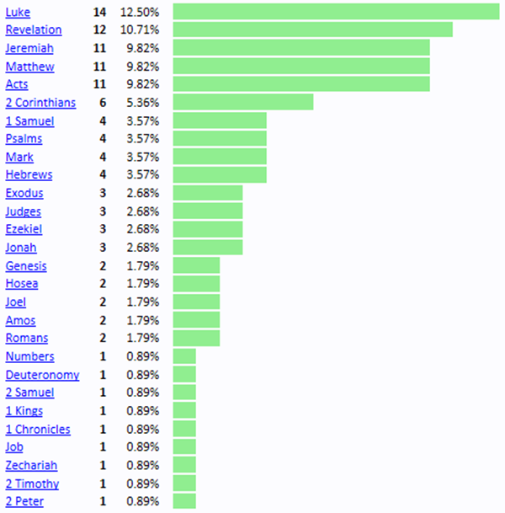
True Words Christian Church

Slide 4
John 20:30-31 And many other signs truly did Jesus in the presence of his disciples, which are not written in this book: 31 But these are written, that ye might believe that Jesus is the Christ, the Son of God; and that believing ye might have life through his name.
True Words Christian Church

Slide 5
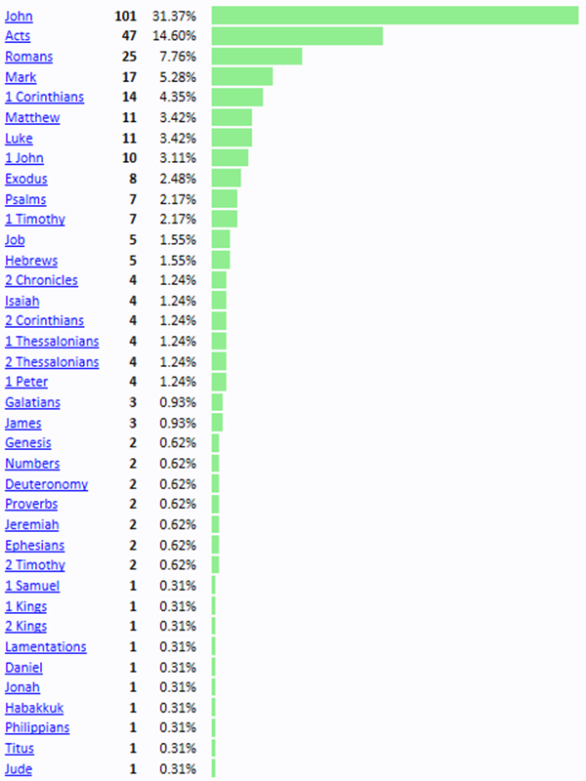
True Words Christian Church

Slide 6
John 1:7 The same came for a witness, to bear witness of the Light, that all men through him might believe.
True Words Christian Church

Slide 7
John 1:12-13 But as many as received him, to them gave he power to become the sons of God, even to them that believe on his name: 13 Which were born, not of blood, nor of the will of the flesh, nor of the will of man, but of God.
True Words Christian Church

Slide 8
John 3:15 That whosoever believeth in him should not perish, but have eternal life.
True Words Christian Church

Slide 9
John 3:36 He that believeth on the Son hath everlasting life: and he that believeth not the Son shall not see life; but the wrath of God abideth on him.
True Words Christian Church

Slide 10
John 5:24 Verily, verily, I say unto you, He that heareth my word, and believeth on him that sent me, hath everlasting life, and shall not come into condemnation; but is passed from death unto life.
True Words Christian Church

Slide 11
Luke 1:1-4 Forasmuch as many have taken in hand to set forth in order a declaration of those things which are most surely believed among us, 2 Even as they delivered them unto us, which from the beginning were eyewitnesses, and ministers of the word; 3 It seemed good to me also, having had perfect understanding of all things from the very first, to write unto thee in order, most excellent Theophilus, 4 That thou mightest know the certainty of those things, wherein thou hast been instructed.
True Words Christian Church

Slide 12
Luke 3:2-4 Annas and Caiaphas being the high priests, the word of God came unto John the son of Zacharias in the wilderness. 3 And he came into all the country about Jordan, preaching the baptism of repentance for the remission of sins; 4 As it is written in the book of the words of Esaias the prophet, saying, The voice of one crying in the wilderness, Prepare ye the way of the Lord, make his paths straight.
True Words Christian Church

Slide 13
Matthew 3:11 I indeed baptize you with water unto repentance: but he that cometh after me is mightier than I, whose shoes I am not worthy to bear: he shall baptize you with the Holy Ghost, and with fire:
True Words Christian Church

Slide 14
Mark 1:4 John did baptize in the wilderness, and preach the baptism of repentance for the remission of sins.
True Words Christian Church

Slide 15
Acts 13:24 When John had first preached before his coming the baptism of repentance to all the people of Israel.
True Words Christian Church

Slide 16
Acts 13:38-39 Be it known unto you therefore, men and brethren, that through this man is preached unto you the forgiveness of sins: 39 And by him all that believe are justified from all things, from which ye could not be justified by the law of Moses.
True Words Christian Church

Slide 17
Acts 19:4 Then said Paul, John verily baptized with the baptism of repentance, saying unto the people, that they should believe on him which should come after him, that is, on Christ Jesus.
True Words Christian Church

Slide 18
Luke 5:30-32 But their scribes and Pharisees murmured against his disciples, saying, Why do ye eat and drink with publicans and sinners? 31 And Jesus answering said unto them, They that are whole need not a physician; but they that are sick. 32 I came not to call the righteous, but sinners to repentance.
True Words Christian Church

Slide 19
Luke 13:2-3 And Jesus answering said unto them, Suppose ye that these Galilaeans were sinners above all the Galilaeans, because they suffered such things? 3 I tell you, Nay: but, except ye repent, ye shall all likewise perish.
True Words Christian Church

Slide 20
Luke 15:7 I say unto you, that likewise joy shall be in heaven over one sinner that repenteth, more than over ninety and nine just persons, which need no repentance.
True Words Christian Church

Slide 21
Luke 17:3 Take heed to yourselves: If thy brother trespass against thee, rebuke him; and if he repent, forgive him.
True Words Christian Church

Slide 22
John 6:47 Verily, verily, I say unto you, He that believeth on me hath everlasting life.
True Words Christian Church

Slide 23
Genesis 6:5-7 And GOD saw that the wickedness of man was great in the earth, and that every imagination of the thoughts of his heart was only evil continually. 6 And it repented the LORD that he had made man on the earth, and it grieved him at his heart. 7 And the LORD said, I will destroy man whom I have created from the face of the earth; both man, and beast, and the creeping thing, and the fowls of the air; for it repenteth me that I have made them.
True Words Christian Church

Slide 24
Exodus 13:17 And it came to pass, when Pharaoh had let the people go, that God led them not through the way of the land of the Philistines, although that was near; for God said, Lest peradventure the people repent when they see war, and they return to Egypt:
True Words Christian Church

Slide 25
Exodus 32:12 Wherefore should the Egyptians speak, and say, For mischief did he bring them out, to slay them in the mountains, and to consume them from the face of the earth? Turn from thy fierce wrath, and repent of this evil against thy people.
True Words Christian Church

Slide 26
Exodus 32:14 And the LORD repented of the evil which he thought to do unto his people.
True Words Christian Church

Slide 27
Numbers 23:19 God is not a man, that he should lie; neither the son of man, that he should repent: hath he said, and shall he not do it? or hath he spoken, and shall he not make it good?
True Words Christian Church

Slide 28
Deuteronomy 32:36 For the LORD shall judge his people, and repent himself for his servants, when he seeth that their power is gone, and there is none shut up, or left.
True Words Christian Church

Slide 29
Judges 2:18 And when the LORD raised them up judges, then the LORD was with the judge, and delivered them out of the hand of their enemies all the days of the judge: for it repented the LORD because of their groanings by reason of them that oppressed them and vexed them.
True Words Christian Church

Slide 30
Jeremiah 15:5-7 For who shall have pity upon thee, O Jerusalem? or who shall bemoan thee? or who shall go aside to ask how thou doest? 6 Thou hast forsaken me, saith the LORD, thou art gone backward: therefore will I stretch out my hand against thee, and destroy thee; I am weary with repenting. 7 And I will fan them with a fan in the gates of the land; I will bereave them of children, I will destroy my people, since they return not from their ways.
True Words Christian Church

Slide 31
Acts 2:21 And it shall come to pass, that whosoever shall call on the name of the Lord shall be saved.
True Words Christian Church

Slide 32
Acts 2:36 Therefore let all the house of Israel know assuredly, that God hath made that same Jesus, whom ye have crucified, both Lord and Christ.
True Words Christian Church

Slide 33
Acts 2:37 Now when they heard this, they were pricked in their heart, and said unto Peter and to the rest of the apostles, Men and brethren, what shall we do?
True Words Christian Church

Slide 34
Acts 2:38 Then Peter said unto them, Repent, and be baptized every one of you in the name of Jesus Christ for the remission of sins, and ye shall receive the gift of the Holy Ghost.
True Words Christian Church

Slide 35
Jonah 3:8-10 But let man and beast be covered with sackcloth, and cry mightily unto God: yea, let them turn every one from his evil way, and from the violence that is in their hands. 9 Who can tell if God will turn and repent, and turn away from his fierce anger, that we perish not? 10 And God saw their works, that they turned from their evil way; and God repented of the evil, that he had said that he would do unto them; and he did it not.
True Words Christian Church

Slide 36
Romans 10:13-14 For whosoever shall call upon the name of the Lord shall be saved. 14 How then shall they call on him in whom they have not believed? and how shall they believe in him of whom they have not heard? and how shall they hear without a preacher?
True Words Christian Church

Slide 37
Acts 2:38 Then Peter said unto them, Repent, and be baptized every one of you in the name of Jesus Christ for the remission of sins, and ye shall receive the gift of the Holy Ghost.
True Words Christian Church

Slide 38
Acts 16:29-31 Then he called for a light, and sprang in, and came trembling, and fell down before Paul and Silas, 30 And brought them out, and said, Sirs, what must I do to be saved? 31 And they said, Believe on the Lord Jesus Christ, and thou shalt be saved, and thy house.
True Words Christian Church

Slide 39
Acts 16:32-33 And they spake unto him the word of the Lord, and to all that were in his house. 33 And he took them the same hour of the night, and washed their stripes; and was baptized, he and all his, straightway.
True Words Christian Church

Slide 40
1 Peter 3:21 The like figure whereunto even baptism doth also now save us (not the putting away of the filth of the flesh, but the answer of a good conscience toward God,) by the resurrection of Jesus Christ:
True Words Christian Church

Slide 41
Acts 2:38 Then Peter said unto them, Repent, and be baptized every one of you in the name of Jesus Christ for the remission of sins, and ye shall receive the gift of the Holy Ghost.
True Words Christian Church

Slide 42
Acts 3:19-21 Repent ye therefore, and be converted, that your sins may be blotted out, when the times of refreshing shall come from the presence of the Lord; 20 And he shall send Jesus Christ, which before was preached unto you: 21 Whom the heaven must receive until the times of restitution of all things, which God hath spoken by the mouth of all his holy prophets since the world began.
True Words Christian Church

Slide 43
Acts 5:30-31 The God of our fathers raised up Jesus, whom ye slew and hanged on a tree. 31 Him hath God exalted with his right hand to be a Prince and a Saviour, for to give repentance to Israel, and forgiveness of sins.
True Words Christian Church

Slide 44
Acts 8:20-22 But Peter said unto him, Thy money perish with thee, because thou hast thought that the gift of God may be purchased with money. 21 Thou hast neither part nor lot in this matter: for thy heart is not right in the sight of God. 22 Repent therefore of this thy wickedness, and pray God, if perhaps the thought of thine heart may be forgiven thee.
True Words Christian Church

Slide 45
Acts 11:18 When they heard these things, they held their peace, and glorified God, saying, Then hath God also to the Gentiles granted repentance unto life.
True Words Christian Church

Slide 46
Matthew 4:17 From that time Jesus began to preach, and to say, Repent: for the kingdom of heaven is at hand.
True Words Christian Church

Slide 47
Romans 4:5 But to him that worketh not, but believeth on him that justifieth the ungodly, his faith is counted for righteousness.
True Words Christian Church

Slide 48
Ephesians 2:8-9 For by grace are ye saved through faith; and that not of yourselves: it is the gift of God: 9 Not of works, lest any man should boast.
True Words Christian Church

Slide 49
Romans 3:28 Therefore we conclude that a man is justified by faith without the deeds of the law.
True Words Christian Church

Slide 50
Mark 1:14-15 Now after that John was put in prison, Jesus came into Galilee, preaching the gospel of the kingdom of God, 15 And saying, The time is fulfilled, and the kingdom of God is at hand: repent ye, and believe the gospel.
True Words Christian Church

Slide 51
2 Corinthians 7:10 For godly sorrow worketh repentance to salvation not to be repented of: but the sorrow of the world worketh death.
True Words Christian Church

Slide 52
Matthew 27:3-5 Then Judas, which had betrayed him, when he saw that he was condemned, repented himself, and brought again the thirty pieces of silver to the chief priests and elders, 4 Saying, I have sinned in that I have betrayed the innocent blood. And they said, What is that to us? see thou to that. 5 And he cast down the pieces of silver in the temple, and departed, and went and hanged himself.
True Words Christian Church

Slide 53
Psalm 55:16 As for me, I will call upon God; and the LORD shall save me.
True Words Christian Church

