Slide 2
SERMON TITLE
Is The Bible
100% Truth?

Slide 3
Isaiah 59:21 As for me, this is my covenant with them, saith the LORD; My spirit that is upon thee, and my words which I have put in thy mouth, shall not depart out of thy mouth, nor out of the mouth of thy seed, nor out of the mouth of thy seed's seed, saith the LORD, from henceforth and for ever.
True Words Christian Church

Slide 4
Matthew 24:35 Heaven and earth shall pass away, but my words shall not pass away.
True Words Christian Church

Slide 5
Isaiah 40:8 The grass withereth, the flower fadeth: but the word of our God shall stand for ever.
True Words Christian Church

Slide 6
Psalm 12:6-7 The words of the LORD are pure words: as silver tried in a furnace of earth, purified seven times. 7 Thou shalt keep them, O LORD, thou shalt preserve them from this generation for ever.
True Words Christian Church

Slide 7
Psalm 19:7-9 The law of the LORD is perfect, converting the soul: the testimony of the LORD is sure, making wise the simple. 8 The statutes of the LORD are right, rejoicing the heart: the commandment of the LORD is pure, enlightening the eyes. 9 The fear of the LORD is clean, enduring for ever: the judgments of the LORD are true and righteous altogether.
True Words Christian Church

Slide 8
Psalm 100:5 For the LORD is good; his mercy is everlasting; and his truth endureth to all generations.
True Words Christian Church

Slide 9
Psalm 119:152 Concerning thy testimonies, I have known of old that thou hast founded them for ever.
True Words Christian Church

Slide 10
Psalm 119:160 Thy word is true from the beginning: and every one of thy righteous judgments endureth for ever.
True Words Christian Church

Slide 11
John 10:34-36 Jesus answered them, Is it not written in your law, I said, Ye are gods? 35 If he called them gods, unto whom the word of God came, and the scripture cannot be broken; 36 Say ye of him, whom the Father hath sanctified, and sent into the world, Thou blasphemest; because I said, I am the Son of God?
True Words Christian Church

Slide 12
Isaiah 30:8 Now go, write it before them in a table, and note it in a book, that it may be for the time to come for ever and ever:
True Words Christian Church

Slide 13
Isaiah 30:9 That this is a rebellious people, lying children, children that will not hear the law of the LORD:
True Words Christian Church

Slide 14
Isaiah 30:10 Which say to the seers, See not; and to the prophets, Prophesy not unto us right things, speak unto us smooth things, prophesy deceits:
True Words Christian Church

Slide 15
Isaiah 30:11 Get you out of the way, turn aside out of the path, cause the Holy One of Israel to cease from before us.
True Words Christian Church

Slide 16
Isaiah 34:16 Seek ye out of the book of the LORD, and read: no one of these shall fail, none shall want her mate: for my mouth it hath commanded, and his spirit it hath gathered them.
True Words Christian Church

Slide 17
Daniel 10:21 But I will shew thee that which is noted in the scripture of truth: and there is none that holdeth with me in these things, but Michael your prince.
True Words Christian Church

Slide 18
Psalm 119:89 For ever, O LORD, thy word is settled in heaven.
True Words Christian Church

Slide 19
Deuteronomy 4:2 Ye shall not add unto the word which I command you, neither shall ye diminish ought from it, that ye may keep the commandments of the LORD your God which I command you.
True Words Christian Church

Slide 20
Psalm 119:140 Thy word is very pure: therefore thy servant loveth it.
True Words Christian Church

Slide 21
Psalm 138:2 I will worship toward thy holy temple, and praise thy name for thy lovingkindness and for thy truth: for thou hast magnified thy word above all thy name.
True Words Christian Church

Slide 22
Proverbs 24:21-22 My son, fear thou the LORD and the king: and meddle not with them that are given to change: 22 For their calamity shall rise suddenly; and who knoweth the ruin of them both?
True Words Christian Church

Slide 23
Proverbs 30:5-6 Every word of God is pure: he is a shield unto them that put their trust in him. 6 Add thou not unto his words, lest he reprove thee, and thou be found a liar.
True Words Christian Church

Slide 24
Matthew 5:18 For verily I say unto you, Till heaven and earth pass, one jot or one tittle shall in no wise pass from the law, till all be fulfilled.
True Words Christian Church

Slide 25
Mark 13:31 Heaven and earth shall pass away: but my words shall not pass away.
True Words Christian Church

Slide 26
Luke 21:33 Heaven and earth shall pass away: but my words shall not pass away.
True Words Christian Church

Slide 27
1 Peter 1:24-25 For all flesh is as grass, and all the glory of man as the flower of grass. The grass withereth, and the flower thereof falleth away: 25 But the word of the Lord endureth for ever. And this is the word which by the gospel is preached unto you.
True Words Christian Church

Slide 28
Deuteronomy 32:19-20 And when the LORD saw it, he abhorred them, because of the provoking of his sons, and of his daughters. 20 And he said, I will hide my face from them, I will see what their end shall be: for they are a very froward generation, children in whom is no faith.
True Words Christian Church

Slide 29
Revelation 22:18-19 For I testify unto every man that heareth the words of the prophecy of this book, If any man shall add unto these things, God shall add unto him the plagues that are written in this book: 19 And if any man shall take away from the words of the book of this prophecy, God shall take away his part out of the book of life, and out of the holy city, and from the things which are written in this book.
True Words Christian Church

Slide 30
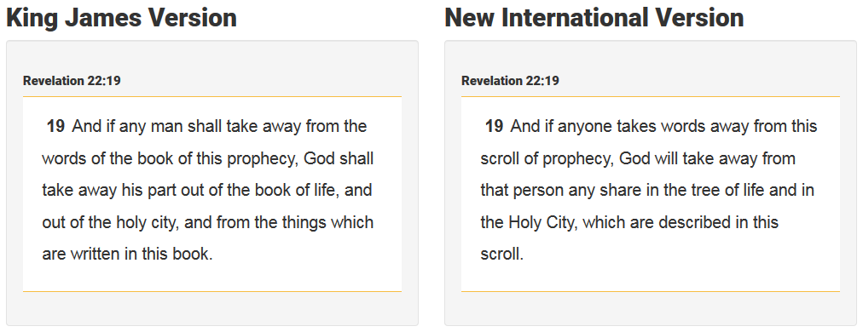
True Words Christian Church

Slide 31
John 14:26 But the Comforter, which is the Holy Ghost, whom the Father will send in my name, he shall teach you all things, and bring all things to your remembrance, whatsoever I have said unto you.
True Words Christian Church

Slide 32
2 Chronicles 19:2 And Jehu the son of Hanani the seer went out to meet him, and said to king Jehoshaphat, Shouldest thou help the ungodly, and love them that hate the LORD? therefore is wrath upon thee from before the LORD.
True Words Christian Church

Slide 33
1 Corinthians 14:36-38 What? came the word of God out from you? or came it unto you only? 37 If any man think himself to be a prophet, or spiritual, let him acknowledge that the things that I write unto you are the commandments of the Lord. 38 But if any man be ignorant, let him be ignorant.
True Words Christian Church

Slide 34
Jeremiah 23:36-37 And the burden of the LORD shall ye mention no more: for every man's word shall be his burden; for ye have perverted the words of the living God, of the LORD of hosts our God. 37 Thus shalt thou say to the prophet, What hath the LORD answered thee? and, What hath the LORD spoken?
True Words Christian Church

Slide 35
True Words Christian Church

Slide 36
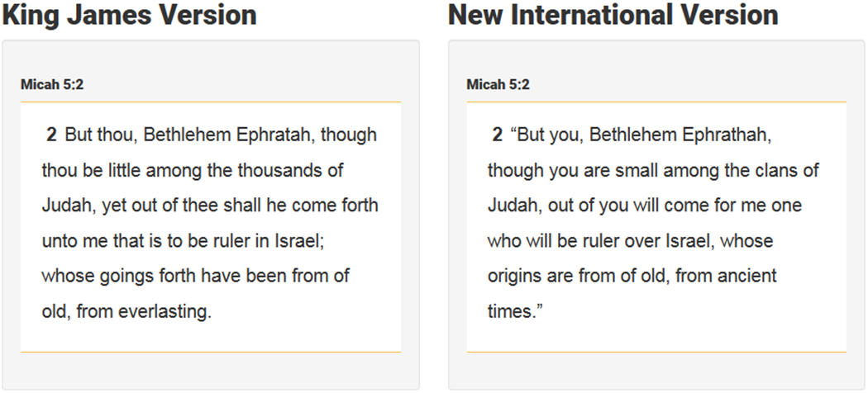
True Words Christian Church

Slide 37
True Words Christian Church

Slide 38
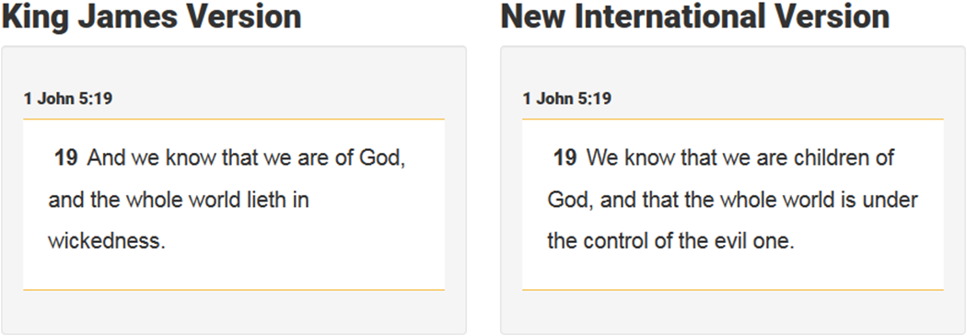
True Words Christian Church

Slide 39
Daniel 4:34-35 And at the end of the days I Nebuchadnezzar lifted up mine eyes unto heaven, and mine understanding returned unto me, and I blessed the most High, and I praised and honoured him that liveth for ever, whose dominion is an everlasting dominion, and his kingdom is from generation to generation: 35 And all the inhabitants of the earth are reputed as nothing: and he doeth according to his will in the army of heaven, and among the inhabitants of the earth: and none can stay his hand, or say unto him, What doest thou?
True Words Christian Church

Slide 40
True Words Christian Church

Slide 41
Isaiah 64:6 But we are all as an unclean thing, and all our righteousnesses are as filthy rags; and we all do fade as a leaf; and our iniquities, like the wind, have taken us away.
True Words Christian Church

Slide 42
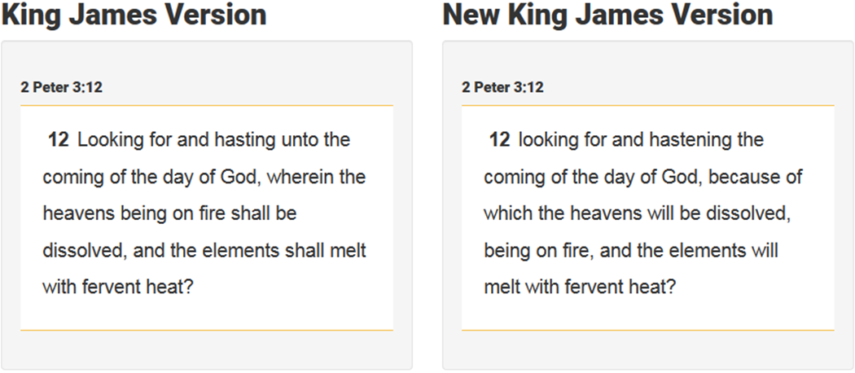
True Words Christian Church

Slide 43
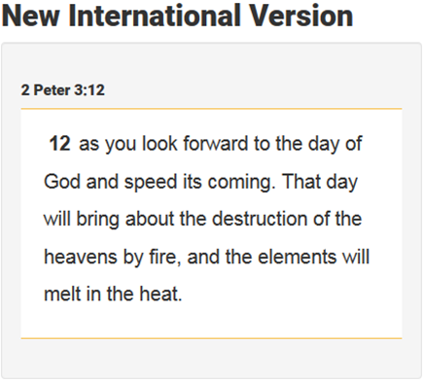
True Words Christian Church

Slide 44
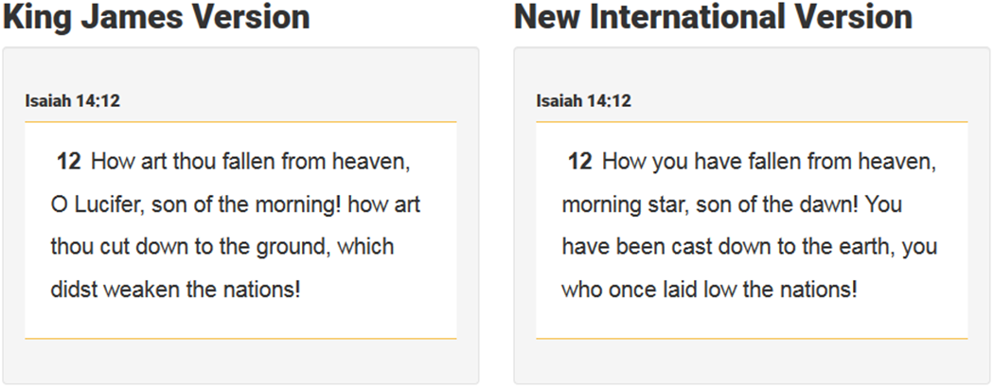
True Words Christian Church

Slide 45
True Words Christian Church

Slide 46
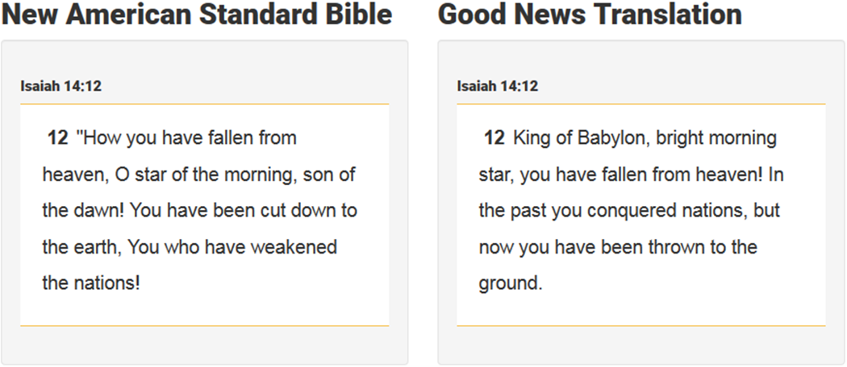
True Words Christian Church

Slide 47
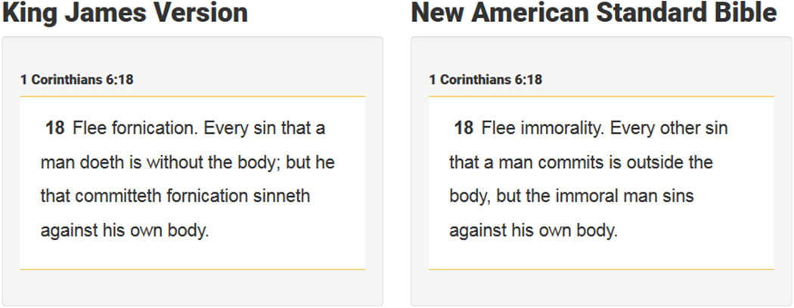
True Words Christian Church

Slide 48
True Words Christian Church

Slide 49
True Words Christian Church

Slide 50
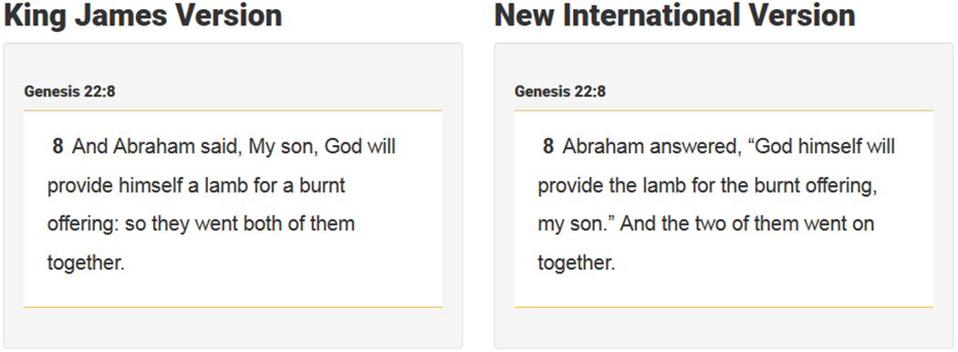
True Words Christian Church

Slide 51
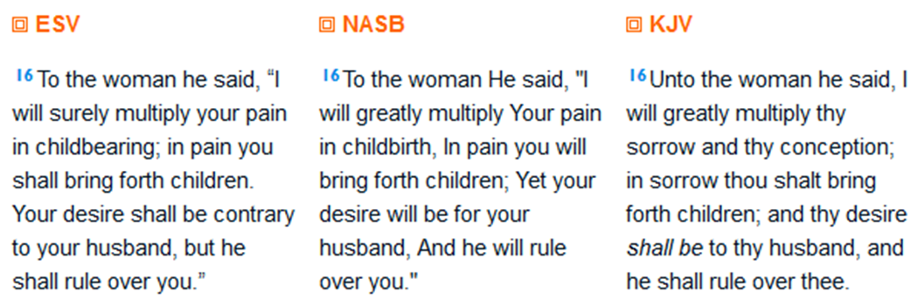
True Words Christian Church

Slide 52
True Words Christian Church

Slide 53
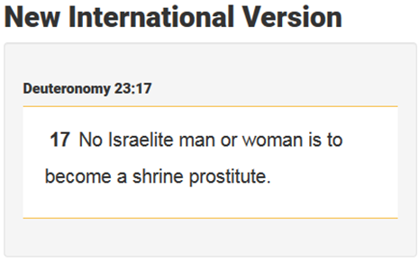
True Words Christian Church

Slide 54
Isaiah 40:8 The grass withereth, the flower fadeth: but the word of our God shall stand for ever.
True Words Christian Church

